Slide 1
RNABindRPlus Predicts RNA-Protein Interface Residues in Multiple Protein Conformations
Carla Mann
December 11, 2014
Rocky Mountain Bioinformatics Conference
Snowmass, CO

Slide 2
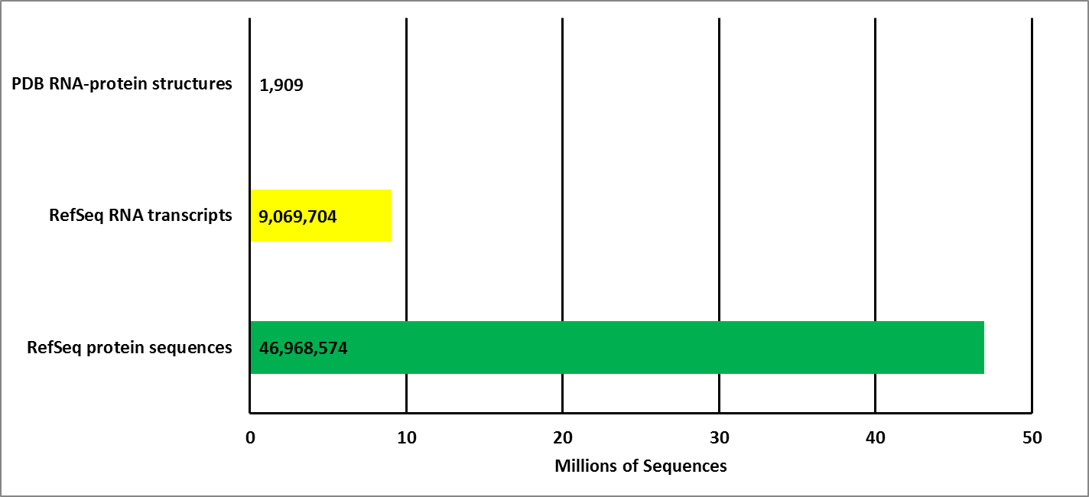

RNA-Protein Interactions
Significance: Implicated in many biological processes beyond transcription/translation
Why predict?
  Hard to crystallize RNA-protein complexes
Why predict based on sequence instead of structure?
Bioinformatics and Computational
Biology Graduate Program

Slide 3
RNA-Protein Interaction Prediction:
HomPrip: sequence homology-based predictor
2 Questions:
  Interacting partner prediction: http://pridb.gdcb.iastate.edu/RPISeq/
  Interacting residue prediction: http://einstein.cs.iastate.edu/RNABindRPlus/
> Protein Sequence
Logistic Regression
SVMOpt: Optimized Support Vector Machine (SVM) classifier-Position Specific Scoring Matrix (PSSM)
Interacting Residue Prediction
RNABindRPlus
Bioinformatics and Computational
Biology Graduate Program

Slide 4
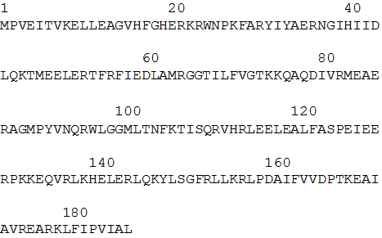
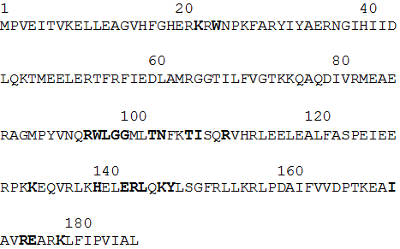
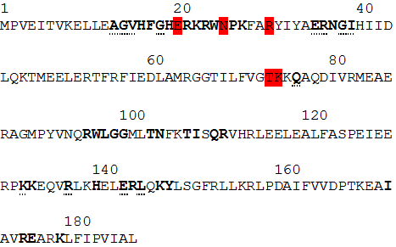
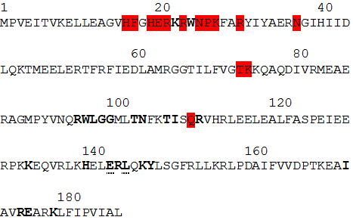
RNABindRPlus False Positive Predictions Are Not Always False
Combined S2 interfacial residues
Interfacial residues are bold
FP highlighted
TP bold
FN underlined
PDB 2VQE_B sequence
Interfacial residues are bold
FP highlighted
TP bold
FN underlined
PDB 2VQE_B 30S ribosomal protein S2 sequence
Interfacial residues are bold
T. thermophilus 30S ribosomal protein S2 sequence (aa 1-187 of 256)
Bioinformatics and Computational
Biology Graduate Program

Slide 5
RNABindRPlus Statistics
 | TP | TN | FP | FN | Specificity | Sensitivity | MCC
Single S2 structure (2VQE) | 21 | 219 | 14 | 2 | 0.60 | 0.91 | 0.71
Mean for 34 different single S2 structures | 23 | 218 | 12 | 3 | 0.65 | 0.88 | 0.73
Combined interfaces from 34 different S2 structures | 30 | 208 | 5 | 13 | 0.86 | 0.70 | 0.73
  $$\text{Specificity}\text{= }\frac{\text{TP}}{\text{TP}\text{+}\text{FP}} \text{Sensitivity}\text{= }\frac{\text{TP}}{\text{TP}\text{+}\text{FN}} \text{MCC}\text{= }\frac{\left(\text{TP} \text{x} \text{TN}\right)\text{−(}\text{FP} \text{x} \text{FN}\text{)}}{\sqrt{\left(\text{TP}\text{+}\text{FP}\right)\left(\text{TP}\text{+}\text{FN}\right)\left(\text{TN}\text{+}\text{FP}\right)\text{(}\text{TN}\text{+}\text{FN}\text{)}}}$$
Definitions from: Baldi and Brunak, 2001. Bioinformatics: The Machine Learning Approach
Bioinformatics and Computational
Biology Graduate Program

Slide 6

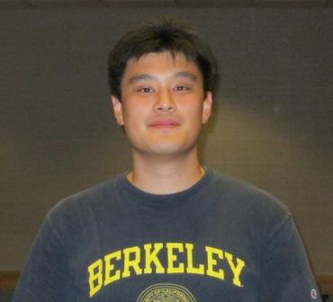
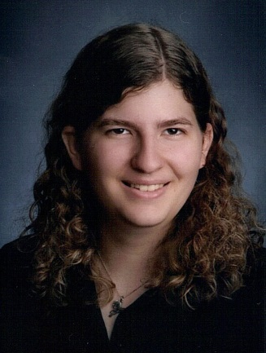

Acknowledgements and Further Reading
Walia RR, Xue LC, Wilkins K, El-Manzalawy Y, Dobbs D, Honavar V. RNABindRPlus: a predictor that combines machine learning and sequence homology-based methods to improve the reliability of predicted RNA-binding residues in proteins. PLoS One. 2014 May 20;9(5):e97725.
http://einstein.cs.iastate.edu/RNABindRPlus/
John Hsieh’s Poster (P25)
My Poster (P33)
Bioinformatics and Computational
Biology Graduate Program

