Slide 1
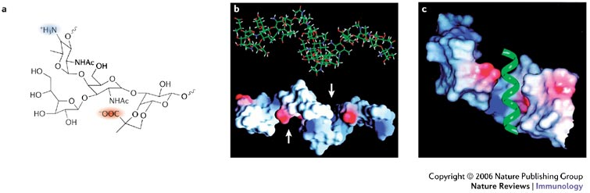
Polysaccharide A a widely distributed immunoregulatory microbial product
Matthew Rhodes and Catherine Lozupone
University of Colorado, Denver
Rocky Mountain Bioinformatics Conference
December 11th 2014
Mazmanian and Kasper 2006

Slide 2
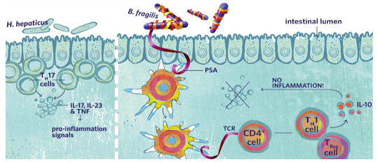
The Microbial Health Factor (PSA)
One bacterial molecule sufficient to mediate healthy immune response!!!
BAD
GOOD
PSA
Mazmanian 2009

Slide 3
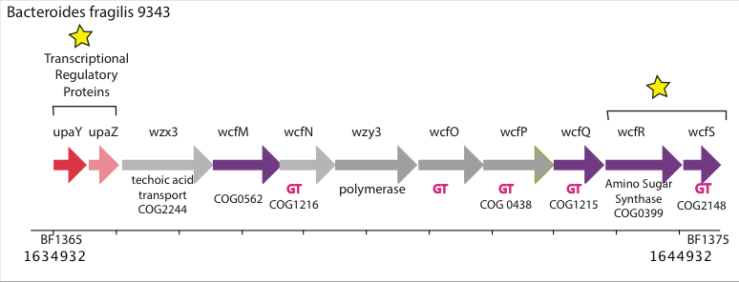
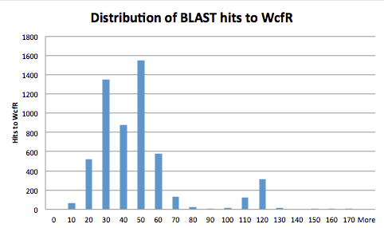
The B. fragilis PSA Operon
Coyne et al. 2001
Hits to wcfR
Next best hit in B. fragilis (PSB)
E-Value

Slide 4
IL-10 Production Amongst PSA Producers
Red: PSA Black:No-PSA
Neff unpublished
Notes:
Oral treatment of BALB/c mice were membranous fraction of P. distasonis lysate reduced severity of inflammation with acute and chronic DSS.
Anti-colitic effect of oral mPD not observed in SCID mice.

Slide 5
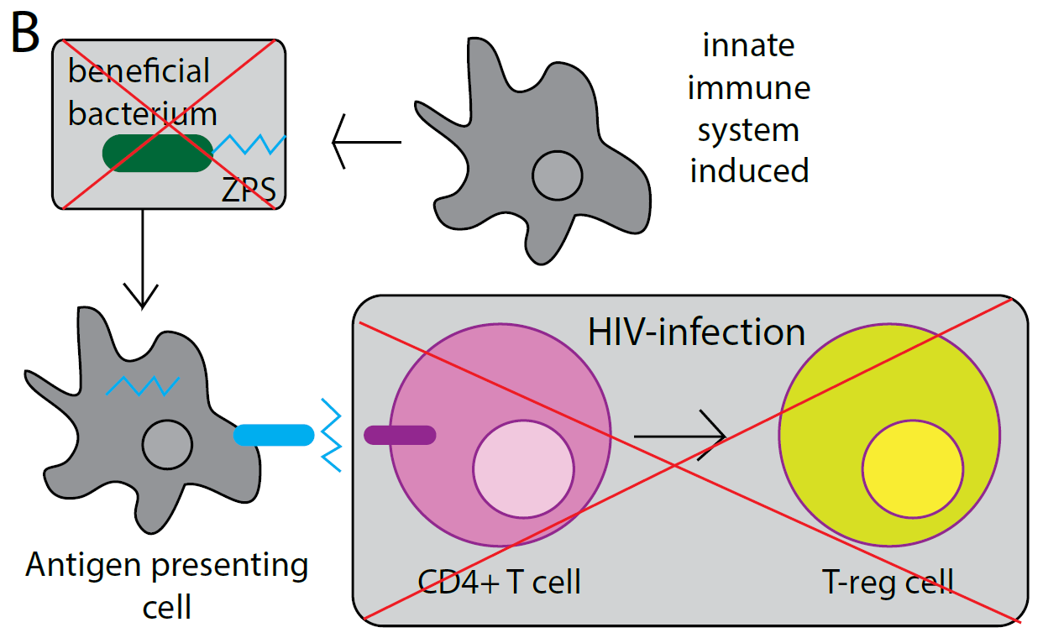
PSA and HIV

Slide 6
Erysipelotrichales and HIV OTUs
Thank You!!!
Lozupone Lab
Palmer Lab
Sarkis Mazmanian and other Collaborators
Computational Bioscience for Funding
Red: Genome without PSA
Orange: OTU up with HIV
Green: Genome with PSA
Blue: OTU down with HIV

