Slide 1

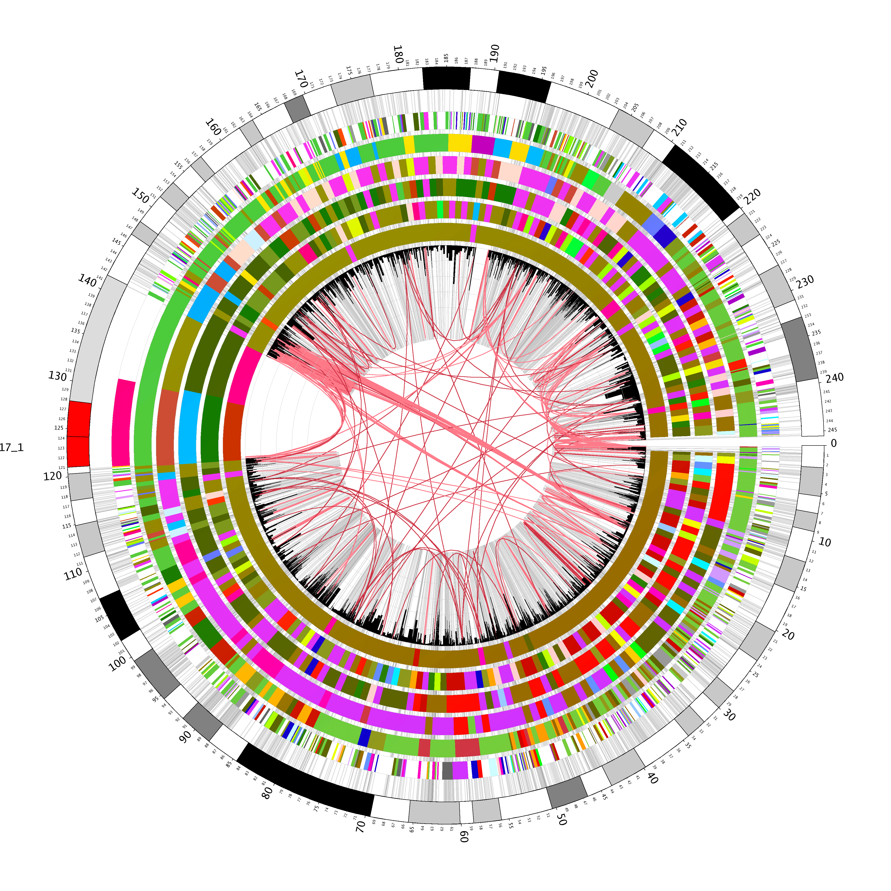
Signatures of Accelerated Somatic Evolution in Gene Promoters in Multiple Cancer Types
Update Talk
Kyle Smith
De Lab

Slide 2
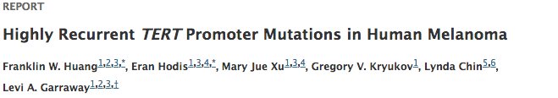
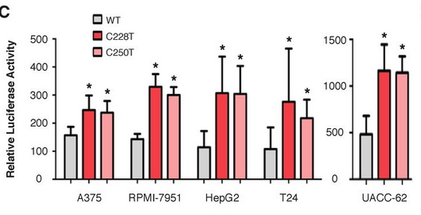
TERT Promoter
-Examined 70 cell lines
-Found 50 with mutations in the telemorase reverse transcriptase (TERT) promoter
-Mutations were in the binding motif for E-twenty-six (ETS) transcription factor
Franklin W. Huang et al. Science 2014

Slide 3
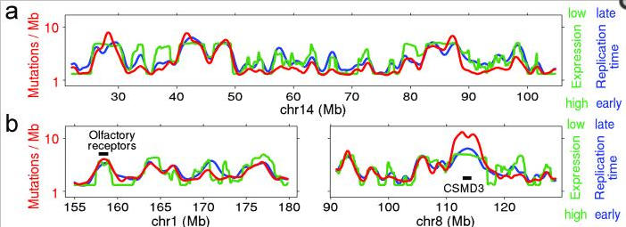
Correlations of Genomic Signals
Lawrence MS et al., Nature 2013

Slide 4

SASE-hunter Algorithm
Gene promoters
(-5kb – +1kb of TSS)
Non-coding and non-repetitive regions
Somatic mutations in a cancer genome
Non-coding, non-repetitive segments of promoters
Non-coding, non-repetitive segments of flanking regions
Mutations in non-coding,
non-repetitive segments of gene promoters and
their flanking regions
Significant promoters in the cancer genome
*
*
Significant promoters detected in multiple cancer genomes in the same cohort
*
*
*
*
*

Slide 5
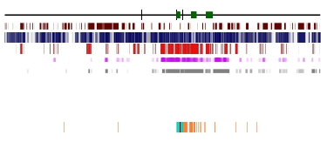
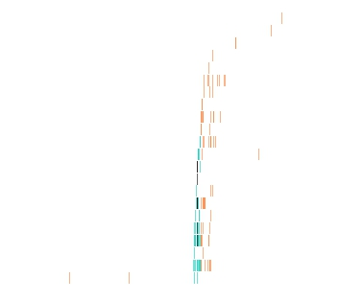
MYC Promoter
MYC gene
Non-coding, non-repetitive
Conservation Score (GERP)
*
*
Regulatory Potential
TF binding sites (ENCODE)
*
*
DNase hypersensitivity
*
*
*
Individual Samples
*
*
*
Total Samples
*
*
*

Slide 6
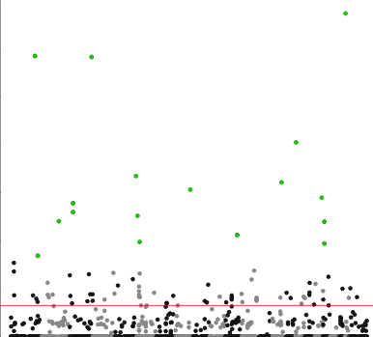
Significant Promoters
MYC
0.0006
p-value: 0.0468
Lymphoma
14
0.0004
BTG2
IGLL5
Normalized Read Count
12
0.0002
10
0
Mutated Un-Mutated
8
CD83
TCL1A
0.0006
p-value: 0.0143
-log₁₀(p)
CD83
MYC
BCL2
0.0004
6
BIRC3
Normalized Read Count
4
0.0002
2
0
Mutated Un-Mutated
0
BCL2
10 12 14 16 18 20 22
0.0003
p-value: 0.0159
1 2 3 4 5 6 7 8 9
11 13 15 17 19 21 X
Chromosome
0.0002
Normalized Read Count
0.0001
0
Mutated Un-Mutated

Slide 7
Future Directions
Apply to the entire genome
  Exons
  3’ UTRs
Permutation analysis with weighted selection
  Conservation
Integrate with methylation data
  Identify mutated methylation sites

Slide 8

Acknowledgements
De lab
  Subhajyoti De
  Vinod Yadav
Brent Pederson, UCDENVER
Katherine Pollard, UCSF
Computational Bioscience Program

