Slide 1
MEseq, a software package for bisulfite sequencing data analysis by regression hidden Markov model
Kui Shen, PhD
Bioinformatics and Computational Biosciences Branch (BCBB)
National Institute of Allergy and Infectious Diseases (NIAID)

Slide 2
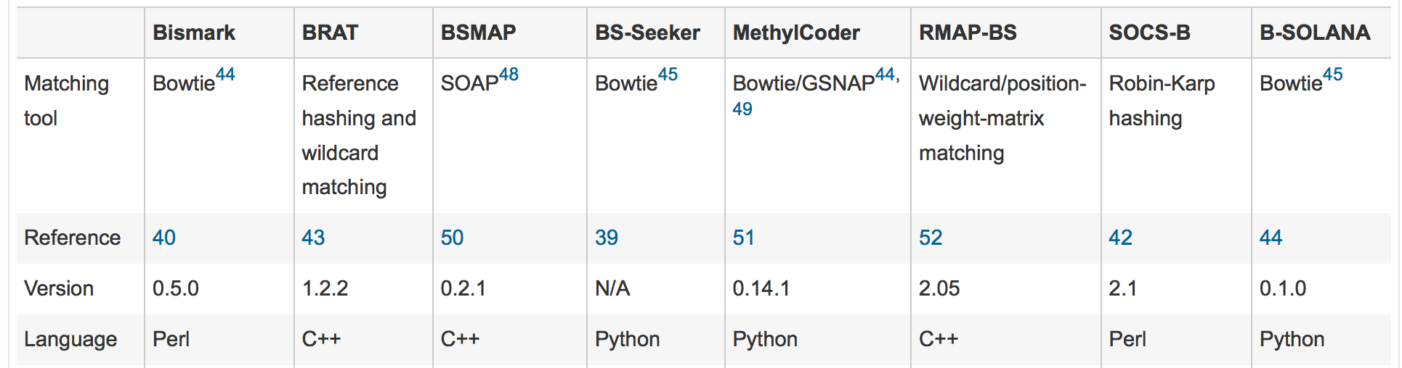
Bisulfite sequencing to measure methylation levels
DNA sequences are treated by bisulfite. After PCR amplification:
  1. Unmethylated C is converted to T.
  2. Methylated C is not converted.
  3. No changes for other bases.
Methylation Callers:
Nature Methods 9, 145–151 (2012)

Slide 3
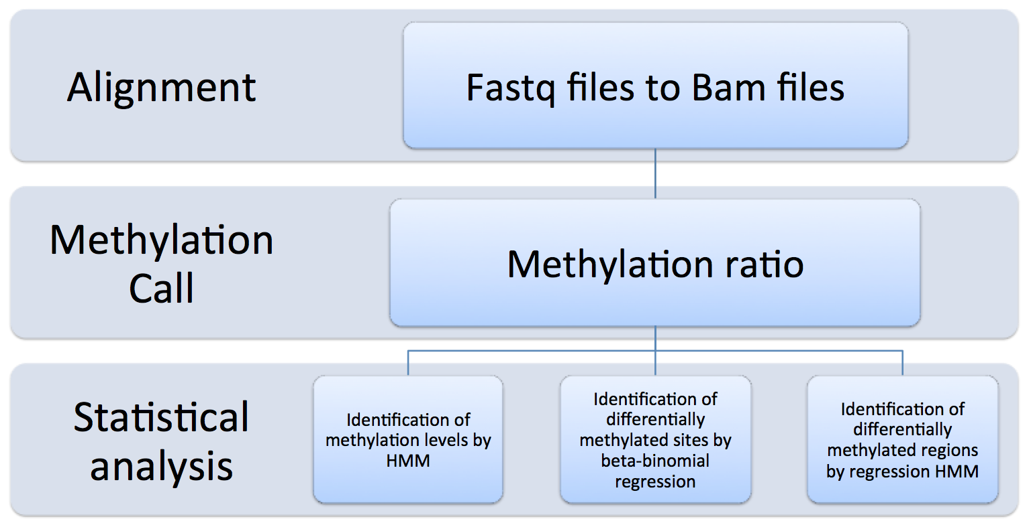
Three statistical questions after methylation call
Q1. For samples from the same group, how to identify methylation levels?
Q2. For samples from multiple groups, how to identify differentially methylated sites?
Q3. For samples from multiple groups, how to identify differentially methylated regions?
MEseq was developed to answer these questions.

Slide 4
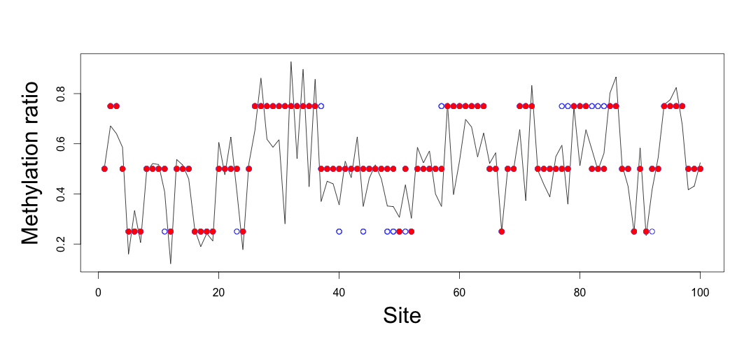
Q1. Identification of methylation levels by hidden Markov model
Three hidden status: hypo-methylation
partially methylation
hyper-methylation
Emission probability: beta-binomial distribution.

Slide 5
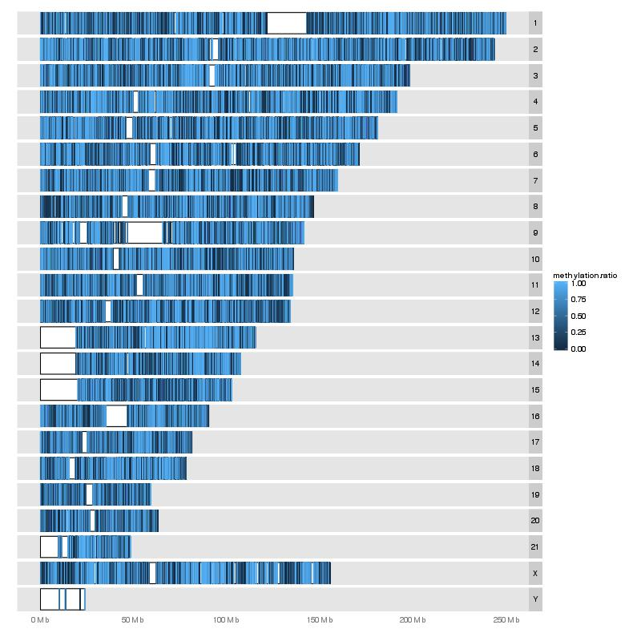
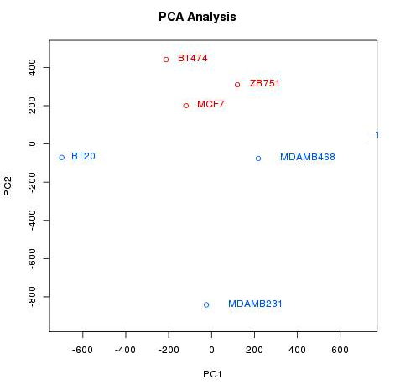
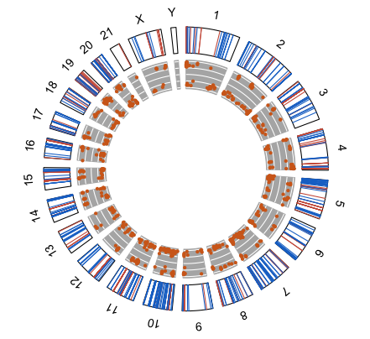
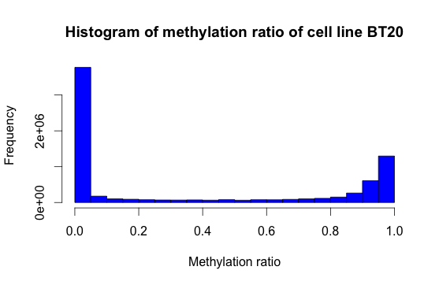
Q2. Identification of differentially methylated sites by beta-binomial regression
 |  | Control group |  |  |  |  |  | Case group
 |  | Sample N1 |  | Sample N2 |  | Sample N3 |  | Sample C1 |  | Sample C2 |  | Sample C3
chr | start | coverage | # of Cs | coverage | # of Cs | coverage | # of Cs | coverage | # of Cs | coverage | # of Cs | coverage | # of Cs
1 | 10003037 | 66 | 10 | 26 | 4 | 30 | 10 | 43 | 20 | 51 | 25 | 28 | 19
1 | 10003043 | 66 | 12 | 26 | 5 | 30 | 11 | 43 | 21 | 51 | 26 | 28 | 16
1 | 10003058 | 66 | 11 | 26 | 3 | 30 | 9 | 43 | 19 | 51 | 23 | 28 | 12
1 | 10003269 | 87 | 10 | 45 | 6 | 66 | 20 | 72 | 36 | 57 | 29 | 56 | 29
1 | 10003286 | 91 | 18 | 50 | 10 | 66 | 22 | 72 | 37 | 58 | 32 | 56 | 20
1 | 10003298 | 98 | 16 | 67 | 12 | 80 | 28 | 84 | 45 | 69 | 40 | 55 | 32

Slide 6
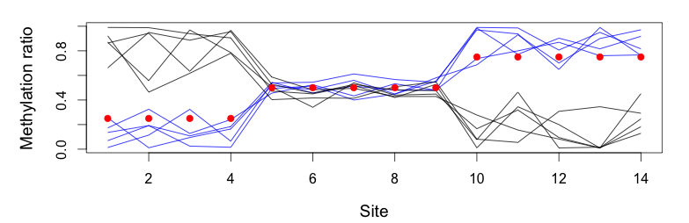
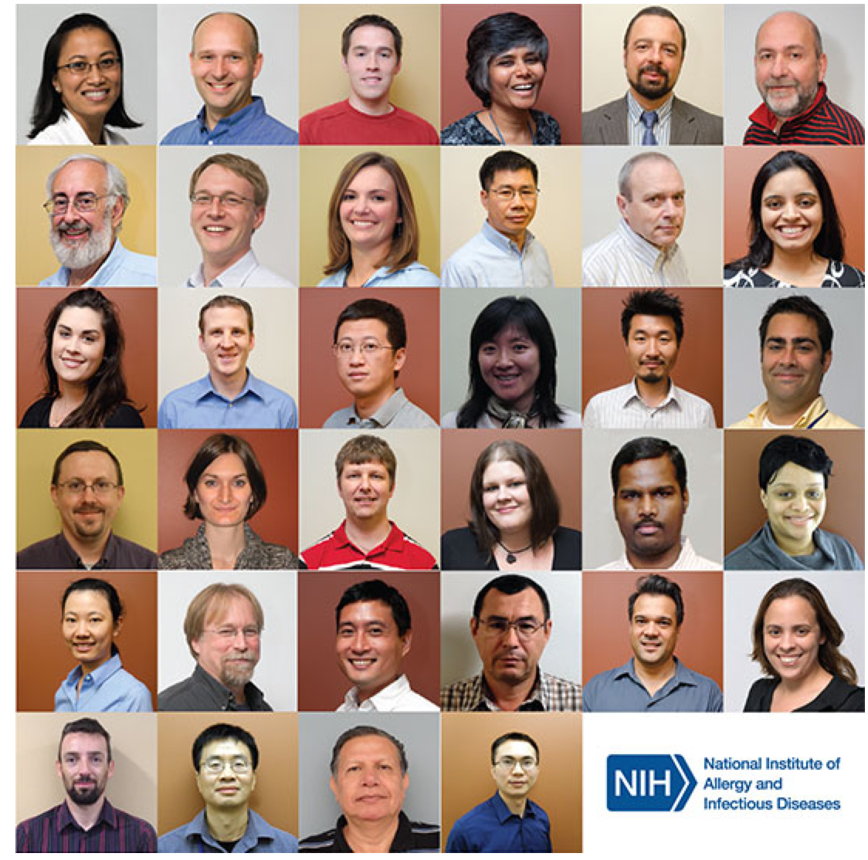
Q3. Identification of differentially methylated regions by regression hidden Markov model
Three hidden status: hypo-methylation
partially methylation
hyper-methylation.
Emission probability: beta-binomial regression.
Acknowledgements:
My colleagues in Bioinformatics and Computational Biosciences Branch (BCBB), National Institute of Allergy and Infectious Diseases (NIAID)

