Slide 1
Research Data: Opportunities and Challenges for Integrating Bioinformatics into the Clinical Realm
Lewis J. Frey, Ph.D.
Associate Professor
Department of Public Health Sciences
Biomedical Informatics Center
Research Member, Hollings Cancer Center
Medical University of South Carolina
Research Scientist, VA Health Equity and Rural Outreach Innovation Center

Slide 2
Outline
Research on the Edge of Discovery - Precision Medicine
Participation & Learning Systems
Leading Edge Big Data
Use Cases On the Edge of Precision Treatment

Slide 3
Research on the Edge of Discovery

Slide 4
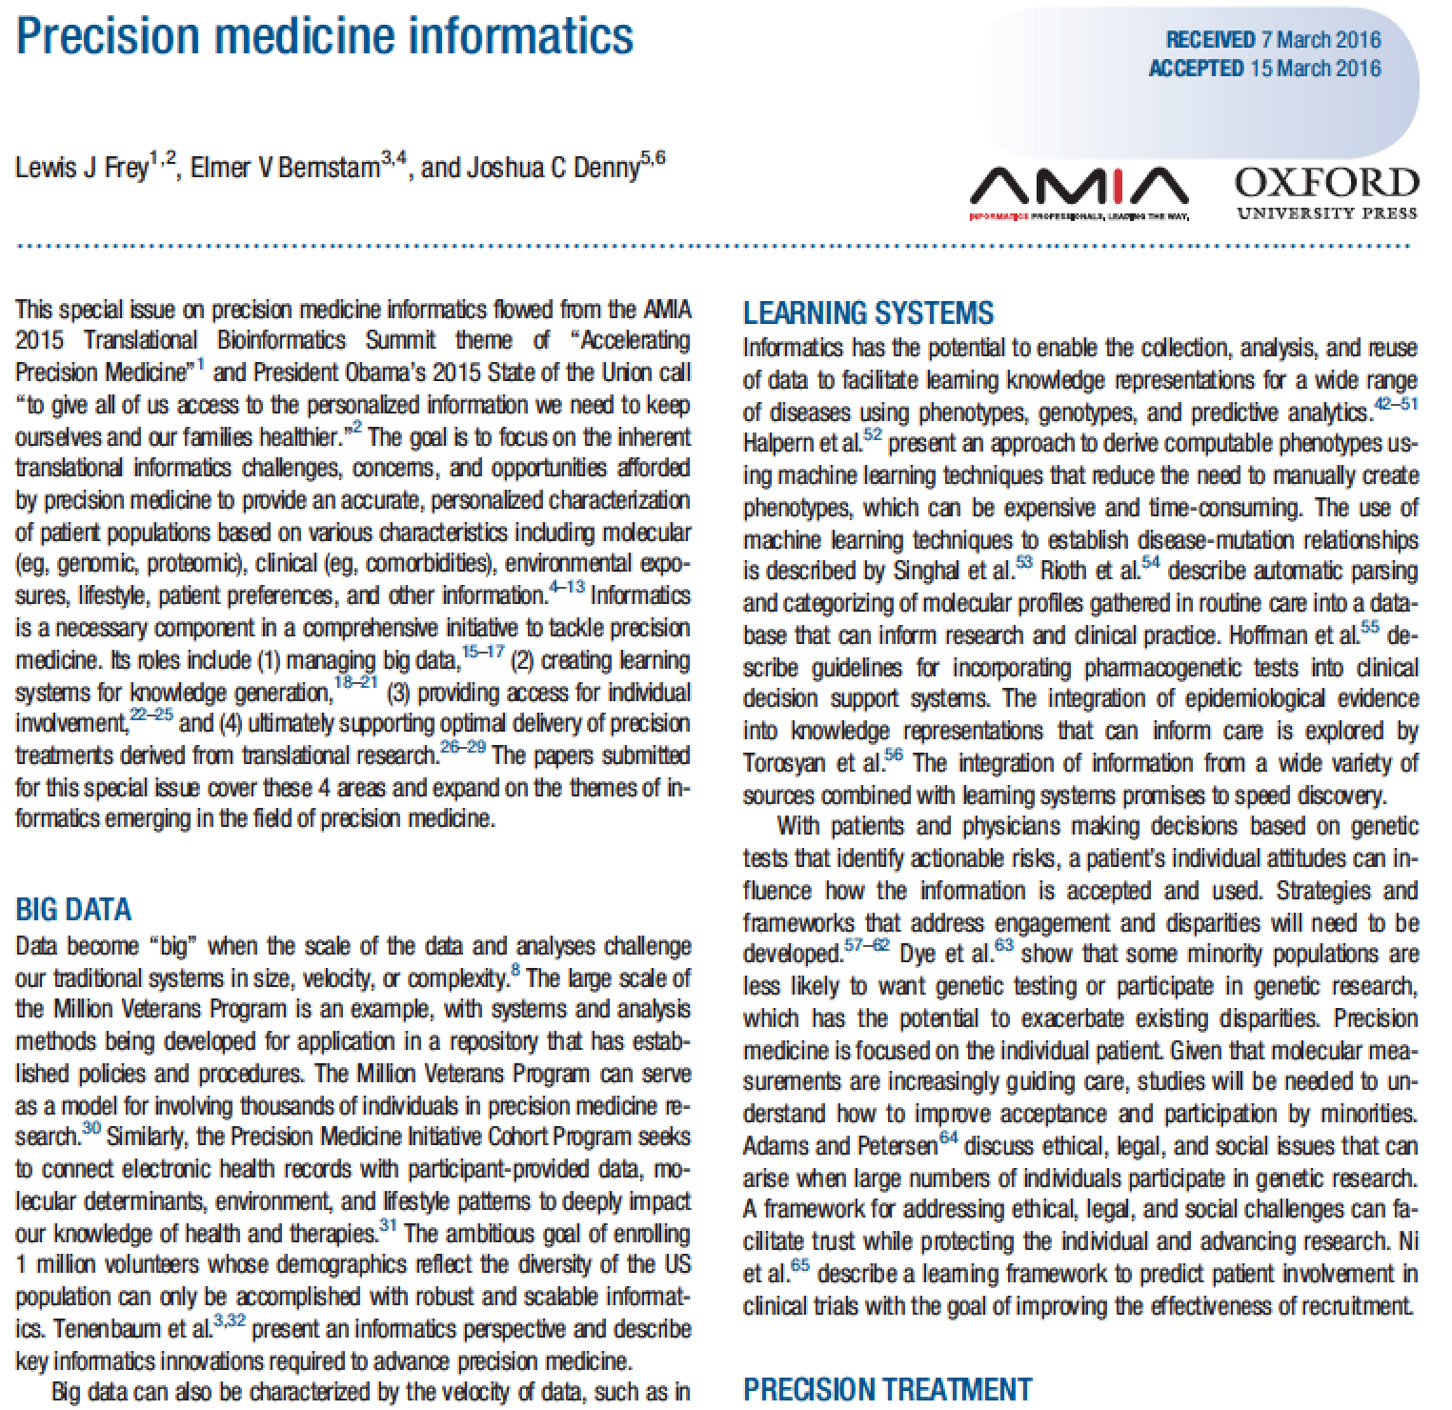
Themes in Precision Medicine
Learning Systems
Individual Involvement
Big Data
Integration and Standardization
Precision Treatment
Molecular and Clinical

Slide 5
Participation & Learning Systems

Slide 6
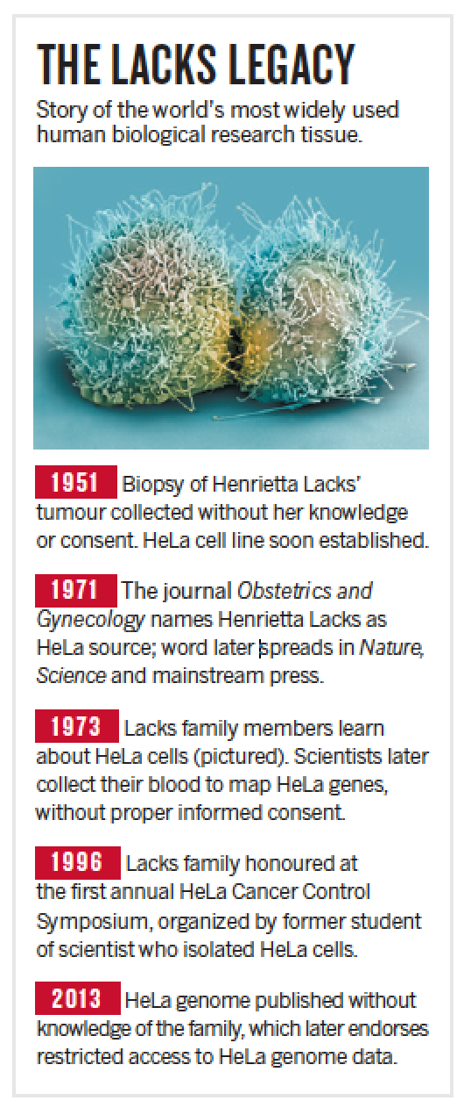
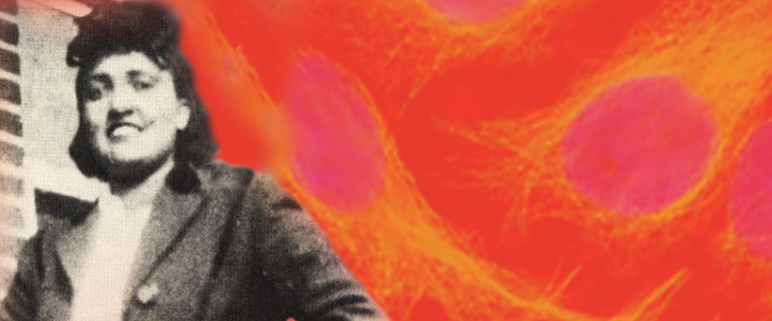
Individual Involvement
Callaway, Ewen. "Deal done over HeLa cell line." Nature 500.7461 (2013): 132-133.

Slide 7
Learning Framework
Environment
Learning Component
Knowledge Representation
Performance Assessment
Shen, Wei-Min, and Herbert A. Simon. "Rule Creation and Rule Learning Through Environmental Exploration." IJCAI. 1989.

Slide 8
Use Case: How are EHR phenotypes learned?
Knowledge Acquisition
Electron Health Record Environment supplies information to learning component
Learning component uses information to make improvements to knowledge representation
Knowledge representation stores a version of what is learned
Performance assessment uses knowledge representation to perform task and provide feedback to learning component

Slide 9
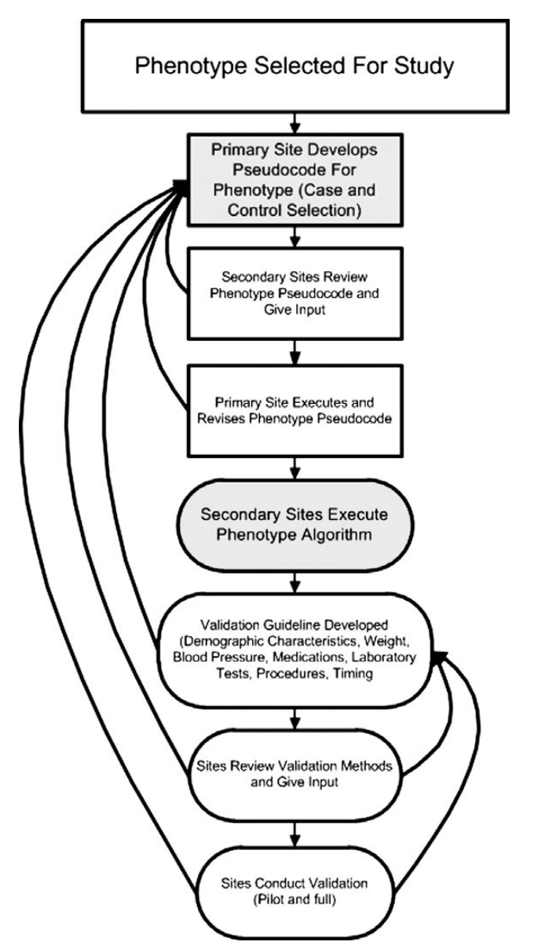
Phenotyping using EHR
Validating phenotypes across multiple sites is complex
Consensus building
Generalization challenges
Newton et al. (2013). Validation of electronic medical record-based
phenotyping algorithms: results and lessons learned
from the eMERGE network. JAMIA

Slide 10
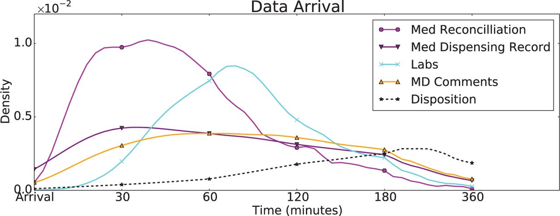
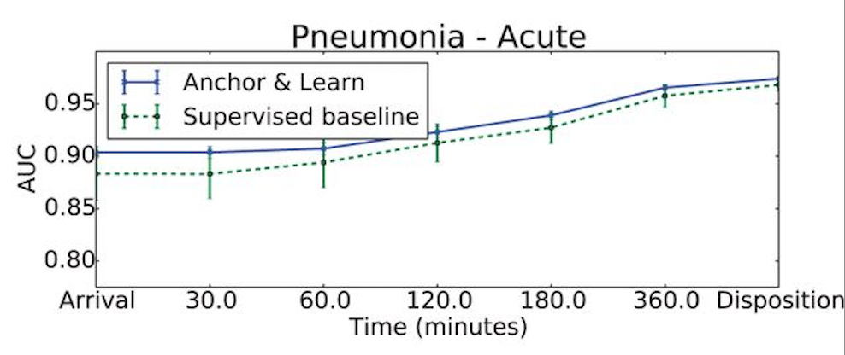
Machine Learning Approach
Halpern Y, Horng S, Choi Y, Sontag D. Electronic medical record phenotyping using the anchor and learn framework. Journal of the American Medical Informatics Association. 2016 Apr 22:ocw011.

Slide 11
Informatics Challenge
Precision medicine poses multiple information challenges in biomedical discovery (e.g., identifying molecular drivers of cancer), knowledge representation and management, clinical decision support and others.
Integrate biomedical informatics research with healthcare
Data from large samples of the population
Heterogeneous data and data types
Genome
Transcriptome
Proteome
Metabolome
Lipidome
Epigenome
History of exposures
Social history
Identifying individual patterns of disease that ideally result in better treatments and outcomes

Slide 12
Leading Edge Big Data

Slide 13
Big Data: a collection of data that pose challenges to traditional data processing approaches (e.g., relational databases)
Characteristics:
Storage
Computability
Complexity
heterogeneity and reproducibility
The presence of combinations of these characteristics can result in a big data problem that cannot be scaled using traditional databases and analysis systems

Slide 14
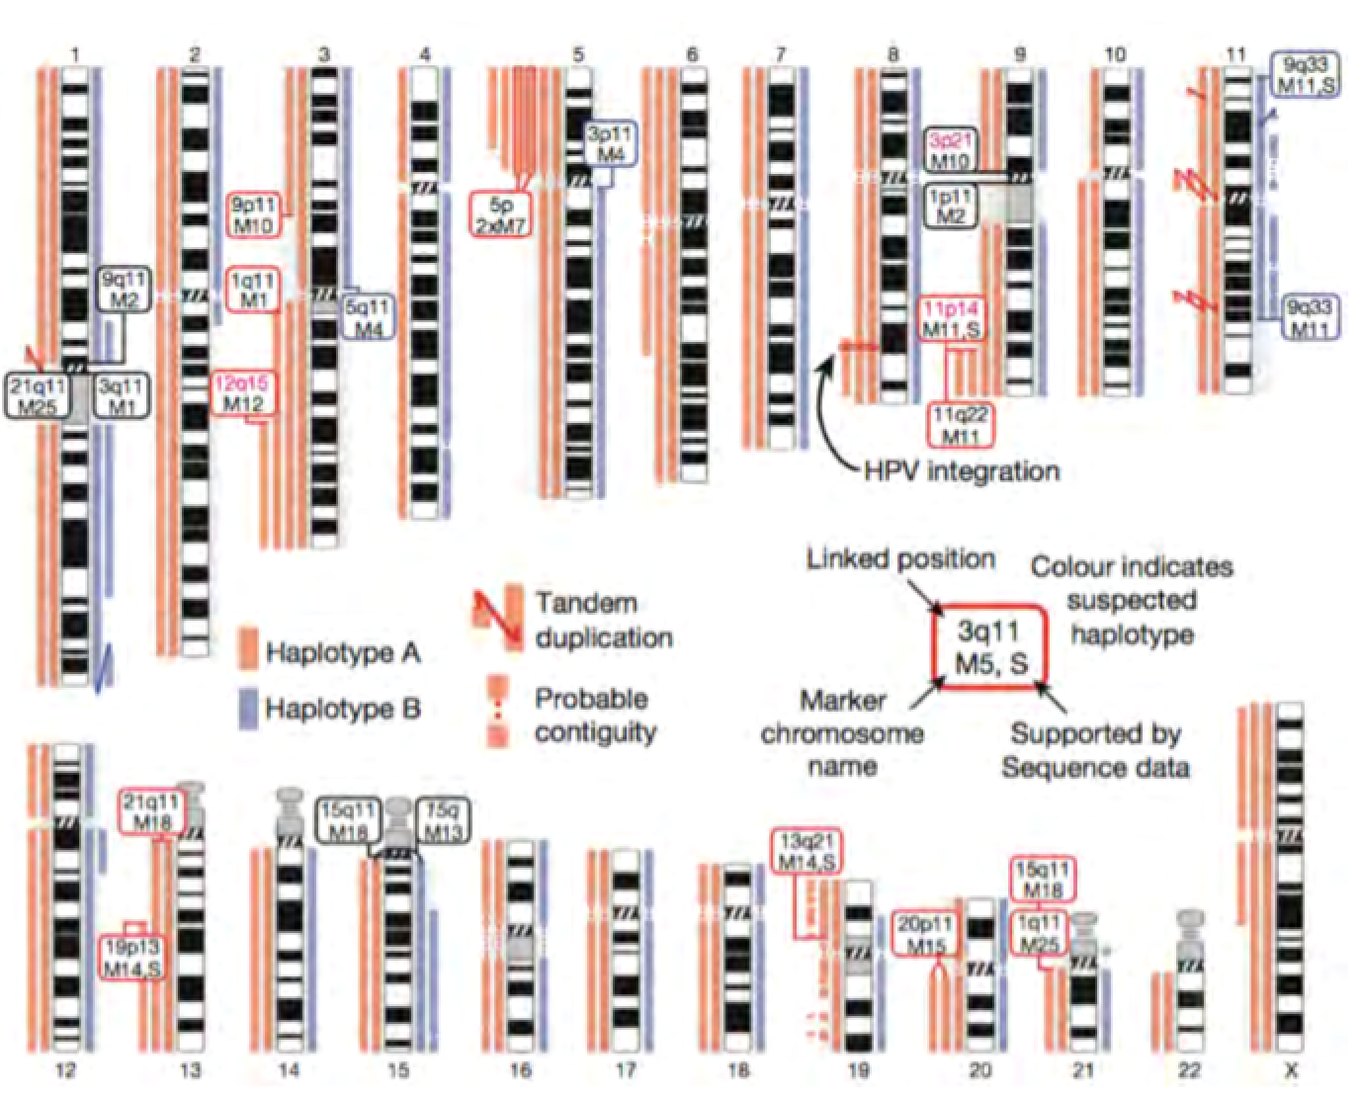
Integration
Kettle ETL
Eclipse environment
BIO programming
Bio Java
Bio Python
Bio Perl
Ontological Management
Protégé
OBO
Relational Databases
MySQL
Postgres
Oracle
Access
Big Data:
NoSQL
Hadoop
MongoDB
MapReduce
Virtualization
VMWare
VirtualBox

Slide 15
Not Only SQL (NoSQL)
Hadoop data store is a distributed file system that can store arbitrary data file representations that can scale with file size
Sequence Alignment Map (SAM) Binary SAM, (BAM), FASTQ, Variant Call Format (VCF), General Feature Format (GFF), etc.
Interface with software to process the files in a MapReduce (functional programming) and parallel processing (procedural programming) hybrid paradigm
Use virtualization to make ubiquitous

Slide 16
Strengths of Virtualization
Virtual systems can be pre-configured with a built-in operating system and interoperable software
Secure turnkey solution that can be easily deployed
Virtual Machine (VM) can be generalized and adapted to needs of data providers

Slide 17
Case Study: Virtualized Data Integration Through Standard Data Model
Researchers in Collaborative Pediatric Critical Care Research Network (CPCCRN)
Perform studies in critically ill and injured children in order to identify optimal critical care practices
pediatric intensive care unit grid (picuGrid):
Virtual machines to integrate EHR and administrative data
Standard Data Model:
National Institute of Child Health and Development – PICUcoreClinicalData (https://cdebrowser.nci.nih.gov/CDEBrowser/)

Slide 18
picuGrid Team Effort

Slide 19
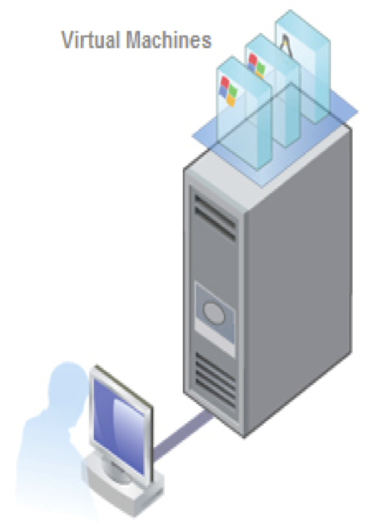
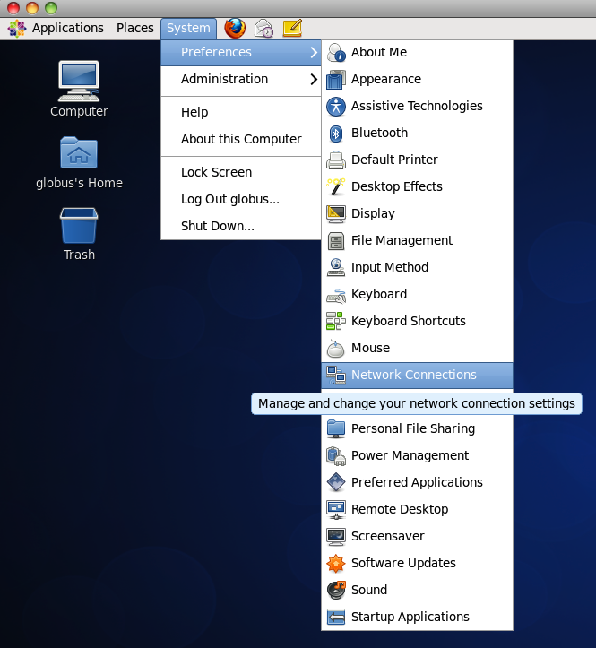
Deployment of Virtual Machine File and Fully Operational Virtual Machine Environment
(3) Fully Operational Virtual Machine
at Hospital with Integrated Data
(2) Hospital IT Installs Virtual Machine on Hospital Computer Infrastructure
(1) Hospital Information Technology (IT) Team
Receives Virtual Machine File

Slide 20
Interoperable picuGrid Data Flow
Frey, Lewis J., et al. "Virtualization of Open-Source Secure Web Services to Support Data Exchange in a Pediatric Critical Care Research Network." Journal of the American Medical Informatics Association (2015): ocv009

Slide 21
Field Format Misalignment
A field format misalignment occurs when sites submit data in a format that differs from that specified by the research protocol
2011 ETL used for 2012
Consistent Extraction Transform and Load (ETL)

Slide 22
Standards & Common Data Model
Desired Functionality:
Open model
Well specified vocabularies
Compatible with scalable analysis engine

Slide 23
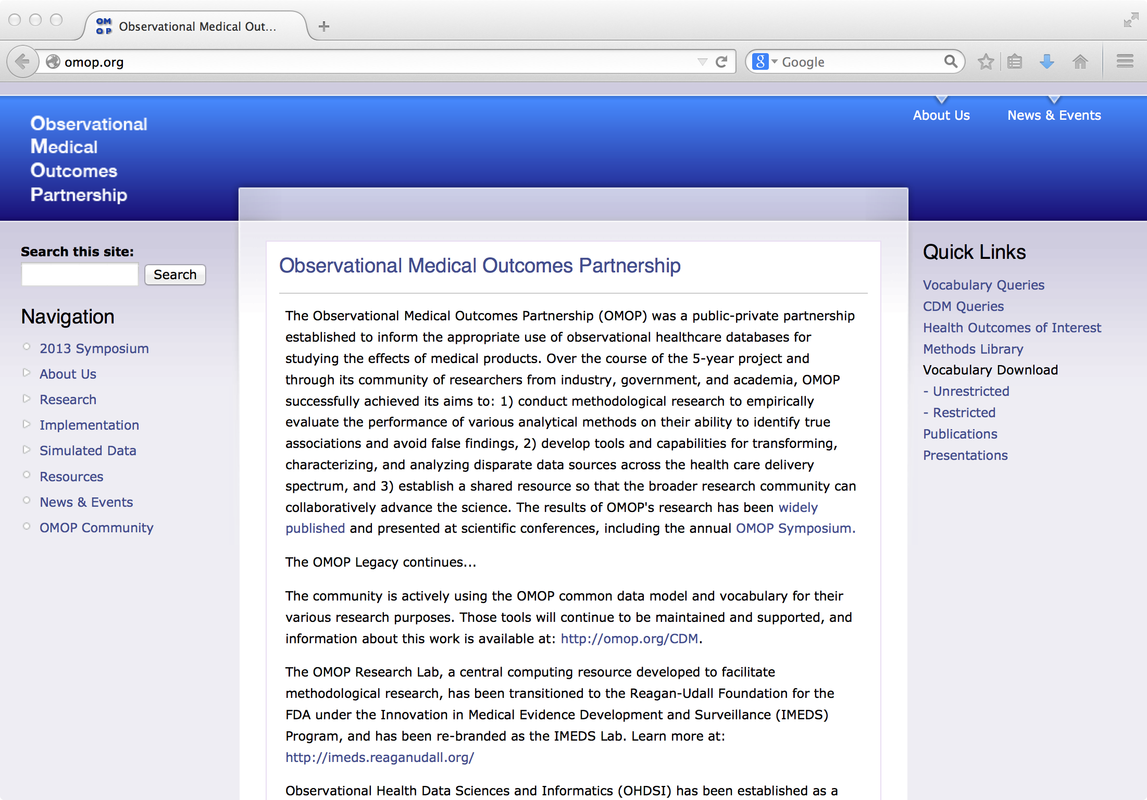
Observational Medical Outcomes Partnership (OMOP)

Slide 24
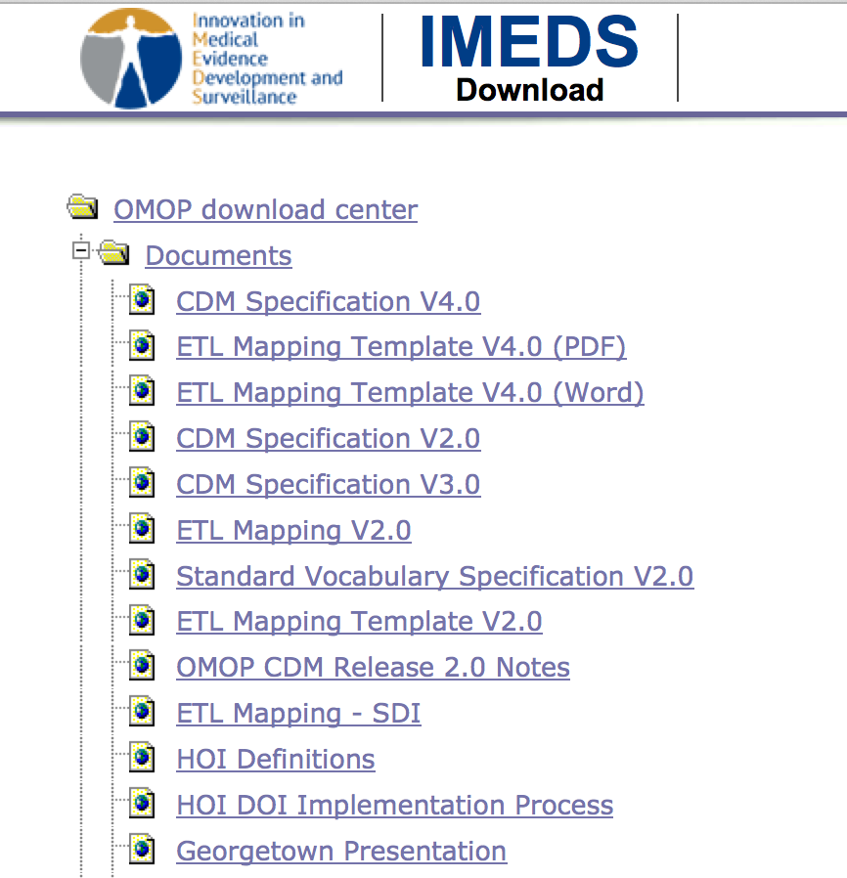
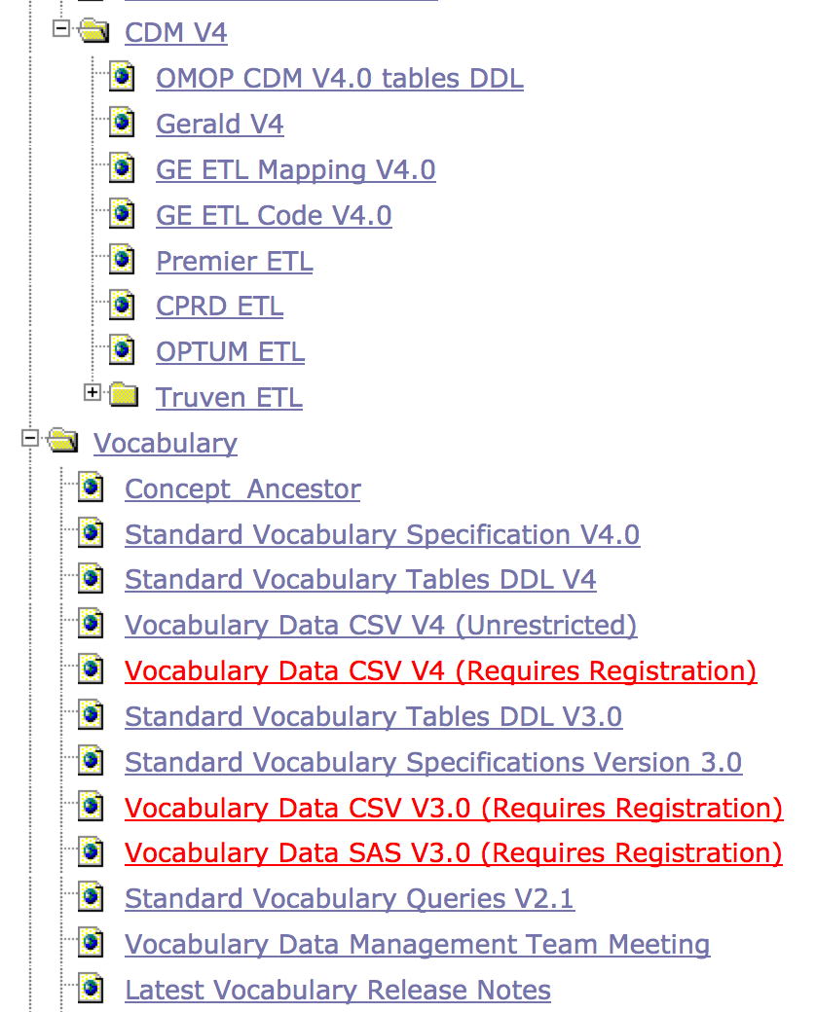
OMOP Documents
http://75.101.131.161/download/links.php

Slide 25
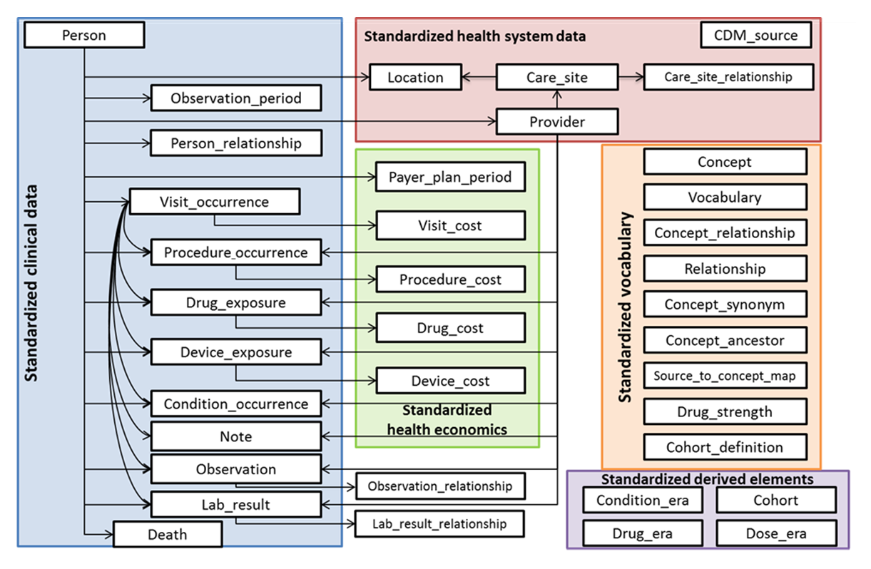
OMOP Model
Source: OMOP Common Data Model Draft Specification Version 5, 2014

Slide 26
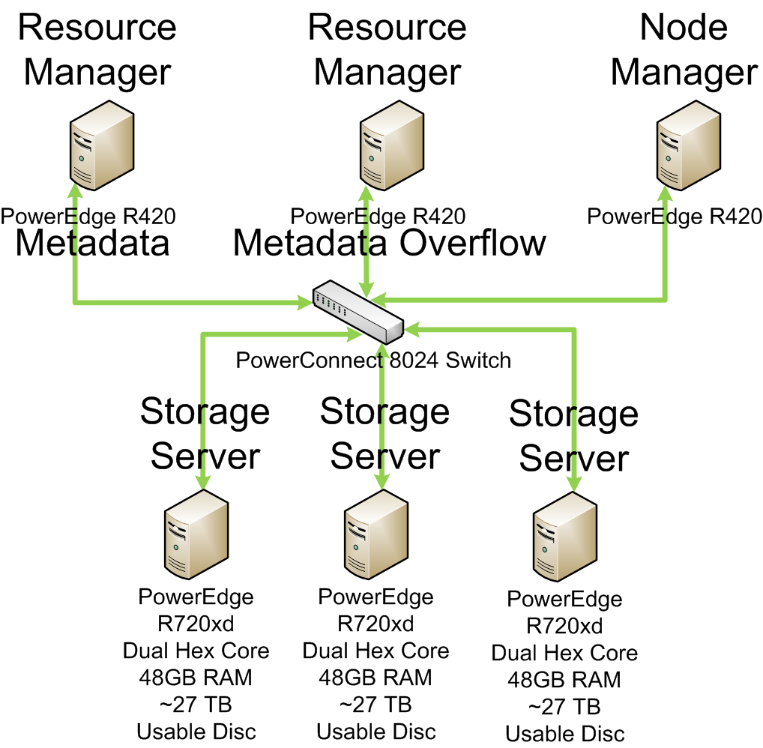
C3PO and VINCI
Unstructured Data - Natural Language Processing: V3NLP, etc.

Slide 27
Clinical Personalized Pragmatic Predictions of Outcomes (C3PO) 2013 Awarded NIH/NSF Big Data Grant
Principal Investigators:
Leslie Lenert, M.D. & Lewis Frey, Ph.D.
Funding to develop open source approaches that apply “big data” methodologies to “medical log” files
Using the Department of Veterans Affairs’ (VA) Informatics and Computing Infrastructure database (VINCI)
Domain of application: Type 2 Diabetes (2.5 million patients), defined as having at least one ICD9 code of 250.x0 or 250.x2

Slide 28
VA Informatics and Computing Infrastructure (VINCI)
The VA Informatics and Computing Infrastructure (VINCI) is a research database with records for tens of millions of patients.
Through VINCI’s partnerships with the VA Corporate Data Warehouse (CDW) and the Consortium for Health Informatics Research (CHIR), a wide range of data sets is available for research, including, but not limited to:
patient care encounter/visit records
UMLS tagging codes derived from NLP for both clinical and administrative data elements
vital signs
prescription data
laboratory data
demographic information
text notes such as on demographics, progress, discharge, and radiology
discharge summaries

Slide 29
C3PO
Frontend
Backend
Web Services
Secure Queries
Java Code
Java Wrapper for R

Slide 30
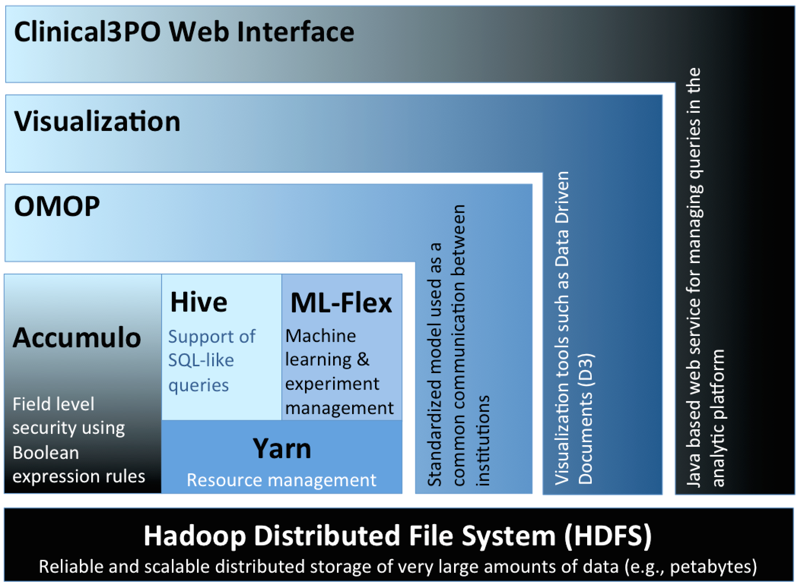
C3PO Platform

Slide 31
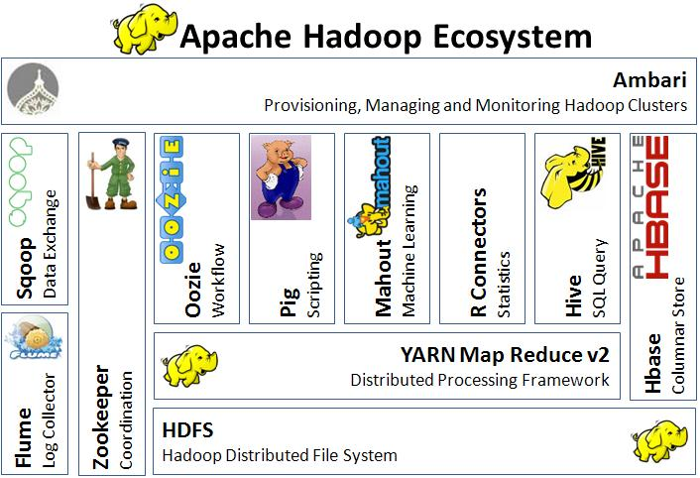
Typical Apache Hadoop Ecosystem

Slide 32
C3PO Hadoop Ecosystem
Hue
Web Interface to Hadoop
Ganglia
Performance
ML-Flex
Machine Learning
Accumulo
Field Level Security

Slide 33
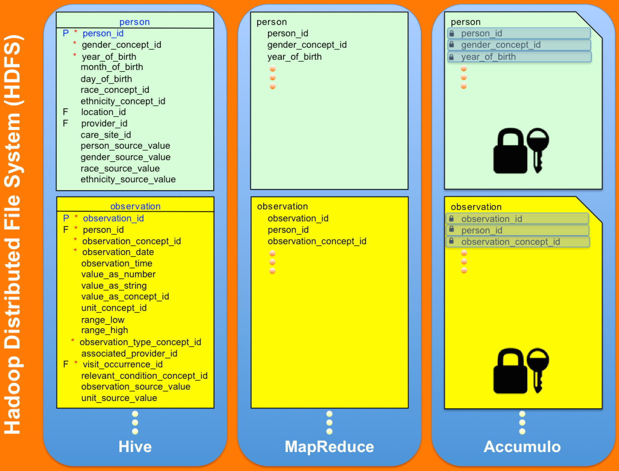
C3PO OMOP Data Representations with Accumulo field level security
Infrastructure for individual based security preference on patient records and data

Slide 34
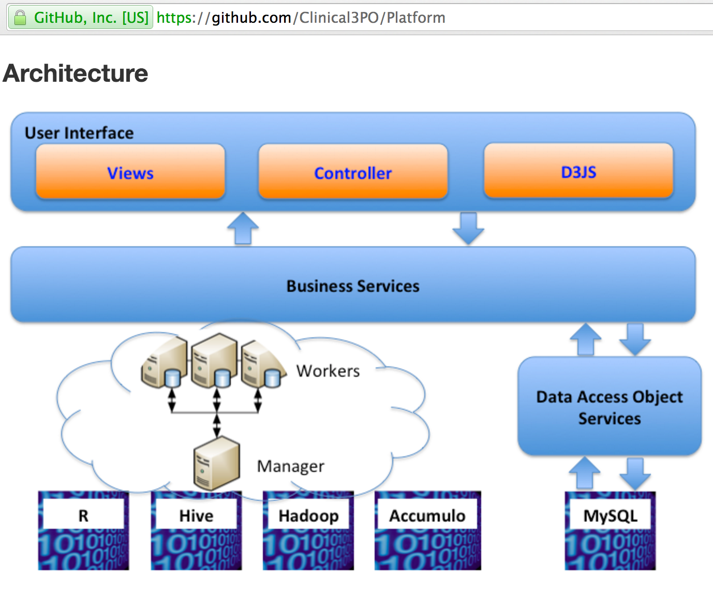
C3PO: Publicly Available Open Source Platform

Slide 35
Use Cases On the Edge of Precision treatment

Slide 36
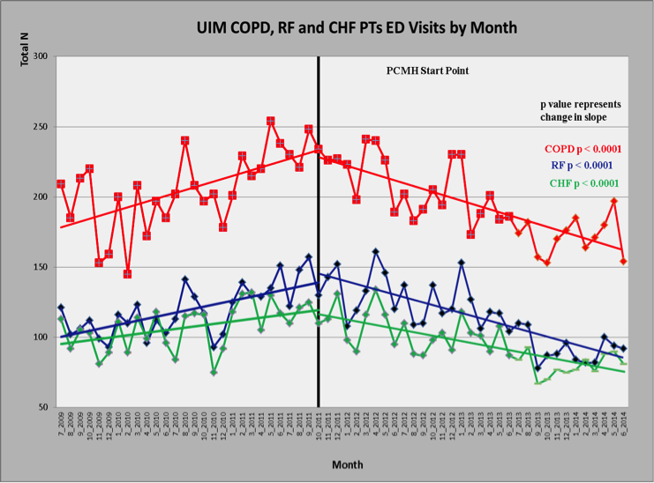
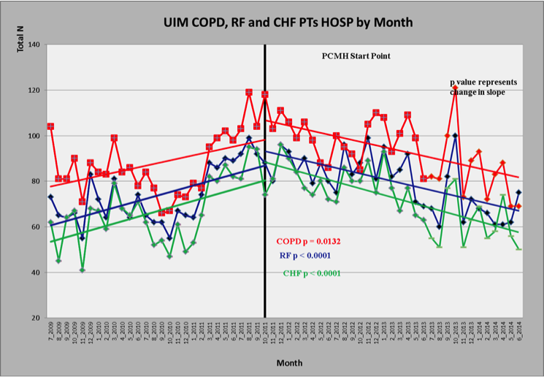
Hospital Utilization
Conduct risk stratification and clustering analysis with MUSC data obtained from traditional existing technology infrastructure and from cloned C3PO system and extend to Christiana Care in Delaware
Intervention
Intervention

Slide 37
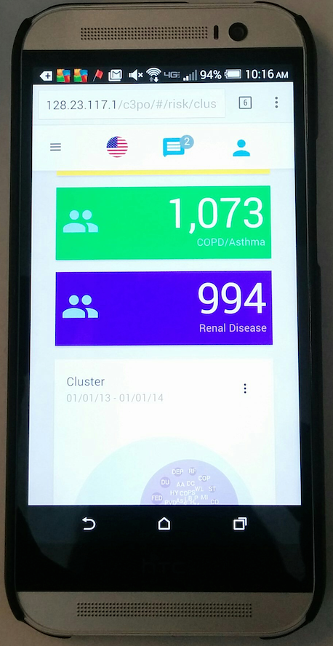
C3PO Medical Data Risk & Cluster Analysis (Mobile)
HU (Hypertension, Uncomplicated)
HLP (Hyperlipidemia)
FED (Fluid and Electrolyte Disorders)
DU (Diabetes, Uncomplicated)
DEP (Depression)
RF (Renal Failure)
COPD (Chronic Pulmonary Disease)

Slide 38
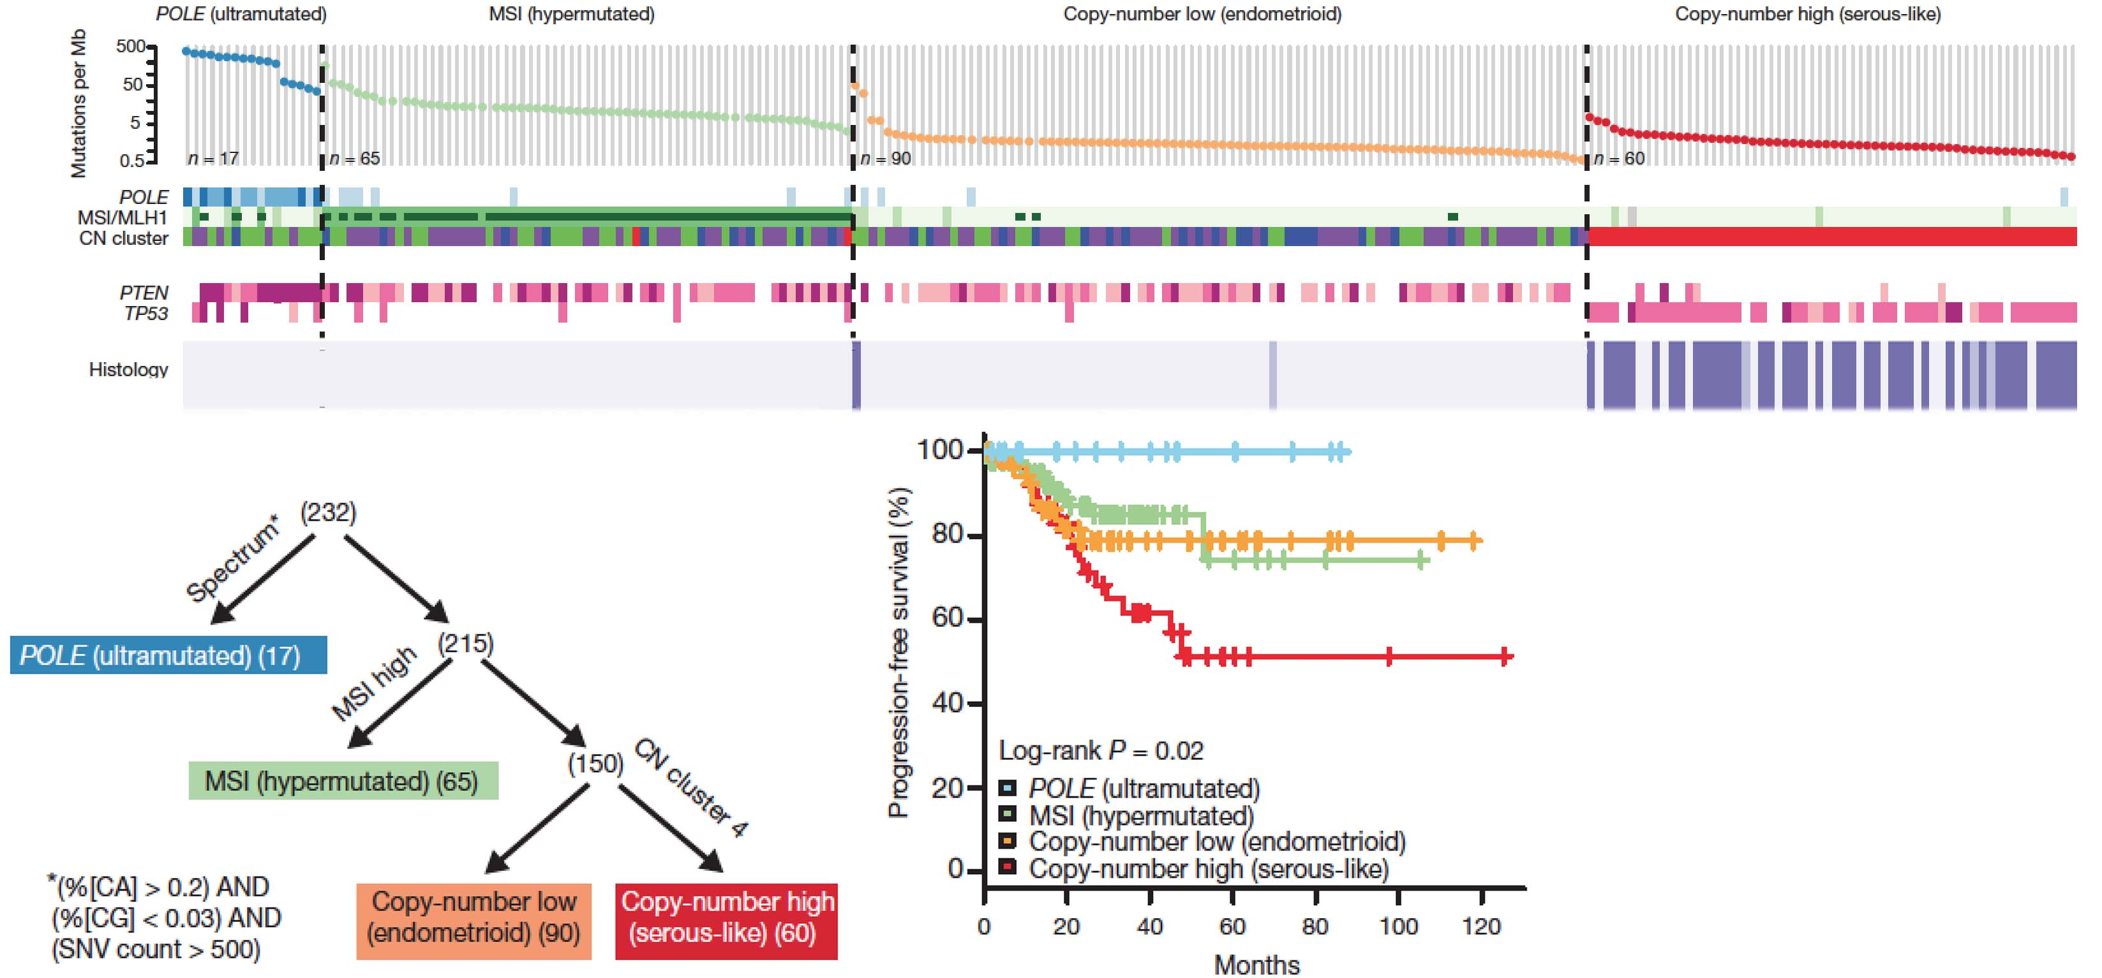
Molecular Subgroups Refine Histological Diagnosis Of Endometrial Carcinoma
POLE
(ultra-
mutated)
MSI
(hypermutated)
Copy-number low
(endometriod)
Copy-number high
(serous-like)
Mutations
Per Mb
PolE
MSI / MSH2
Copy #
PTEN
p53
Histology
Histology
Serous
misdiagnosed
as endometrioid?
Endometrioid
Serous
TCGA Nature 497:67 (2013)
Notes:
Having detailed molecular signatures has allowed us to identify inconsistencies in interpretation and classification.

Slide 39
Molecular Diagnosis of Endometrial Cancer May Influence Choice of Therapy
POLE
(ultra-
mutated)
MSI
(hypermutated)
Copy-number low
(endometriod)
Copy-number high
(serous-like)
Mutations
Per Mb
PolE
MSI / MSH2
Copy #
PTEN
p53
Histology
Surgery only?
Adjuvant
radiotherapy?
Adjuvant
chemotherapy?
TCGA Nature 497:67 (2013)
Notes:
Better classification allows us to differentiate between aggressive and less aggressive disease, allowing us to tailor therapy.

Slide 40
Conclusion
An open source big data integrated learning system such as C3PO offers:
Discoveries enable through novel computational analysis of larger more comprehensive data sets of both molecular and clinical data in the same data store
Improved individually focused patient care and outcomes
Opportunities for national and international collaborations on precision medicine
Publicly available at
http://github.com/Clinical3PO/

Slide 41
Acknowledgements
Collaborators
Leslie Lenert
Brian Davis
Scott Duvall
Michael E. Matheny
Jonathan Nebeker
Augie Turano
Andre Kushniruk
Patrick Mauldin
William Moran
Jihad Obeid
William Weintraub
Wei Ding
Santoshi Davata
Funding
NIGMS Grant No. 1R01GM108346-01 (PIs: Lenert & Frey; C3PO)
Work supported by an Institutional Development Award (IDeA) from the National Institute of General Medical Sciences of the National Institutes of Health under grant number U54-GM104941 (PI: Binder-Macleod).

