Slide 1
Practical Precision Medicine: Integration of clinical and genomic data to support cancer research and care
1. MACE2K: Molecular And Clinical Extraction: A tool for Personalized Medicine
2. G-DOC Plus: A translational Informatics Platform
Subha Madhavan, Ph.D.
Innovation Center for Biomedical Informatics
Georgetown University
@subhamadhavan

Slide 2
Personalized Cancer Therapy
Genomic marker testing on the rise to identify therapies
Not all mutations are actionable
Consider biomarkers that predict response to chemotherapy
Need to customize therapy based on molecular anomalies as well as chemo-predictive biomarkers
Many companies offering molecular diagnostic testing
  Foundation Medicine, Caris, PGDx to name a few

Slide 3

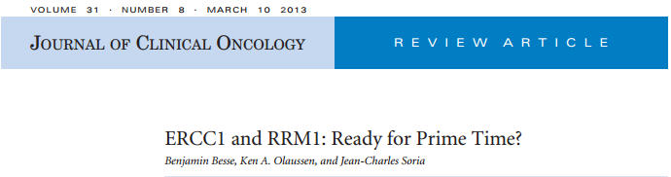
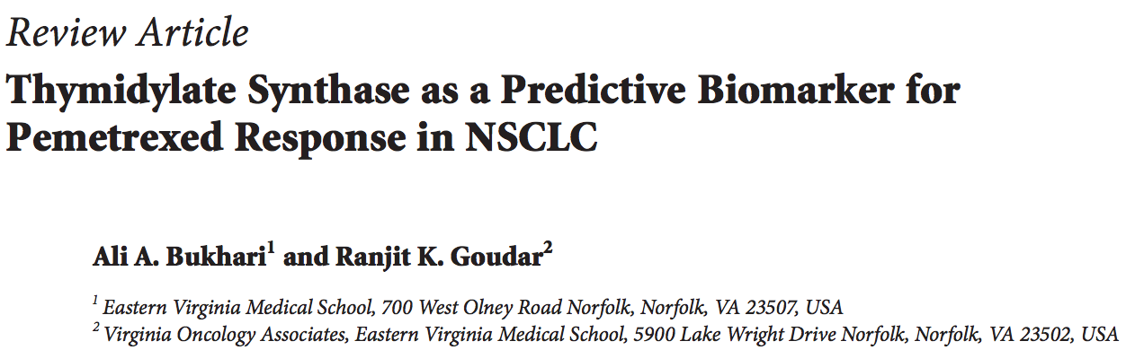
In conclusion, in the field of cytotoxic agents, and across all solid tumors, no biomarker has yet reached a level of significance allowing its routine use. Given the narrow therapeutic index of platinum-based chemotherapy in patients with NSCLC, there is an urgent need for the medical community to promote the prescription of cytotoxics based on biomarker analysis. Among hundreds of candidates, ERCC1 and RRM1 have aroused a lot of enthusiasm. The scientific and preclinical rationales regarding their predictive value are compelling. However, clinical reproducibility of research techniques is an area of concern. Technologic issues have yet to be solved before implementation in daily practice.
A major limitation of current research is that most studies described above are retrospective, relying exclusively upon banked tissue specimens. Most of these studies utilized pemetrexed second- or third line. We need to consider the up- and down-regulation of enzymes through exposure to multiple chemotherapy agents, as this undoubtedly alters tumor biology

Slide 4
There are many working groups for clinical cancer genomics actionability
CSER Tumor Working Group
Approaches for adapting genomics in the clinic
Association for Molecular Pathologists (AMP)
Guidelines for somatic variant interpretation
Global Alliance for Genomics and Health (GA4GH)
Data sharing; strong in data “representation”
GENIE: Real time CLIA data and outcomes
7 institutions
Actionable Cancer Genome Initiative (ACGI)
4 institutions + Illumina, best practices
Others, Private or commercial efforts
QUESTIONS and NEEDS for What and How?
Data Sharing
Common Language
Guidelines for Classification
Guidelines for Interpretation
Guidelines for new test development

Slide 5
Examples of somatic variant classification tools and frameworks
MDACC PCT
Vanderbilt MyCancerGenome
OSU Cancer Driver Log database
WashU CiViC database
DFCI framework
Broad TumorPortal framework

Slide 6
What does the somatic variant actionability
community need
Common categories for types of biomarker applications
Common levels of evidence for evaluating variants
Bake off to measure how Somatic community applies the above categories/levels to variants.
Minimum Variant Level Data (MVLD) for common data sharing
Repository to store and share variants

Slide 7
Clinical Genome Resource (ClinGen)
Purpose: Create authoritative central resource that defines the clinical relevance of genomic variants for use in precision medicine and research.
NHGRI-funded program launched Sept. 2013
  FY13-FY16
  Co-funding from the NICHD and NCI
  Work with NCBI’s ClinVar
  > 300 researchers & clinicians from >80 institutions

Slide 8





ClinGen Goals
Share genomic and phenotypic data through ClinVar
Standardize clinical annotation and interpretation of variants
Implement transparent, evidence-based expert consensus for curation of clinical validity and medical actionability
Improve understanding of variation in diverse populations
Develop machine-learning algorithms to improve the throughput of variant interpretation
Disseminate the collective knowledge and ensure EHR interoperability

Slide 9
CLINGEN Somatic working group
Leverage experiences of clinicians and lab directors to develop data elements for representation of data to aid in somatic variant classification and clinical actionability
Current activities
Define Common Language for biomarkers using controlled vocabularies
Define Minimum Variant Level Data (MVLD)
Define Minimum Case Level Data (MCLD)

Slide 10
Minimal Variant Level Data
Genome
Version
DNA
Position
Refseq
Transcript
Refseq
Protein
Allele
Descriptive
Gene
Chromosome
DNA Sub
& Position
Protein Sub
& Position
Mutation
Type
Allele
Interpretive
PMIDs
Cancer
Type
The cancer type in which the variant was found. Cancer ontology should come from terms in NCI Thesaurus, or ICD9/10 codes that can be translated to NCI Thesaurus terms.
Tier4: Alteration has matching FDA approved or NCCN recommended therapy.
Tier3: Alteration has matching therapy based on evidence from clinical trials, case reports, or exceptional responders.
Tier2: Alteration predicts for response or resistance to therapy based on evidence from pre-clinical data (in vitro or in vivo models).
Tier1: Alteration is a putative oncogenic driver based on functional activation of a pathway
Level of
Evidence
Sub-Level
of
Evidence
Somatic
Interpretive
Prospective/retrospective trials, expert opinion, case reports, preclinical data, inferential data
Biomarker
Class
Diagnostic, Prognostic, Predictive
Therapeutic
Context
Known Associated Drugs or Drug Classes
Effect of Variant in Therapeutic Context:
Resistant, Responsive, Not-Responsive, Sensitive, Reduced-Sensitivity
Minimum Variant Level Data
For Clinical Somatic Interpretation
Effect

Slide 11
Informatics Tasks To Support These Goals
Biocuration
Automation of information retrieval
Presentation of genomic information to clinicians

Slide 12


Software Development
Curators/Users
BioC to JSON Converter
Literature
NLP Tools
mongoDB
Computational Experts
JSON
Not curated
Data
Ranking
Precision Medicine User Interface
Evidence
Translational
Researchers
Variant Level Search
G-DOC
CLIA/CAP/MDx
Search & Retrieval
Case Level Search
Cognitive Systems Analysis
Surveys, Semi-structured interviews, Talk aloud protocols, Mockup Designs, Prototype interfaces, Test prototype on users, Analyze data.
Optimal Final interface Design to maximize comprehension

Slide 13
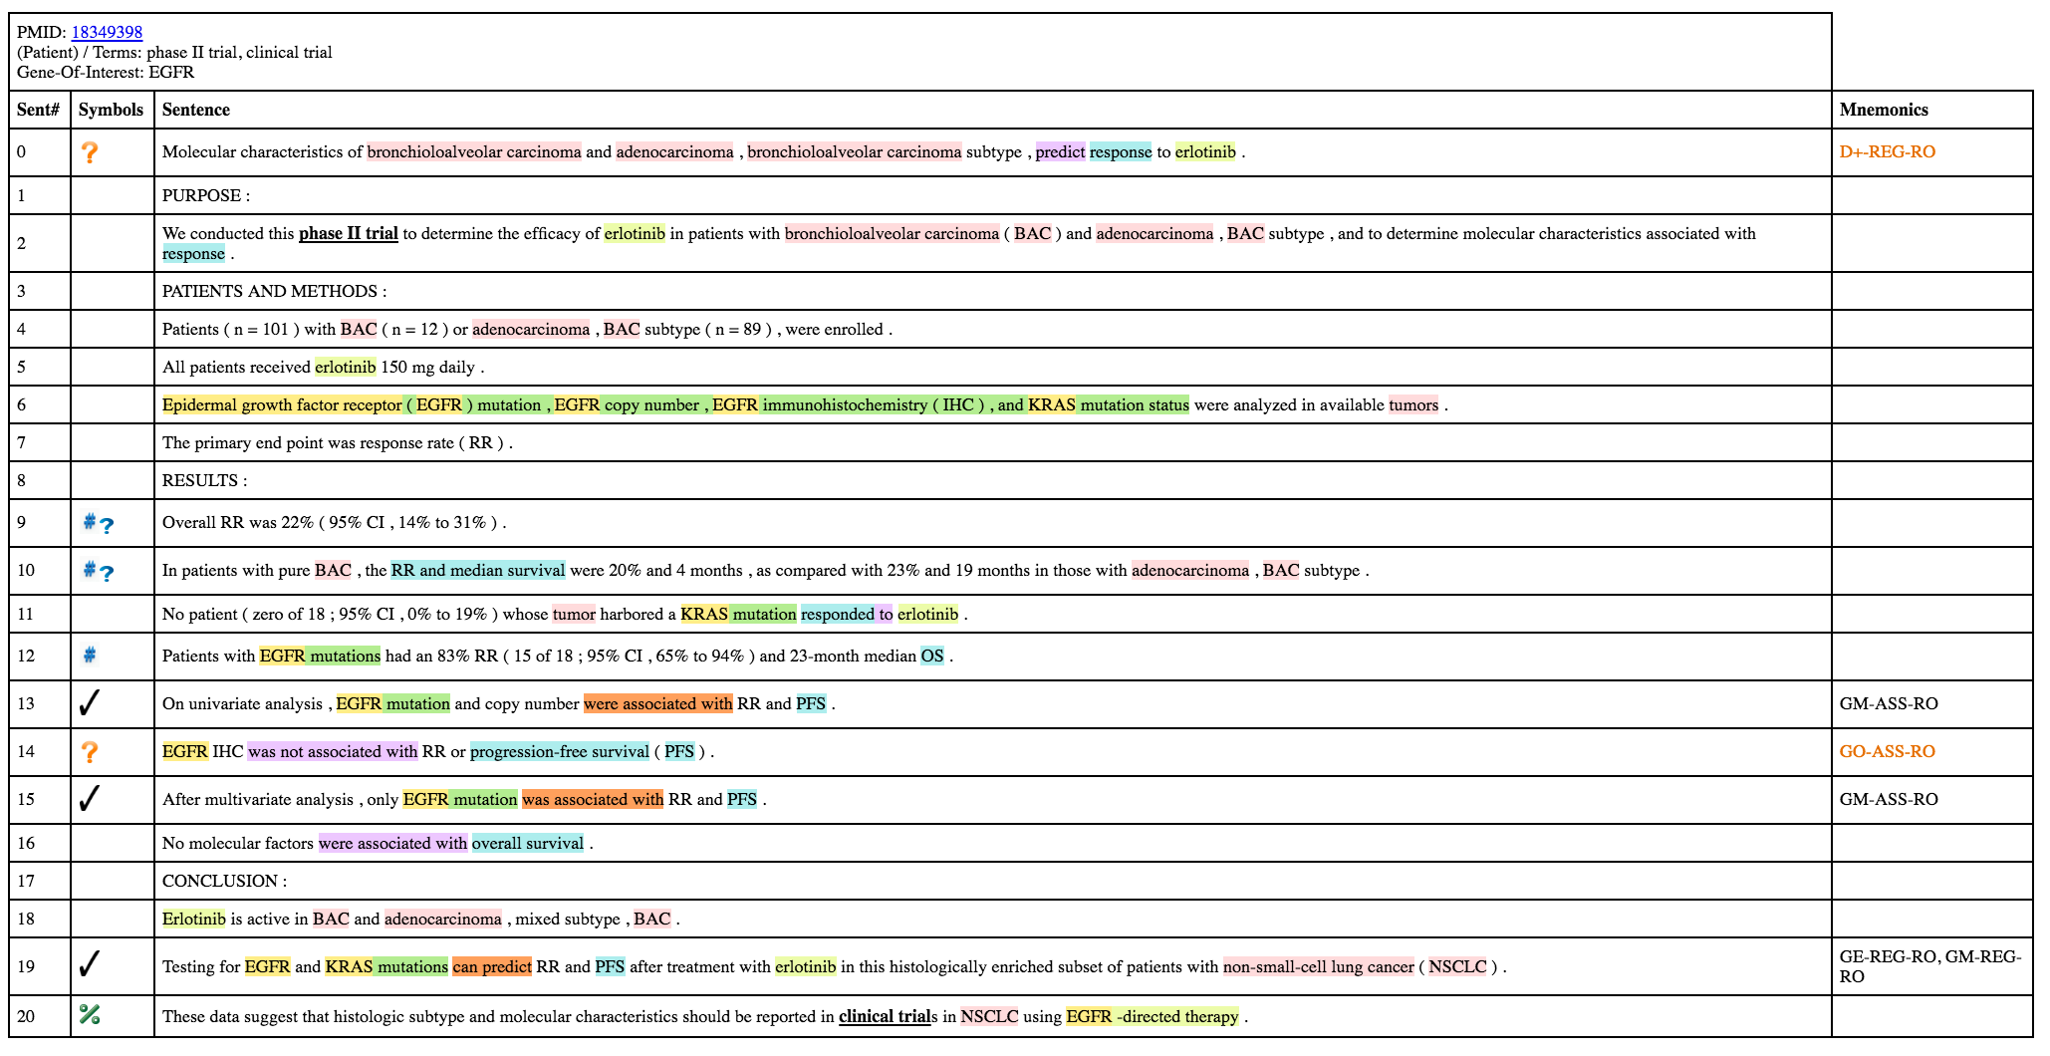
Example NLP output for EGFR+Erlotinib
NLP results currently visualized in html

Slide 14
Information to be captured from each paper
Cancer Type - Validation: Add/Edit/Delete
Cancer stage - Add
Gene Symbol - Validation: Add/Edit/Delete
Genomic Anomaly - Validation: Add/Edit/Delete
Assay Type - Add
Model system (Specify if human, cell line, animal model) - Validation: Add/Edit/Delete
Other genes studied - Validation: Add/Edit/Delete
Drug/Combination of drugs - Validation: Add/Edit/Delete
Therapy setting - Add
Predictive effect of biomarker on therapeutic outcome – Interpretation: based on statements with mnemonics or full text
Type of study – Interpretation based on abstract or full text
Strength of Evidence - Interpretation based on abstract or full text
Total # of samples in study - Add
Outcomes (will mainly be statements with mnemonics) – Validation: Add/Edit/Delete
Adverse Events - Add
Patient inclusion criteria - Add
Patient exclusion criteria – Add
Pathways involved - Add

Slide 15
Study level evidence assignment
IA: High impact meta analysis
IB: High impact review
IC: Prospective randomized clinical trial using stratification based on biomarkers
ID: Biomarker driven retrospective review of a prospective randomized trial
Level I: Randomized controlled trials
Level II: Non-randomized trials
Level III: Observational Studies
Level IV: In-Vitro Studies, Animal models, Expert Opinions
IIA: Meta analysis using prospective non randomized or retrospective biomarker studies
IIB: Prospective non randomized trial (Biomarker driven)
IIC: Retrospective review of biomarkers from a non randomized trial
IID: Low powered retrospective review of biomarkers from a non randomized trial
IIIA: Meta analysis using case control studies or retrospective case control studies
IIIB: Case control studies
IIIC: Low powered case control studies
IIID: Retrospective non case control studies
IIIE: Low powered non case control studies
IVA: Single case report
IVB: Meta analysis using in-vitro and cell line studies only
IVC: In-Vitro and Animal model studies
IVD: Low impact review
IVE: Expert Opinion

Slide 16
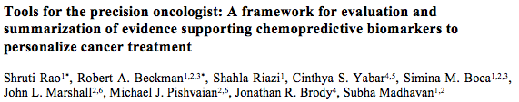
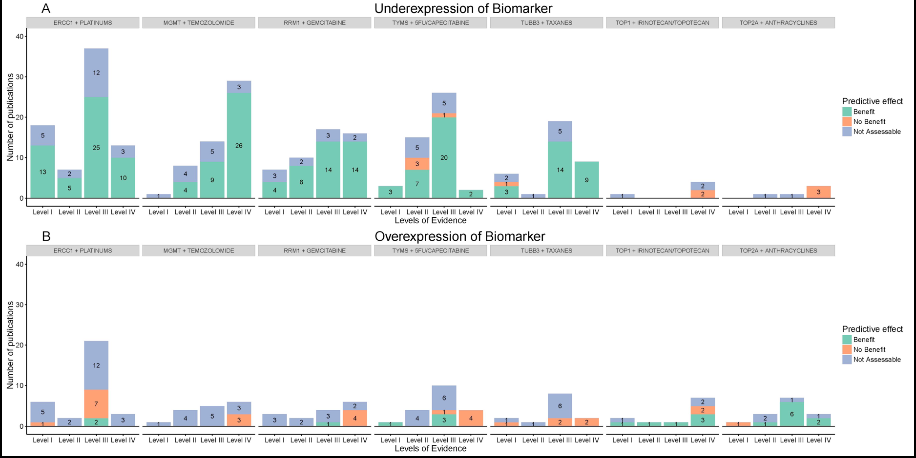

Slide 17
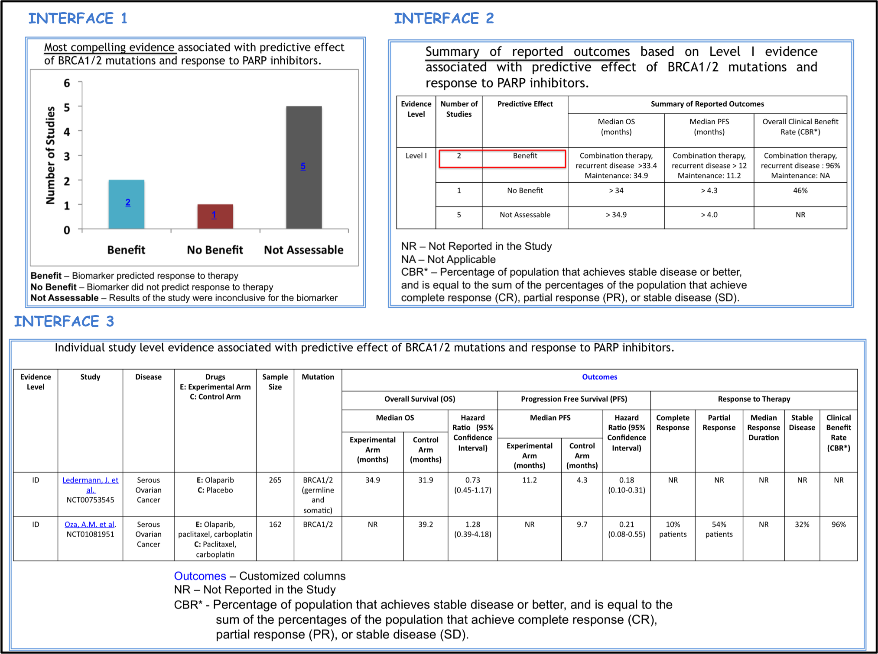
Presenting Genomic Information in a Clinical Context

Slide 18
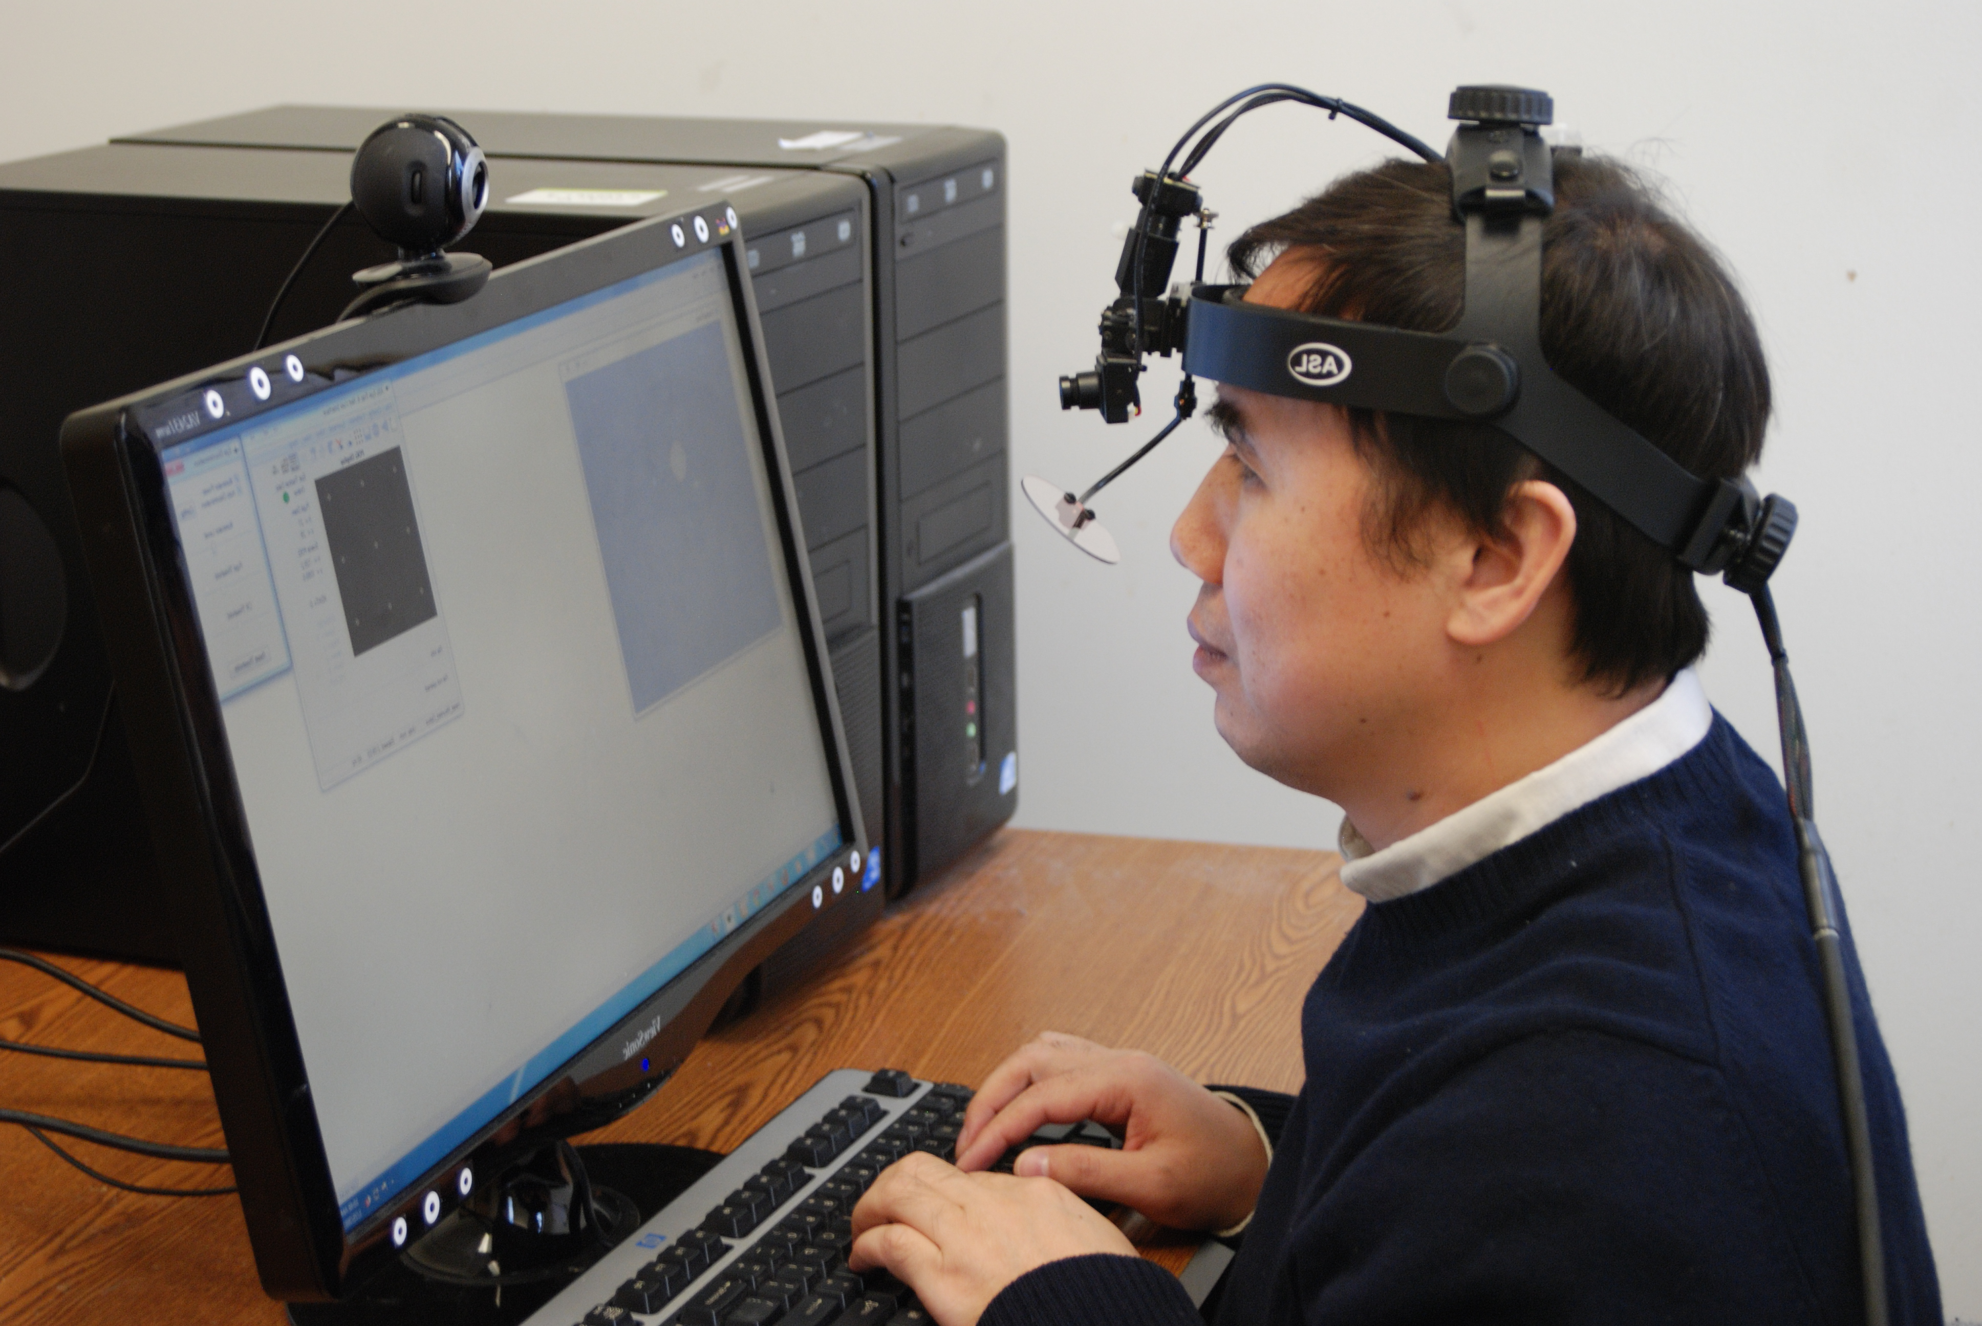
Understanding cognitive process:
Eye-tracking device
Data every 16.7 milliseconds
4.32 million data points
for 20 participants/Hour
faceLab 5 desktop eye-tracker from Seeing Machines Inc

Slide 19
Future activities
  Continue to define standards for capturing and sharing somatic variant data to aid in classification and medical interpretation
  Support Somatic variant data Curation, interpretation and sharing
    Work closely with ClinVar to enhance somatic variant data submissions
  Refine user interfaces to improve presentation of MolDx data to clinicians

Slide 20
Team Members
ClinGen Somatic Working Group & NLM ClinVar & BioQurator Team
Georgetown University
  Subha Madhavan
  Peter McGarvey
  Shruti Rao
  Simina Boca
  Vishakha Sharma
  Robert Beckman
  Karen E. Ross
University of Delaware
  Vijay K. Shanker
  Cathy H. Wu
MedStar National Center for Human Factors Engineering
  Raj Ratwani
  Zach Hettinger
Funding:
NHGRI ClinGen U24
NIH BD2K U01

