Slide 1
DTC genetic testing in the clinical care context: Personalized medicine from the patient/pin-cushion perspective
Jessica D. Tenenbaum, PhD
Duke University
Department of Biostatistics and Bioinformatics
@jessiet1023

Slide 2
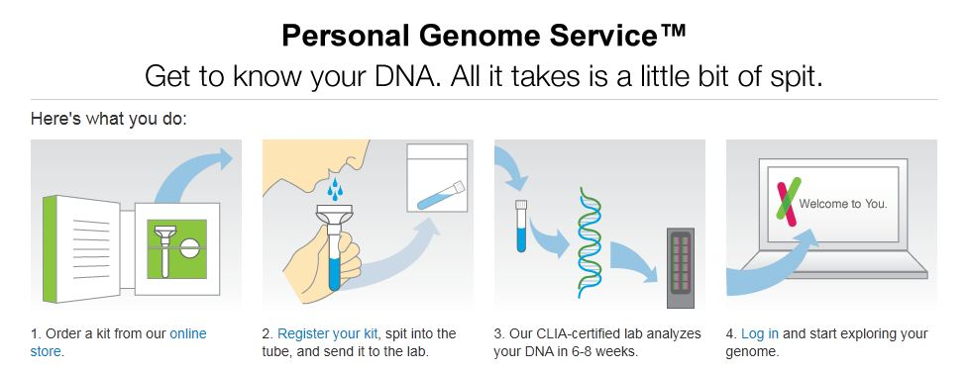
Direct To Consumer Genetic Testing
http://www.singularityweblog.com/23andme-dna-test-review-its-right-for-me-but-is-it-right-for-you/

Slide 3
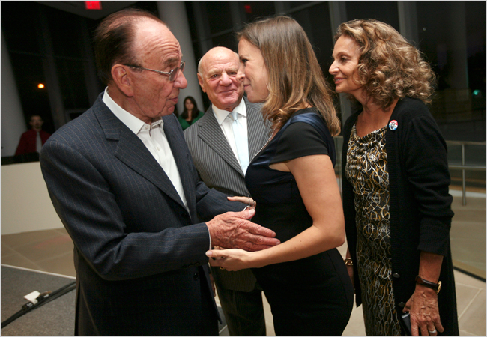
NYX Fashion and Style Section 2008
“It was a funny thing to be doing in a cocktail dress.”

Slide 4
Direct To Consumer Genetic Testing circa 2009
23andMe, Navigenics, Knome, deCODE, etc.
Give sample, get back genomic results
Variations on:
traits tested
cost of tests
counselor involvement
Notes:
transition

Slide 5
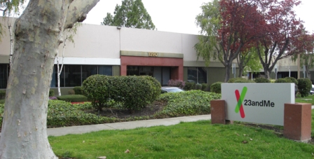
Ethical, Legal, Social Issues (ELSI)
Regulated by government?
Are consumers ready?
Are providers ready?
http://www.bio-itworld.com/BioIT_Article.aspx?id=136445

Slide 6
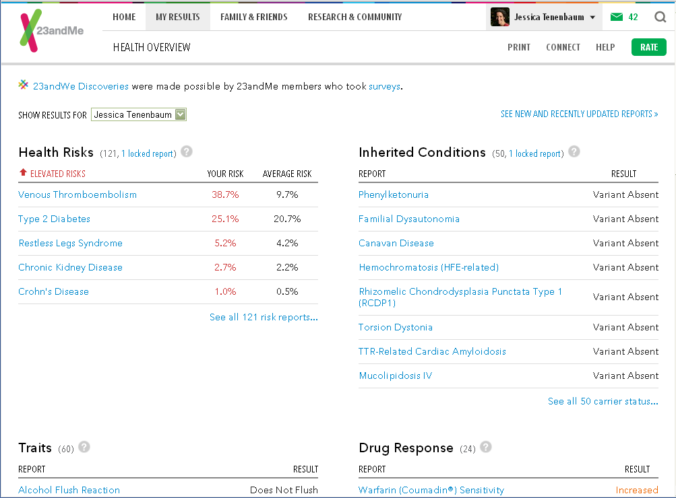

Slide 7
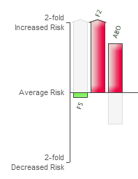
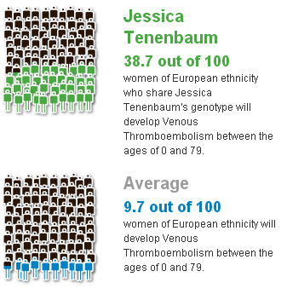
23andMe graphical results
Tenenbaum et al. J Personalized Med. 2012

Slide 8
Case
35 years old female
Heterozygous prothrombin gene mutation (rs1799963) aka factor 2
Present in ~2% of population
Pregnant with twins
Recommendation: anti-coagulant throughout pregnancy

Slide 9
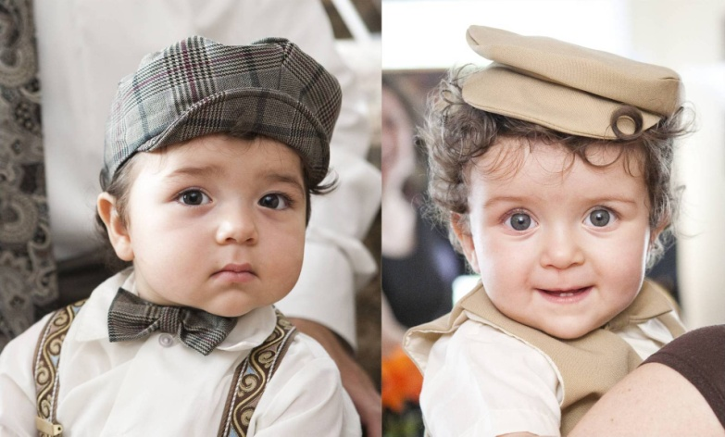
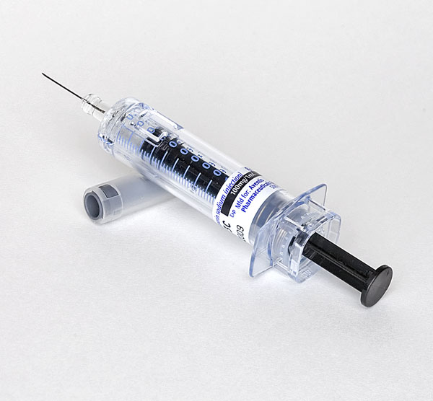

Slide 10
Other factors for consideration
No personal or family history
Infertility
“Advanced maternal age”
Economic status
Professional expertise
Fear of needles

Slide 11
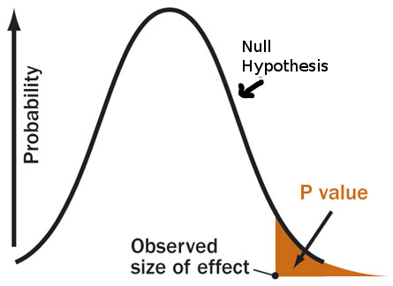
Numeracy: how rare is rare?
Age * twins * thrombophilia mutation
Back of the envelope- 5% chance of “something bad”
Physician vs. patient perception

Slide 12
Remember high school genetics?
Quintessential example of heritability: eye color (BB, Bb, bb)
One gene in particular, OCA2, thought to control ~74% of eye color variation

Slide 13
Risk and Guidelines
Past studies decidedly mixed on risks
My own reported risk on 23andMe changed over time
Many guidelines (at the time) focused on whether to screen, NOT what to do if one is “pre-screened” via DTC
Guidelines today would not recommend prophylactic anticoagulation

Slide 14
Next chapter: life insurance
Patient applied for life insurance
Original policy included statement that patient had not been treated for clotting disorder
$530
Patient drew company’s attention to (debatable) inaccuracy
New policy $1170- more than double previous rate

Slide 15
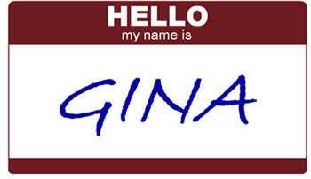
Beyond GINA’s Reach
Genetic Information Non-discrimination Act of 2008
Applies to health care insurance, employment
Does not cover life, disability, long term care insurance
Considerations
Not everyone gets these types of insurance
Patients/research participants may be reluctant to get actionable testing done
Companies need to make a profit

Slide 16
The good (?) news
Increased rate was not due to genetic data per se
Reason for rate hike was statement regarding treatment, or recommendation for treatment, of clotting disorder
Health records so difficult to interpret that genomic and therapeutic data was initially missed (?)

Slide 17
Opinion: Genomic professionals should lead the way
Yes, there are challenges
Variants of unknown significance
Precision medicine guidelines as a moving target
Ethical, legal, social, policy issues
We won’t be able to address them until we identify them
The scientific community should take the risk and lead the way

Slide 18
In summary
Genetic data has the potential to improve consumer health
It also comes with risks and challenges
Urgent need for:
Training and education- researchers, patients, providers, regulators
Evidence, clinical guidelines
Guinea pigs & canaries

Slide 19
American Medical Informatics Association
www.amia.org
Professional society for biomedical informatics
Working Groups:
Genomics and Translational Bioinformatics
Ethical Legal and Social Issues
Conferences
Fall: Annual Symposium, November 12-16, Chicago
Spring: 2017 Joint Summits on Translational Science
March 27-30, San Francisco
Submission deadline September 2016

Slide 20
American Medical Informatics Association
www.amia.org
Professional society for biomedical informatics
Working Groups:
Genomics and Translational Bioinformatics
Ethical Legal and Social Issues
Conferences
Fall: Annual Symposium, November 12-16, Chicago
Spring: 2017 Joint Summits on Translational Science
March 27-30, San Francisco
Submission deadline September 2016

Slide 21
Acknowledgements
Andra James
Kristin Paulyson-Nuñez
23andMe
Shirley Wu
Funding
NCRR UL1RR024128
David H Murdock
jessie.tenenbaum@duke.edu
@jessiet1023

