Slide 1
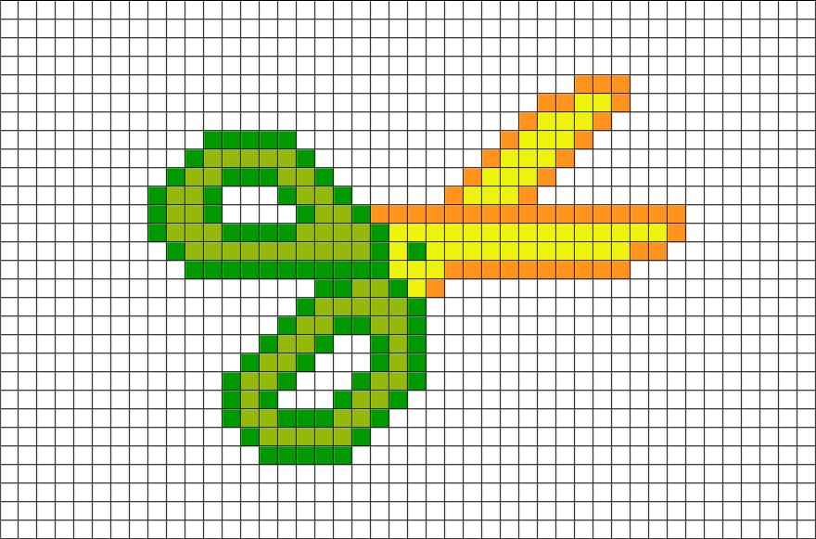
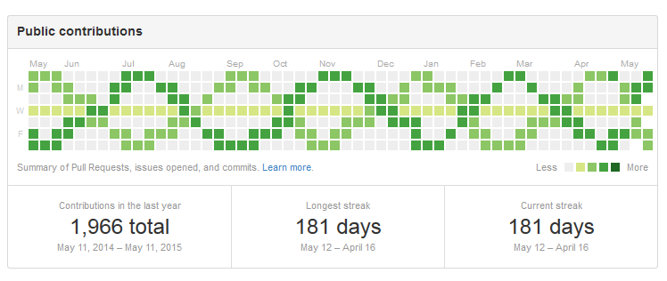

A practical introduction to the design, quantification, and analysis of CRISPR genome editing data
Basheer Becerra, Lucas Ferreira da Silva, Jayoung Ryu, Maya Talukdar & Luca Pinello
ISMB 2022

Slide 2







A little bit about us...
@lucapinello
Luca Pinello
Associate Professor
Massachusetts General Hospital
Harvard Medical School
Maya Talukdar
MD-PhD Student (M2/G0)
Harvard/MIT HST Program
Bioinformatics & Integrative Genomics PhD Program
Lucas Ferreira da Silva
Postdoctoral Fellow
Harvard Medical School
Basheer Becerra
PhD Student (G3)
Harvard Medical School
Bioinformatics & Integrative Genomics PhD Program
Jayoung Ryu
PhD Student (G3)
Harvard Medical School
Bioinformatics & Integrative Genomics PhD Program

Slide 3
Conflict of Interest Declaration
  Luca Pinello: Excelsior Genomics, SeQure Dx, Inc., Edilytics
  My interests were reviewed and are managed by Massachusetts General Hospital and Partners HealthCare in accordance with their conflict of interest policies.

Slide 4
Outline
Topic | Instructor | Contents | Time | Duration
Intro & overview |  |  | 11:00 – 11:05 | 5 min
CRISPR genome editing: What and How | Maya | Lecture | 11:05 – 11:35 | 30 min
Quantification of genome editing activity by sequencing | Luca | Lecture | 11:35 – 12:00 | 25 min
 |  | Workshop | 12:00 – 12:30 | 30 min
Lunch break |  | 🍔 | 12:30 – 13:30 | 1 hour
Strategy and Design of pooled CRISPR screens | Basheer | Lecture | 13:30 – 14:05 | 35 min
 |  | Workshop | 14:05 – 14:50 | 45 min
Analyses of pooled CRISPR screens | Jayoung | Lecture | 14:50 – 15:25 | 35 min
 |  | Workshop | 15:25 – 16:10 | 45 min
Coffee break |  | ☕ | 16:10 – 16:25 | 15 min
Pooled CRISPR screens with single-cell readout | Lucas & Maya | Lecture | 16:25 – 17:00 | 35 min
 |  | Workshop | 17:00 – 17:45 | 45 min
Conclusion + final Q&A |  |  | 17:45 – 18:00 | 15 min

Slide 5
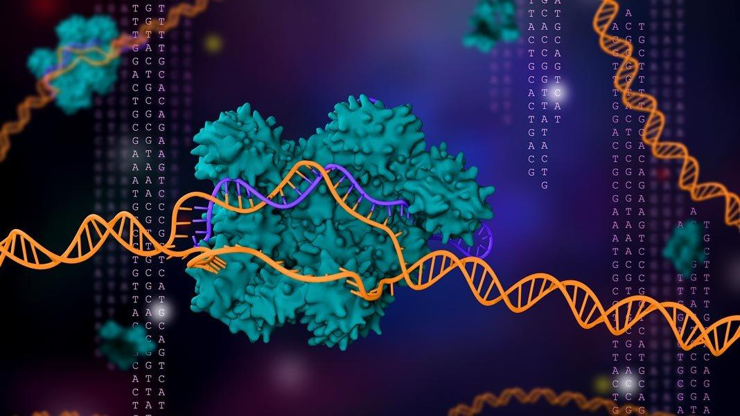
Genome editing: what and how
ISMB 2022
Maya Talukdar

Slide 6
AIMS
To provide key historical background on the discovery of CRISPR and how it has since been modified to facilitate genome editing
To discuss a standard workflow for CRISPR experiments and key decision points in designing high-content CRISPR screens

Slide 7


A curious discovery in a Spanish salt marsh…

Slide 8
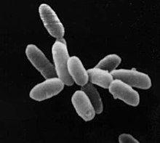
A curious discovery in a Spanish salt marsh…
    1989

Slide 9
A curious discovery in a Spanish salt marsh…
    1989

Slide 10
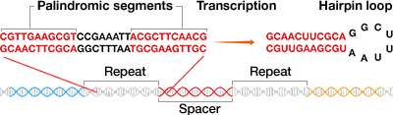
A curious discovery in a Spanish salt marsh…
    1989
Clustered regularly interspersed short palindromic repeats
Notes:
https://www.bio-rad.com/en-us/applications-technologies/crispr-cas-gene-editing-teaching-resources?ID=Q58I0DWDLBV5

Slide 11
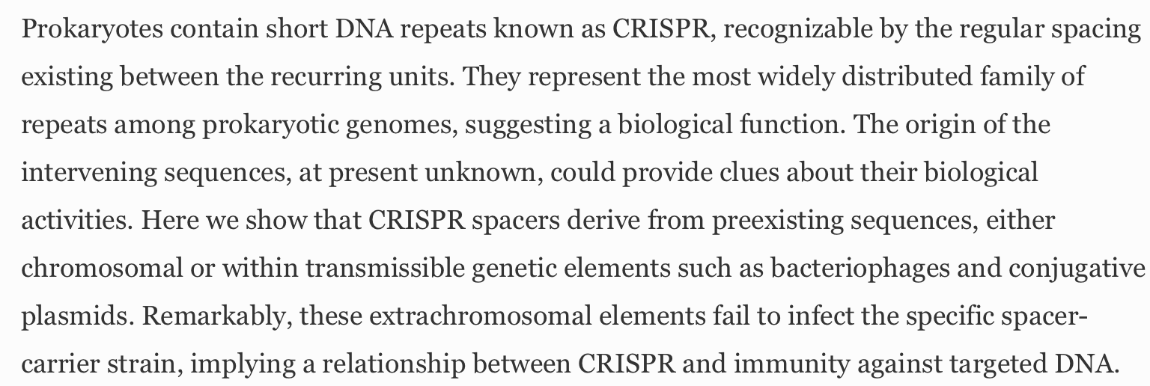
A curious discovery in a Spanish salt marsh…
    1989
Clustered regularly interspersed short palindromic repeats
Mojica et al., Journal of Molecular Evolution (2005)

Slide 12
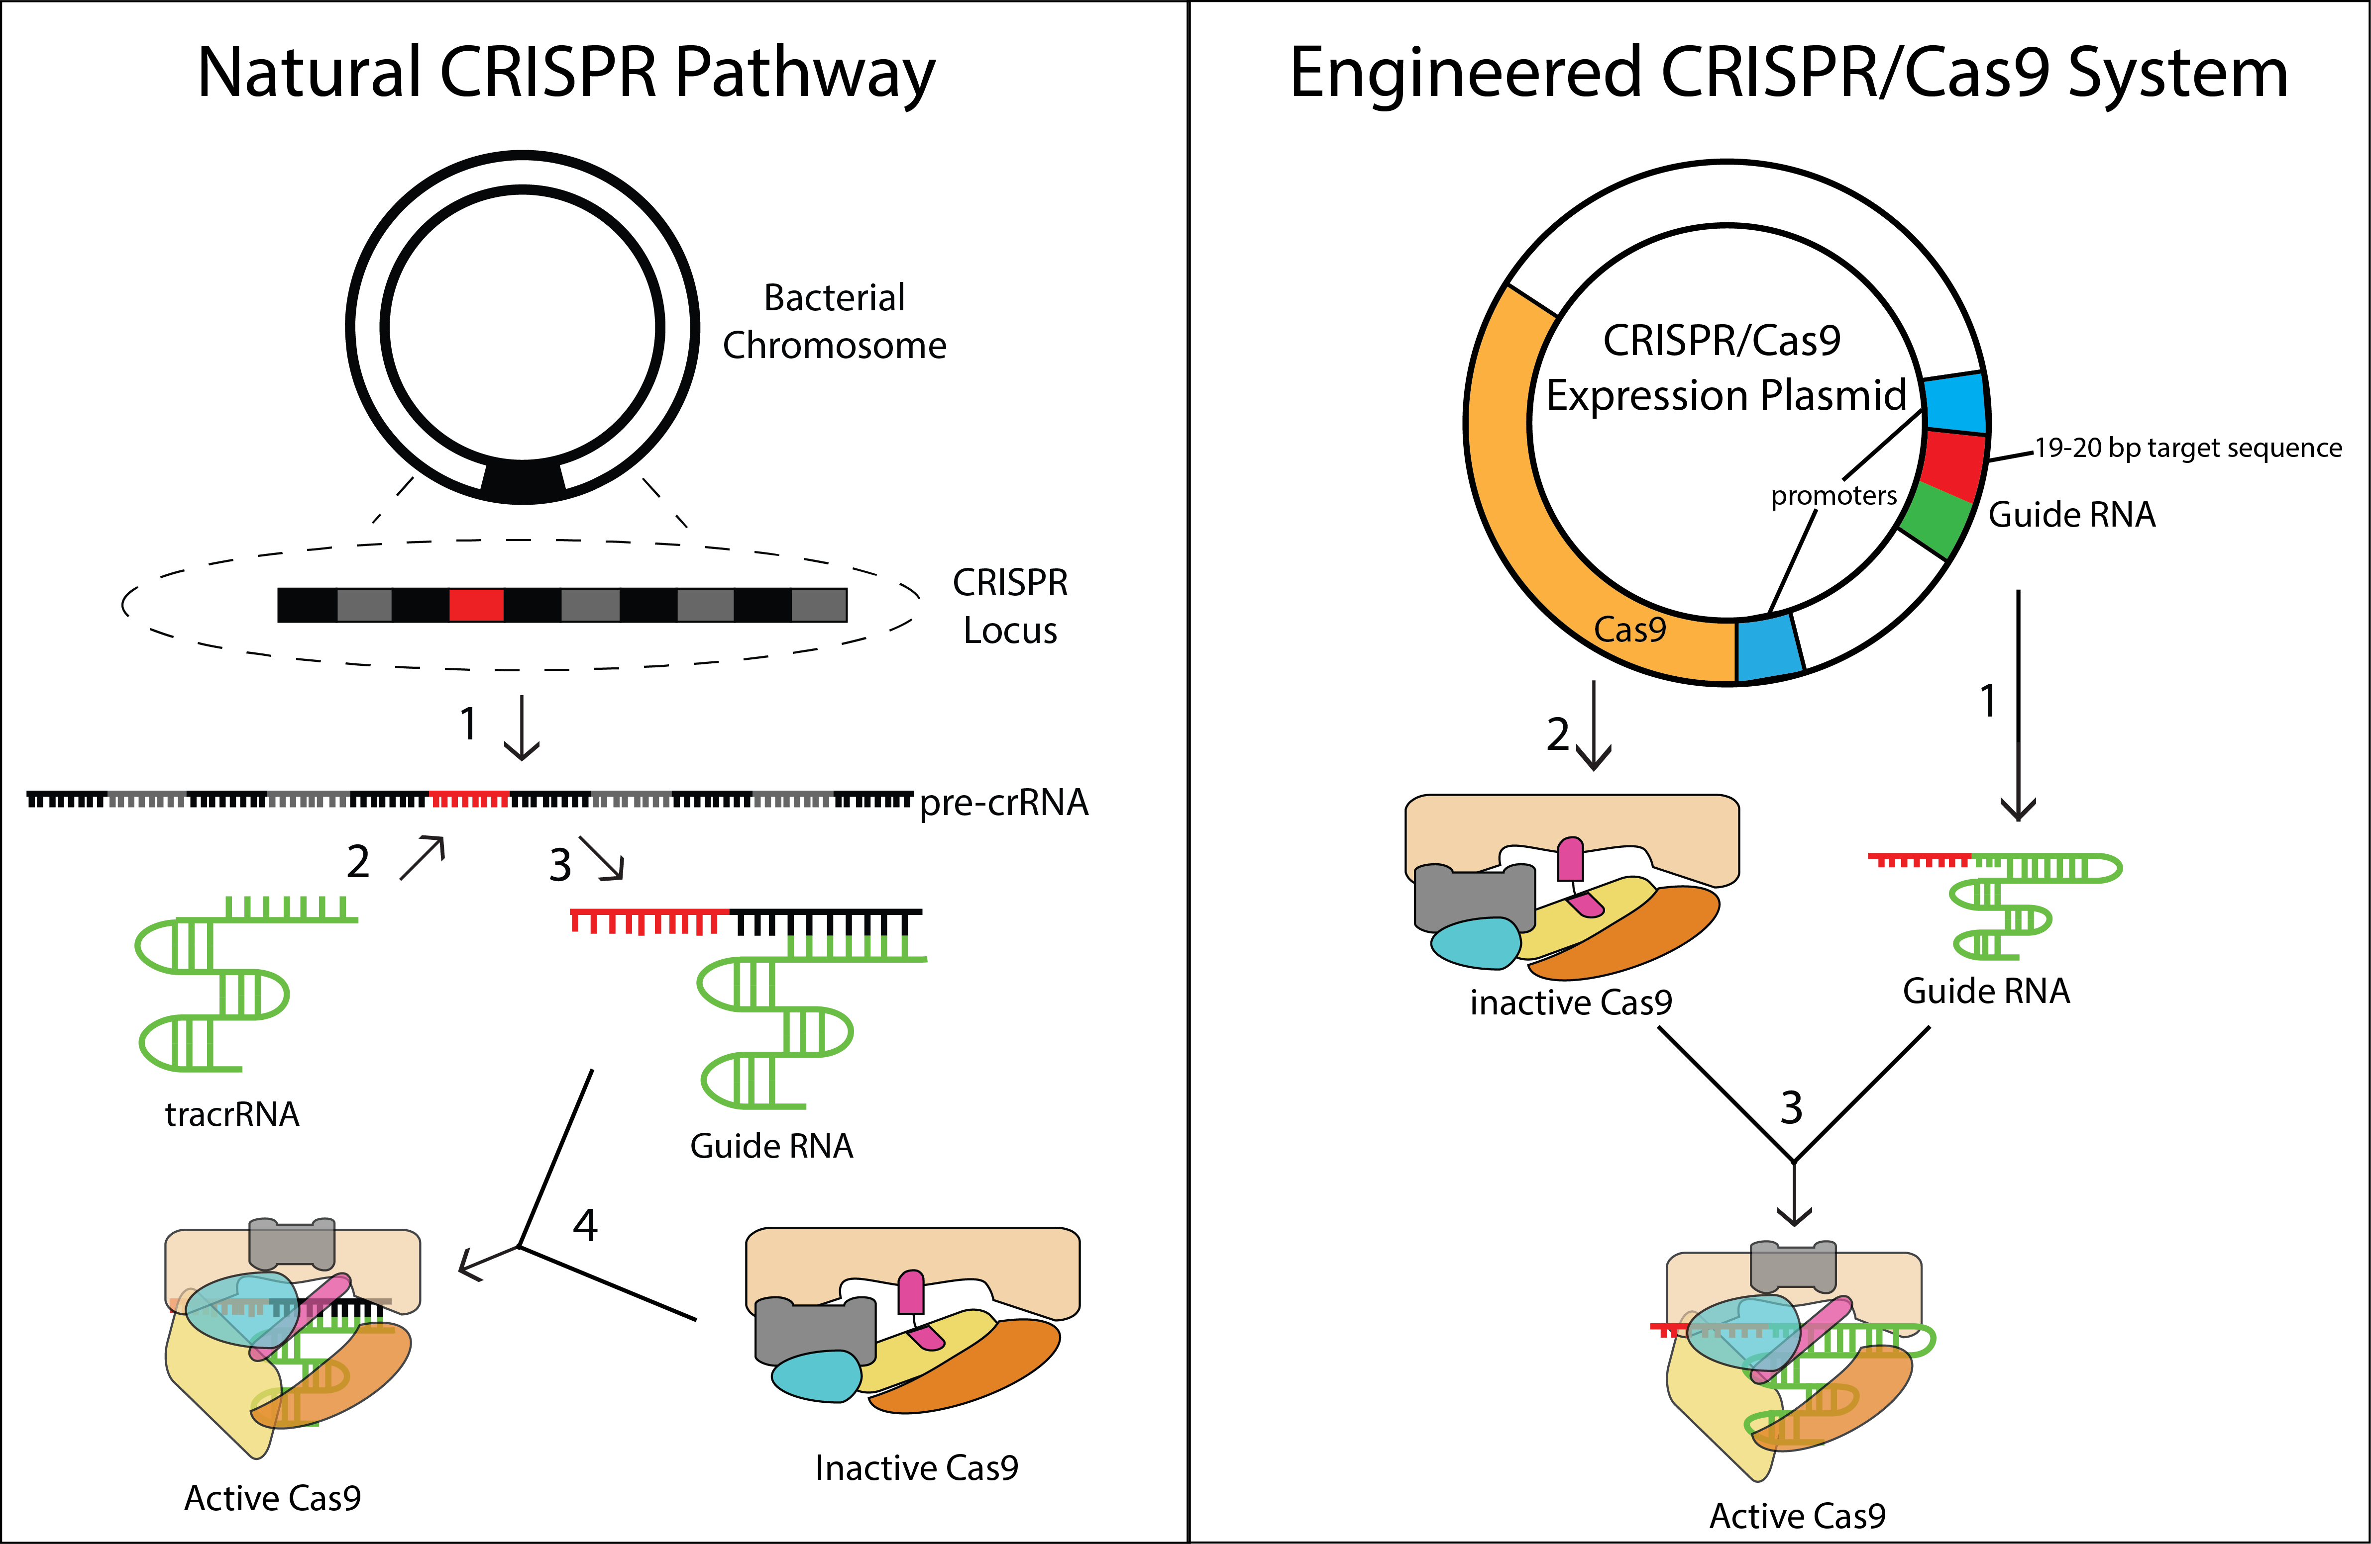
… that revolutionizes biology as we know it
Notes:
https://sites.tufts.edu/crispr/genome-editing/

Slide 13

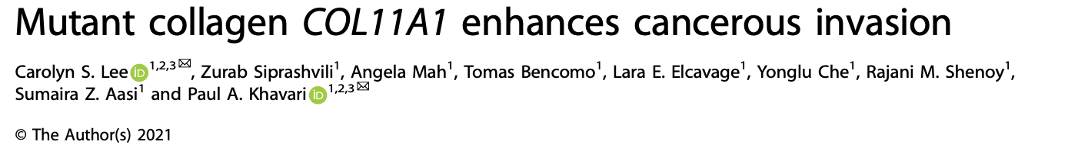
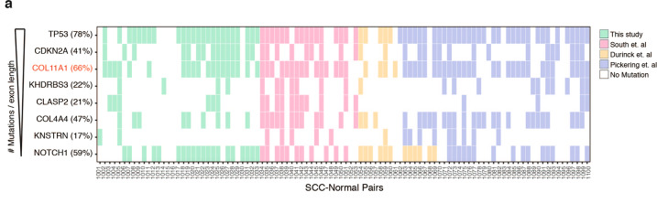
With individual, targeted guides, we can precisely induce genetic edits to study specific biological hypotheses...
Notes:
https://sites.tufts.edu/crispr/genome-editing/

Slide 14
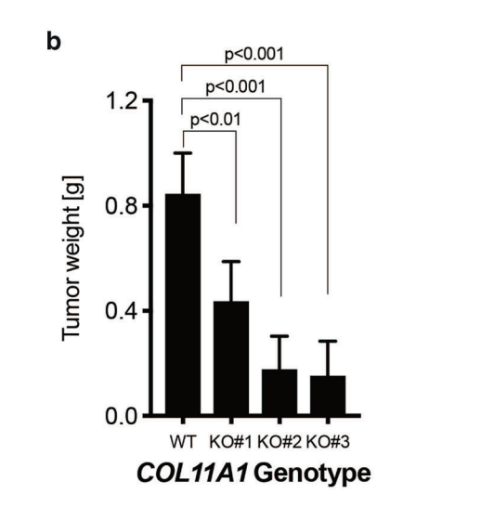
With individual, targeted guides, we can precisely induce genetic edits to study specific biological hypotheses...
Notes:
https://sites.tufts.edu/crispr/genome-editing/

Slide 15
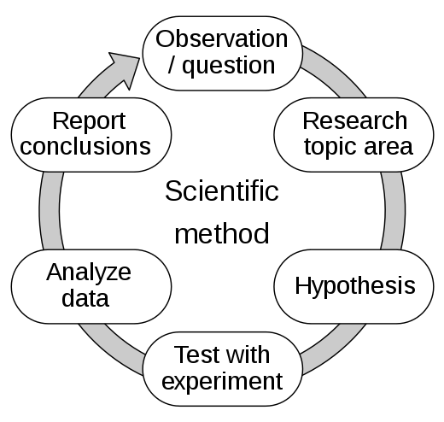
… but many biological questions are best initially addressed by hypothesis-generating approaches
Hypothesis-driven approach: using CRISPR to edit a genomic region of interest, to observe phenotypic results in context of chosen biology hypothesis
Notes:
https://sites.tufts.edu/crispr/genome-editing/

Slide 16
… but many biological questions are best initially addressed by hypothesis-generating approaches
Hypothesis-driven approach: using CRISPR to edit a genomic region of interest, to observe phenotypic results in context of chosen biology hypothesis
Hypothesis-generating approach: using CRISPR to edit many genomic regions, to utilize phenotypic results to generate a new hypothesis about a biological system
Notes:
https://sites.tufts.edu/crispr/genome-editing/

Slide 17
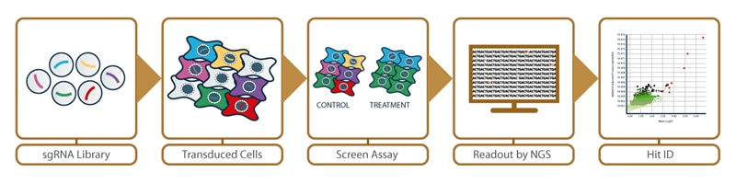
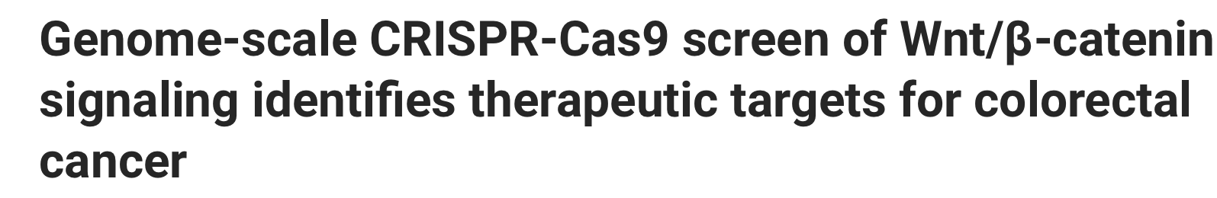
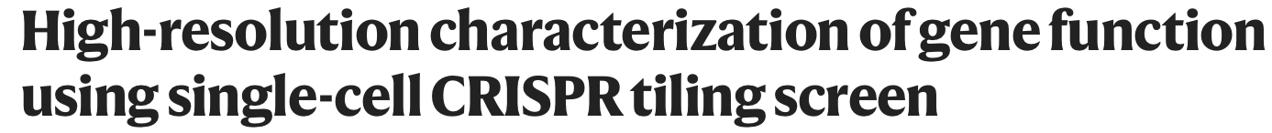
CRISPR screens are high-throughput tools that can be used for the hypothesis-generating approach
Wan et al., Science Advances (2021)
Wei at al., Cell (2021)
Yang et al., Nature Communications (2021)

Slide 18
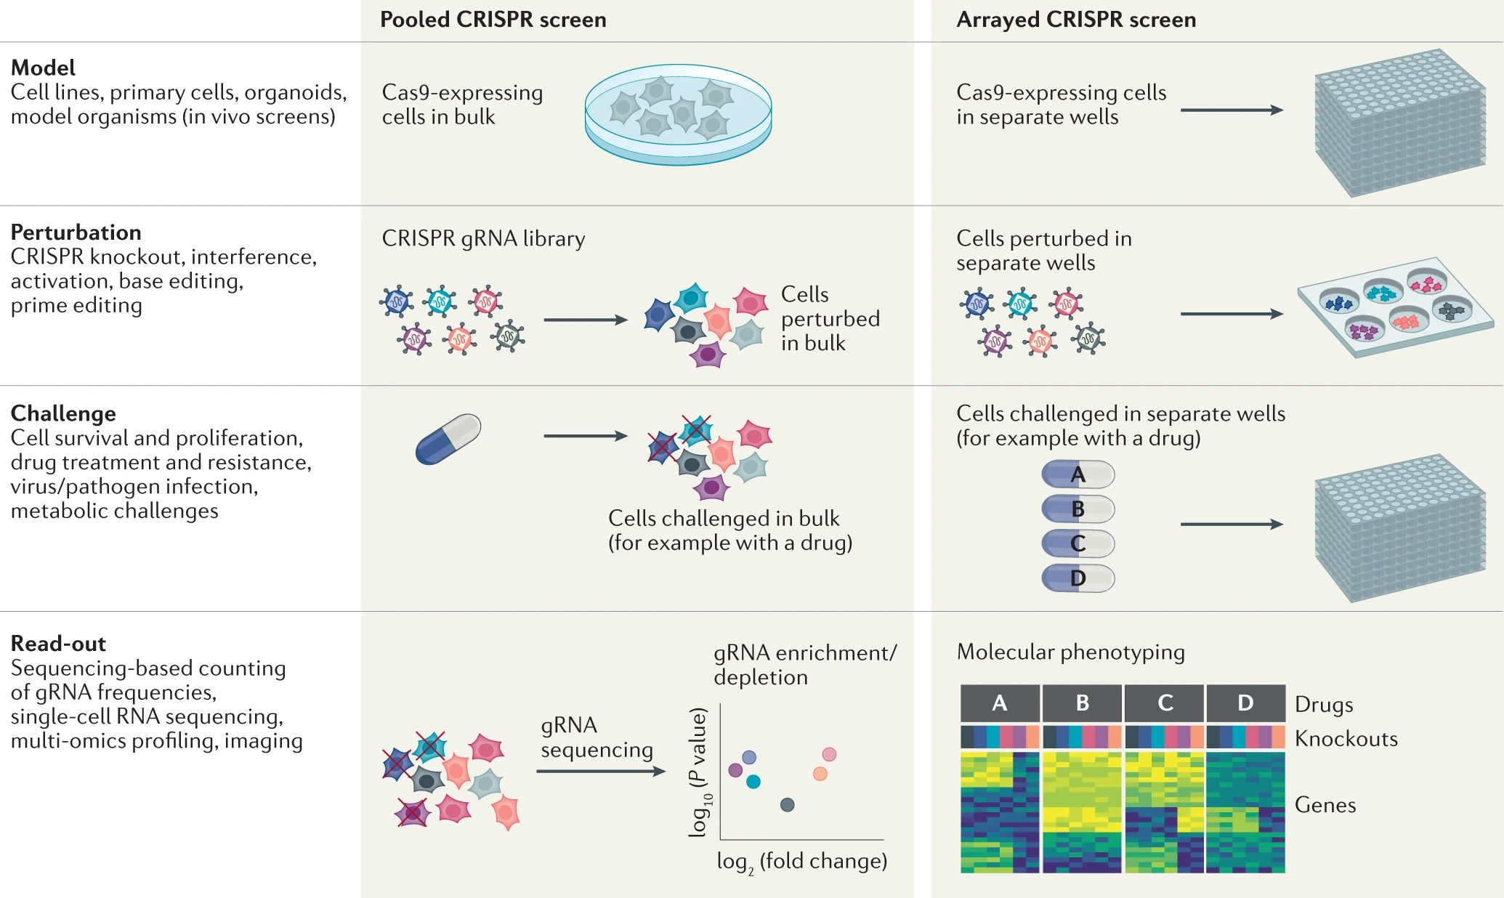
CRISPR screen customization: pooled vs arrayed screens
Less labor intensive
Less expensive
Easier to perform high-content screening
Can be used to study the effects of gRNAs in combination, depending on multiplicity of infection (MOI) used
Classically used for discovery
Offers precise control over which guides are transfected into which cells
Cells receive pre-defined perturbations so the gRNA(s) within a cell don’t have to be explicitly determined by sequencing; useful if read-out otherwise doesn’t require sequencing (ex: proteomics screen)
Classically used for validation and follow-up
Notes:
I am not sure if quantification

Slide 19
CRISPR screen customization: pooled vs arrayed screens
Less labor intensive
Less expensive
Easier to perform high-content screening
Can be used to study the effects of gRNAs in combination, depending on multiplicity of infection (MOI) used
Classically used for discovery
Offers precise control over which guides are transfected into which cells
Cells receive pre-defined perturbations so the gRNA(s) within a cell don’t have to be explicitly determined by sequencing; useful if read-out otherwise doesn’t require sequencing (ex: proteomics screen)
Classically used for validation and follow-up

Slide 20
CRISPR screen customization: type of perturbation

Slide 21
CRISPR screen customization: type of perturbation

Slide 22
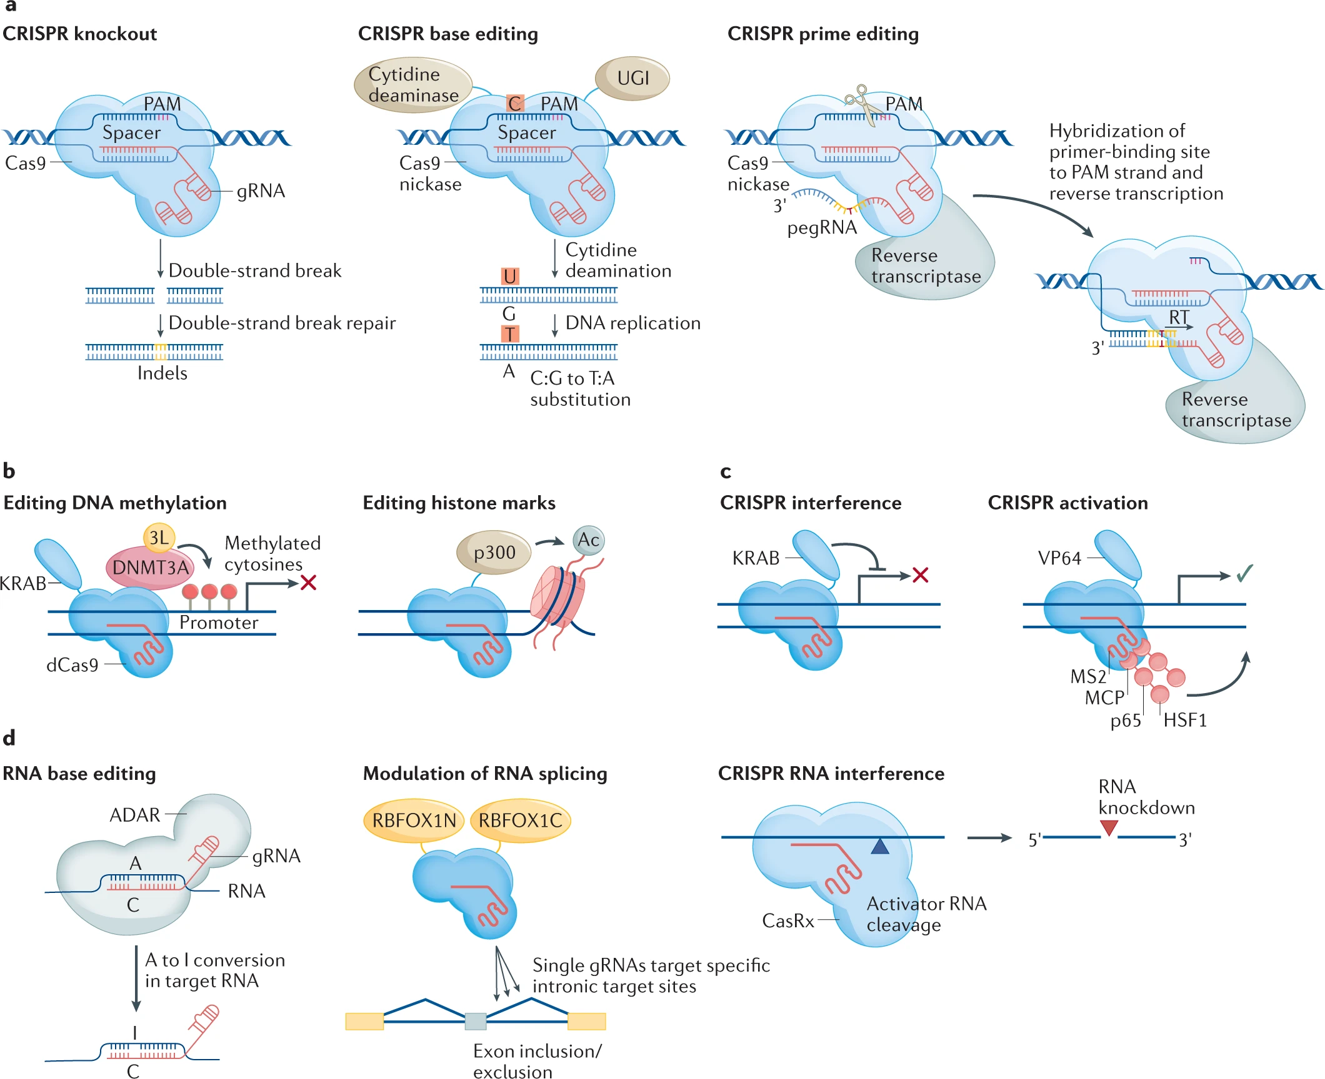
CRISPR screen customization: type of perturbation

Slide 23
CRISPR screen customization: type of perturbation
Short DNA sequence required for a Cas nuclease to cut; in bacteria, used to prevent auto-cleavage of the CRISPR region
Notes:
I am not sure if quantification

Slide 24
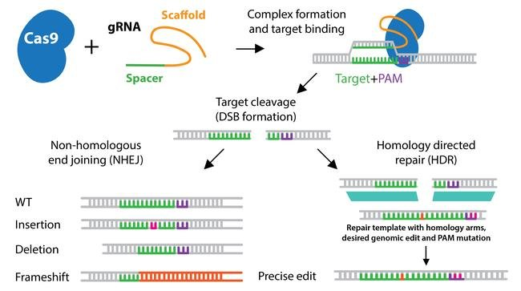
CRISPR screen customization: type of perturbation
Short DNA sequence required for a Cas nuclease to cut; in bacteria, used to prevent auto-cleavage of the CRISPR region
Relatively low editing efficiency

Slide 25
CRISPR screen customization: type of perturbation
Allow targeted control of gene expression by using a dead Cas9 (dCas9) that does not have nuclease activity complexed with either transcriptional repressors (CRISPRi) or transcriptional activators (CRISPRa)

Slide 26
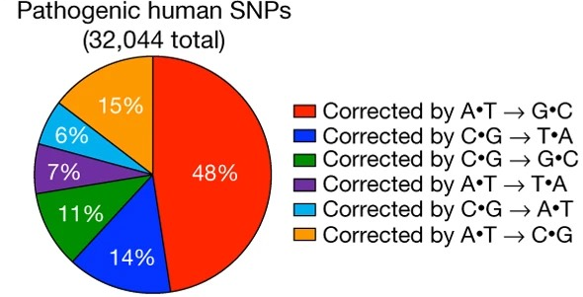
CRISPR screen customization: type of perturbation
Allows creation of transition mutations without the need for DNA cleavage by using dCas9 fused with a cytosine or adenosine deaminase + an inhibitor of uracil DNA glycosylase (UGI), preventing base excision repair and removal of the edit

Slide 27
CRISPR screen customization: type of perturbation
Allows creation of numerous targeted edits, including all substitution mutations, insertions, and deletions, without the need for a dsDNA break by using Cas9 nickase complexed with reverse transcriptase & a prime editing gRNA (pegRNA) that contains an edit template
In comparison to base editing...
  Doesn’t require a precisely positioned PAM site
  Higher specificity/less off-target edits
  But....
  Lower editing efficiency
  Fewer indel byproducts

Slide 28
CRISPR screen customization: type of perturbation
And many others!

Slide 29
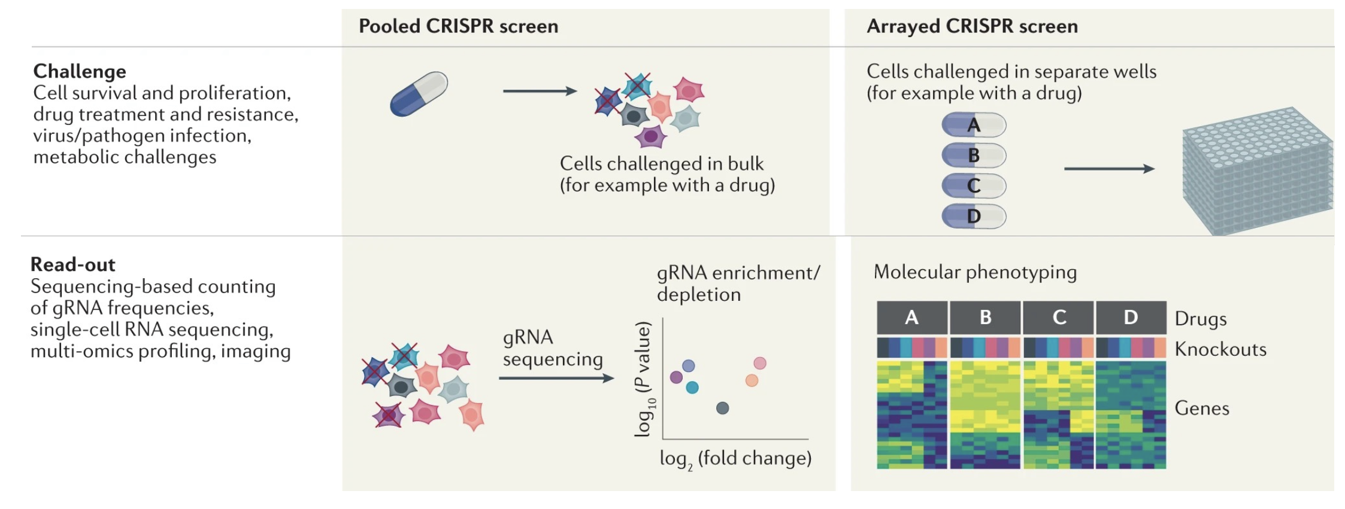
CRISPR screen customization: challenge and readout

Slide 30
You've convinced me...

Slide 31
You've convinced me... but how do I actually do these screens?!
In this workshop, we will cover:
  How to design sgRNAs
  How to quantify genome editing activity
  How to design and analyze pooled bulk CRISPR screens
  How to design and analyze quantification pooled single-cell CRISPR screens
With special consideration of:
  Experimental constraints
  Technical details & tools
  The successful application of CRISPR screens to answer fundamental biological questions

Slide 32


You've convinced me... but how do I actually do these screens?!
In this workshop, we will cover:
  How to design sgRNAs
  How to quantify genome editing activity
  How to design and analyze pooled bulk CRISPR screens
  How to design and analyze quantification pooled single-cell CRISPR screens
With special consideration of:
  Experimental constraints
  Technical details & tools
  The successful application of CRISPR screens to answer fundamental biological questions

Slide 33
CONCLUSIONS
CRISPR-Cas9 is a key component of the bacterial adaptive immune system that can be exploited for targeted and efficient genome editing
CRISPR can be used for a variety of different genomic perturbations, ranging from gene knockdown to precise single-nucleotide edits
Designing high-throughput CRISPR screens involves a variety of decision points that can be used to customize the experimental design toward exploring a given biological question of interest

Slide 34
Quantification of genome editing activity by sequencing
ISMB 2022
Luca Pinello

Slide 35



Common problems faced in analysis of genome editing experiments
How can we measure the efficiency, accuracy, and safety of our genome editing approach?
How can we visualize results of genome editing?
How do we compare between editors?

Slide 36
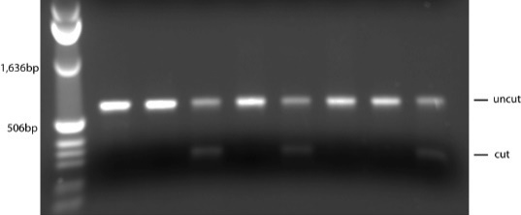
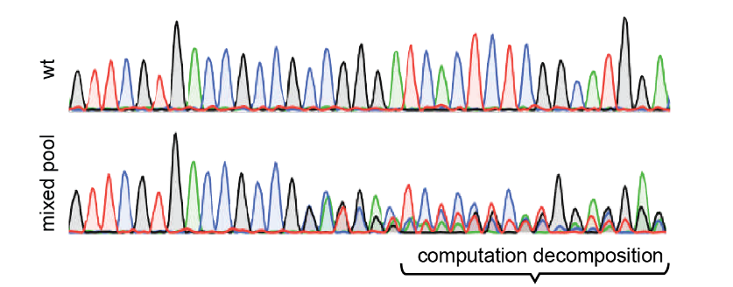
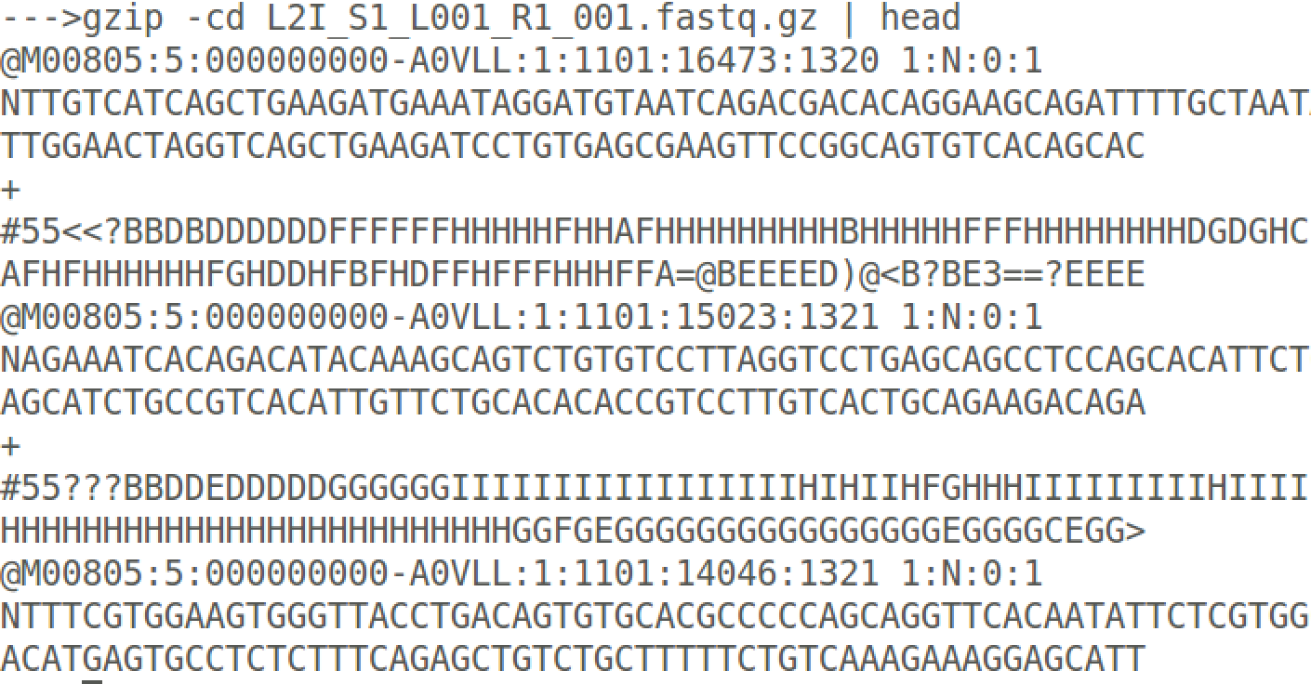
How can we detect engineered mutations?
T7 endo/Surveyor assay
Sanger sequencing
Targeted sequencing or WGS

Slide 37

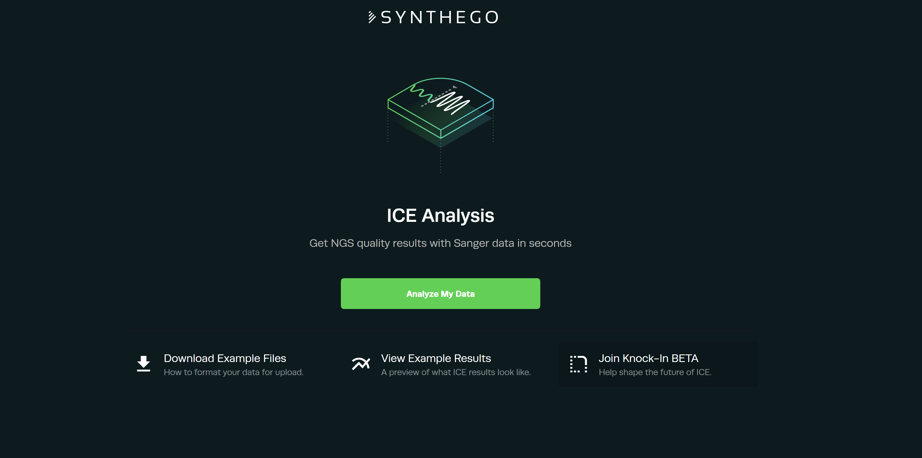
Sanger sequencing, TIDE-Analysis and ICE analysis
http://tide-calculator.nki.nl/
https://ice.synthego.com

Slide 38
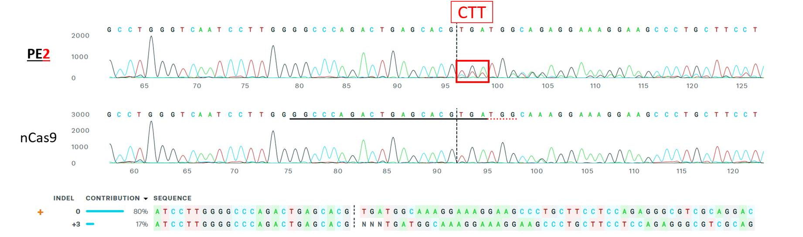
Example: ICE analysis of prime editing

Slide 39
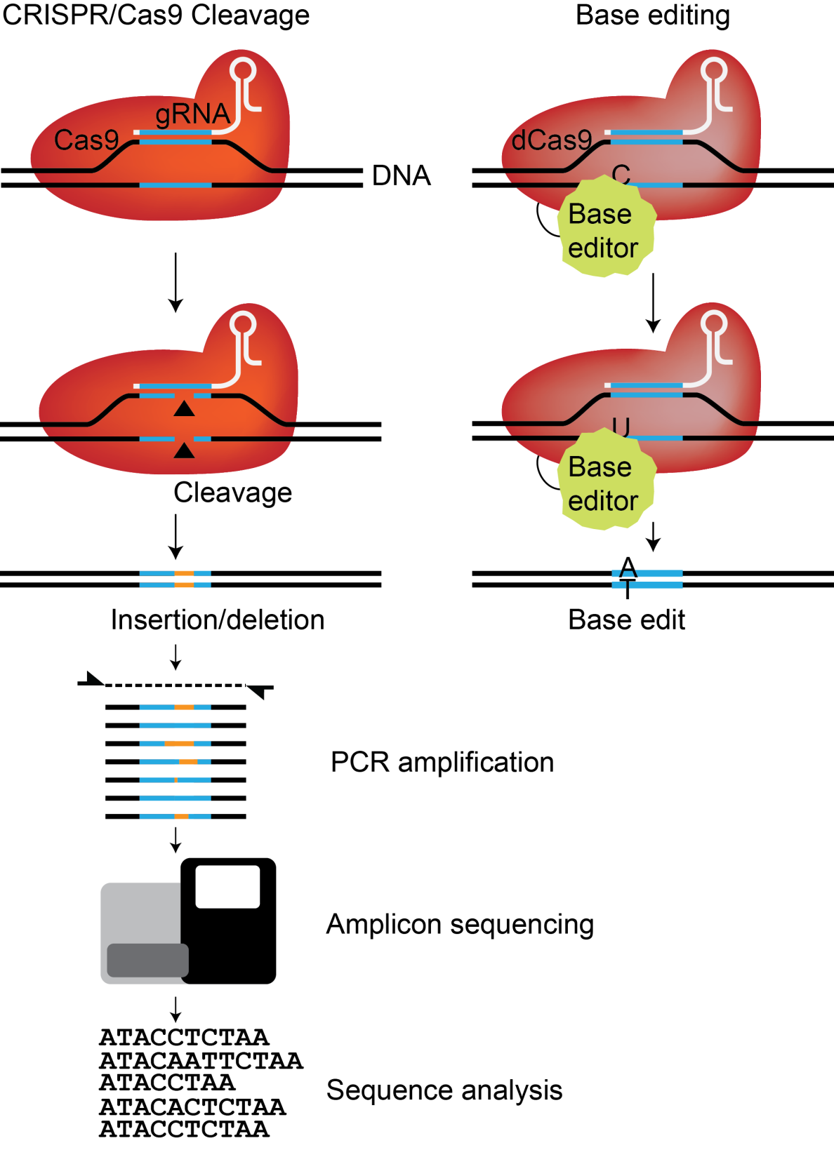
Targeted amplification and sequencing

Slide 40
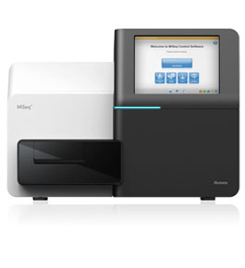
I got my deep-sequencing reads, now what?

Slide 41
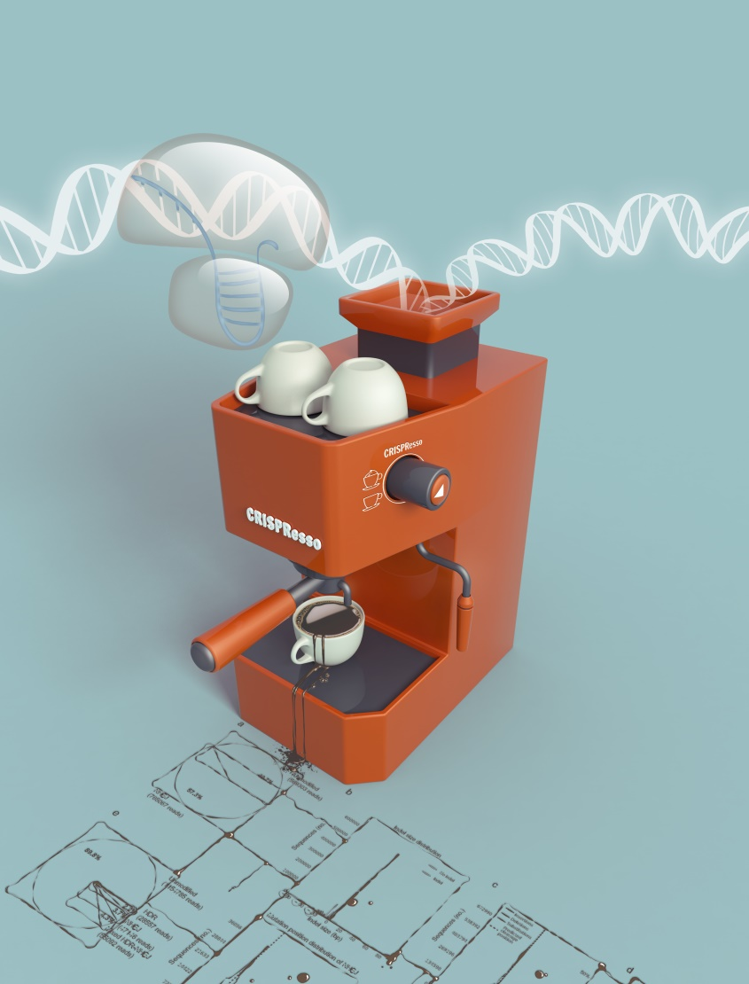


Sequencing analysis toolbox for CRISPR genome editing
Clement et al. Nature Biotech (2019)
Pinello et al., Nature Biotech (2016)

Slide 42
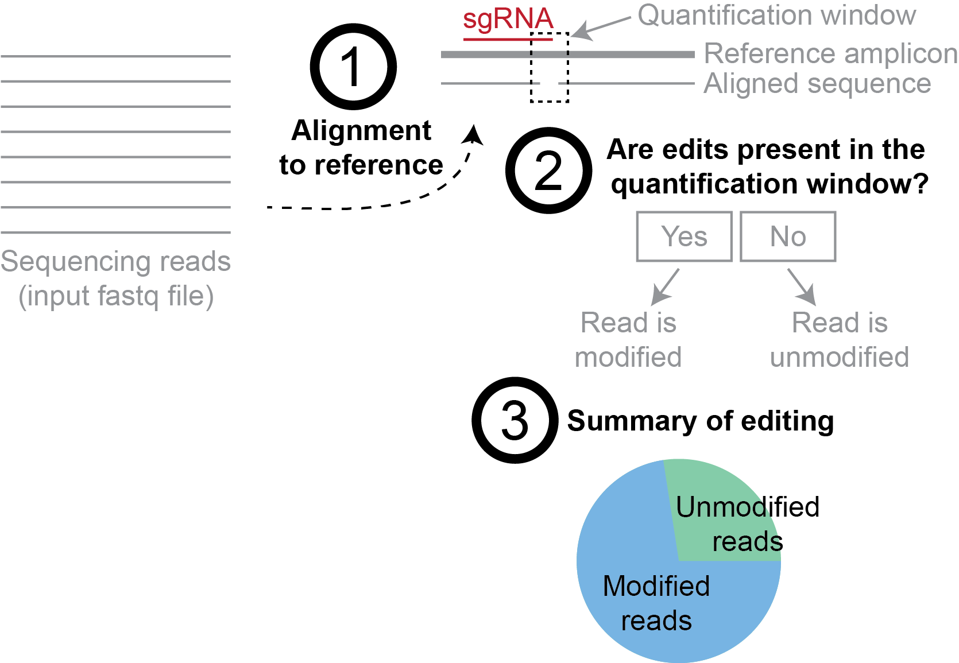

Quantification of edits with CRISPResso

Slide 43
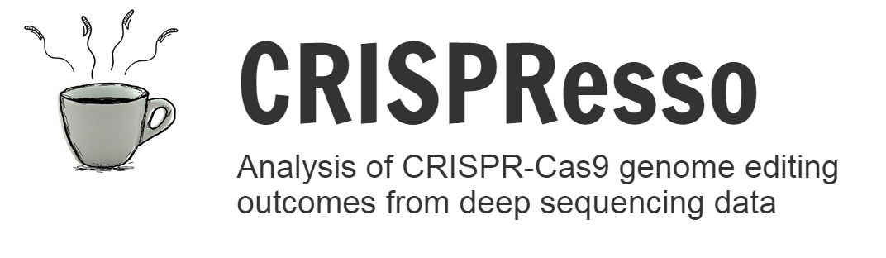
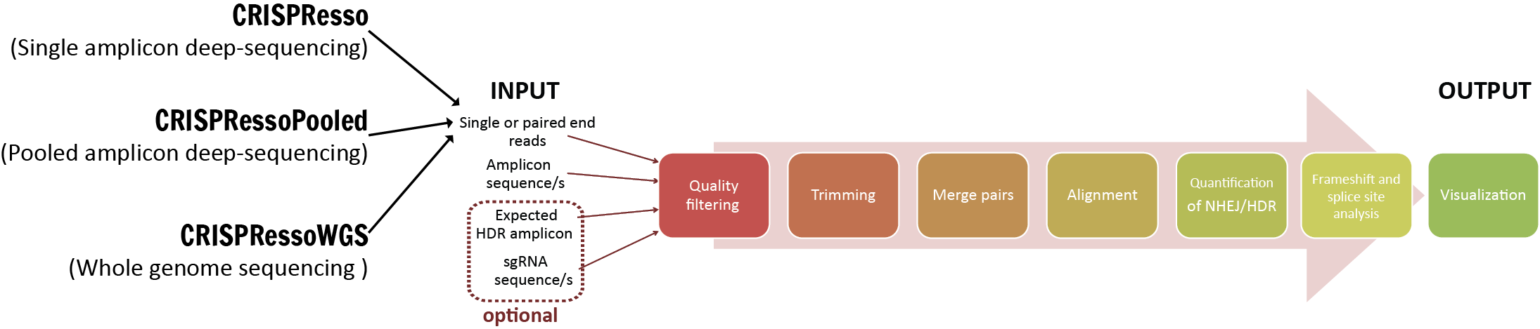

CRISPResso covers common sequencing strategies that are currently used to assess genome editing efficiency
Pinello et al. Nat Biotech (2016)

Slide 44
Quantification
  Recover indels and substitutions and map position to the reference amplicon, considering the strandedness
  Implement a window strategy to reduce false positive due to sequencing errors
  De-convolve reads in unmodified, NHEJ, HDR and mixed
  Frameshift analysis
  Error reporting and logging

Slide 45
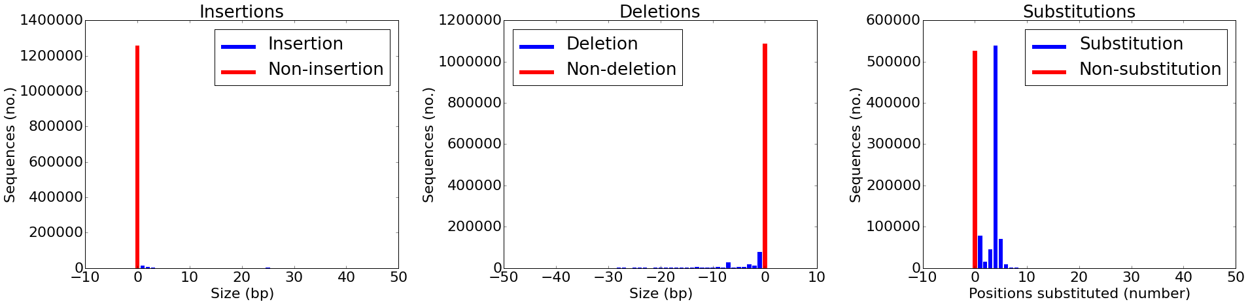
Indel size distribution

Slide 46
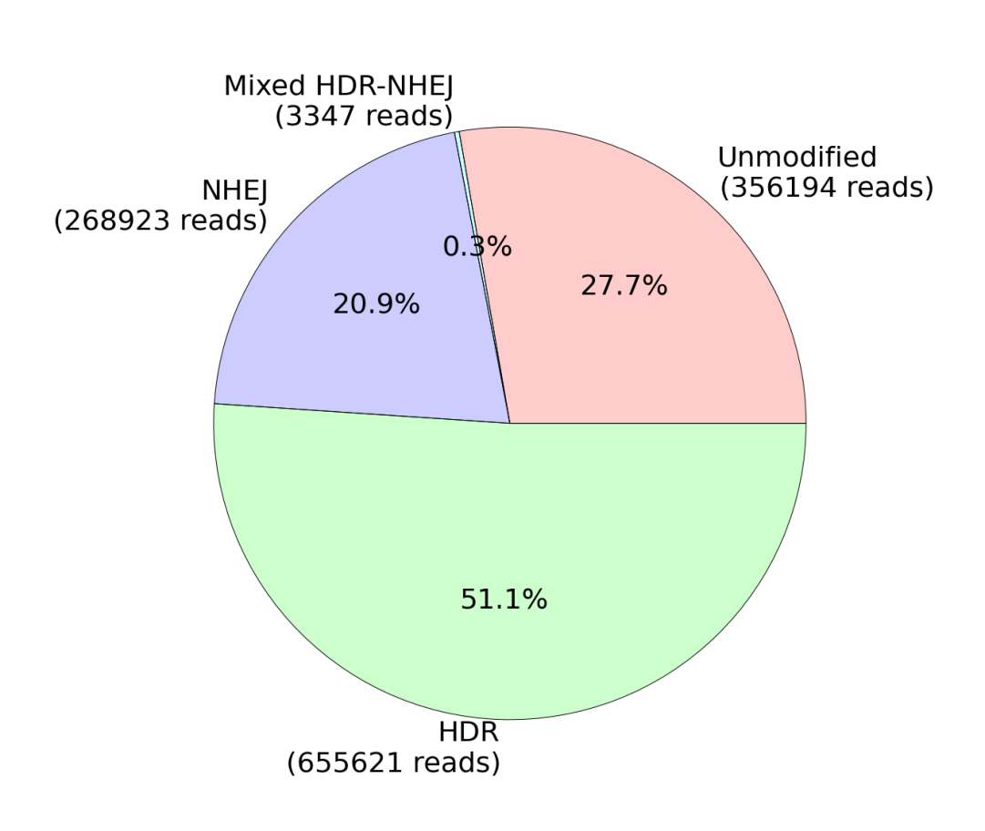
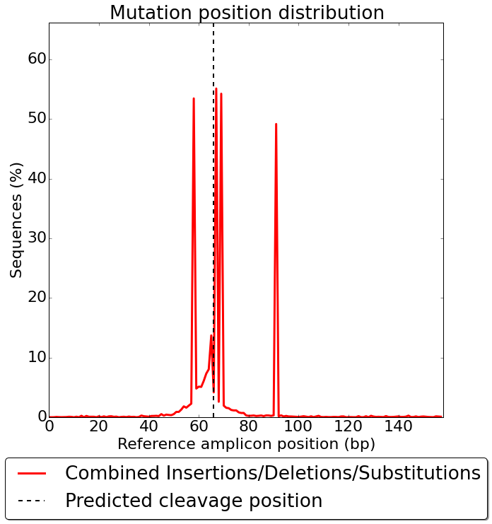
Quantification of editing frequency and location of mutation

Slide 47
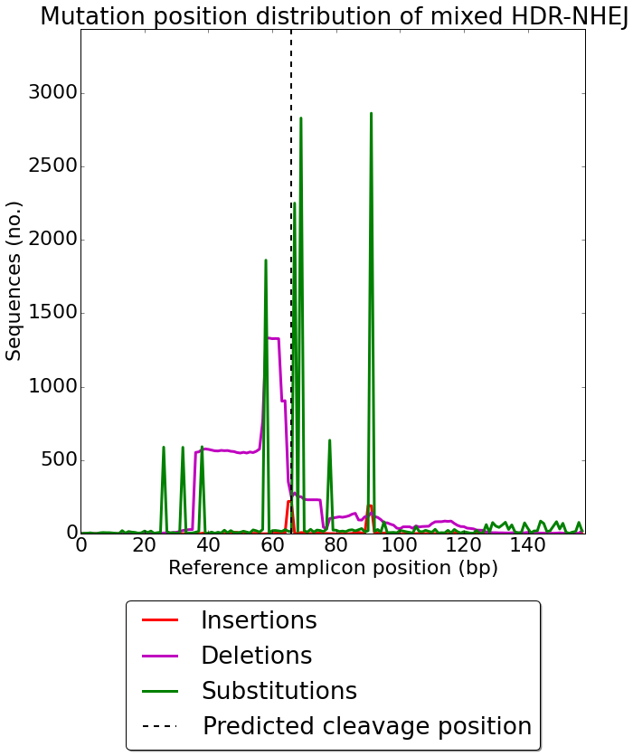
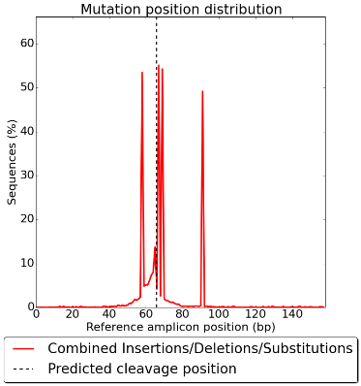
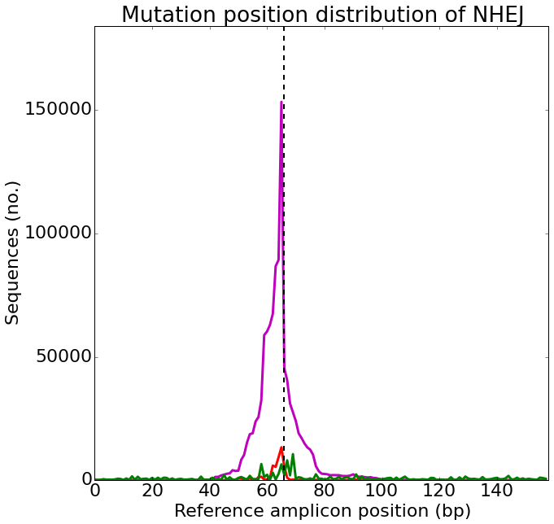

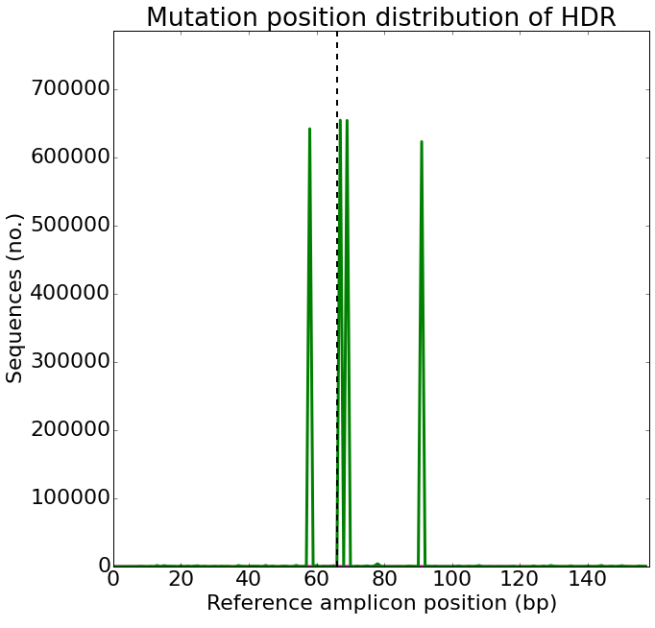
Precise location of mutation

Slide 48
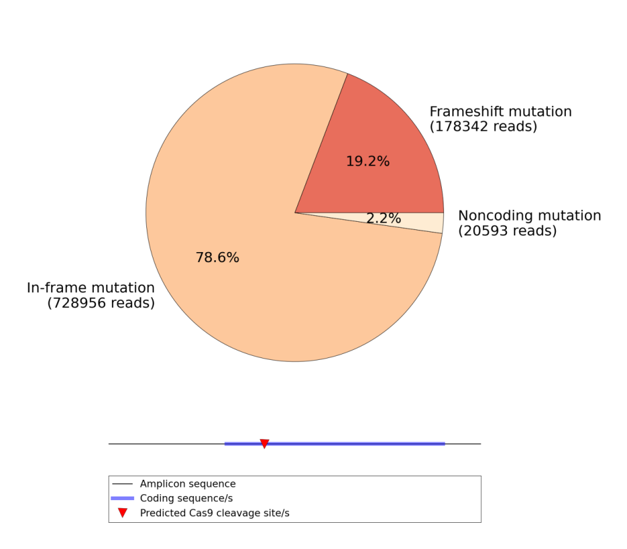
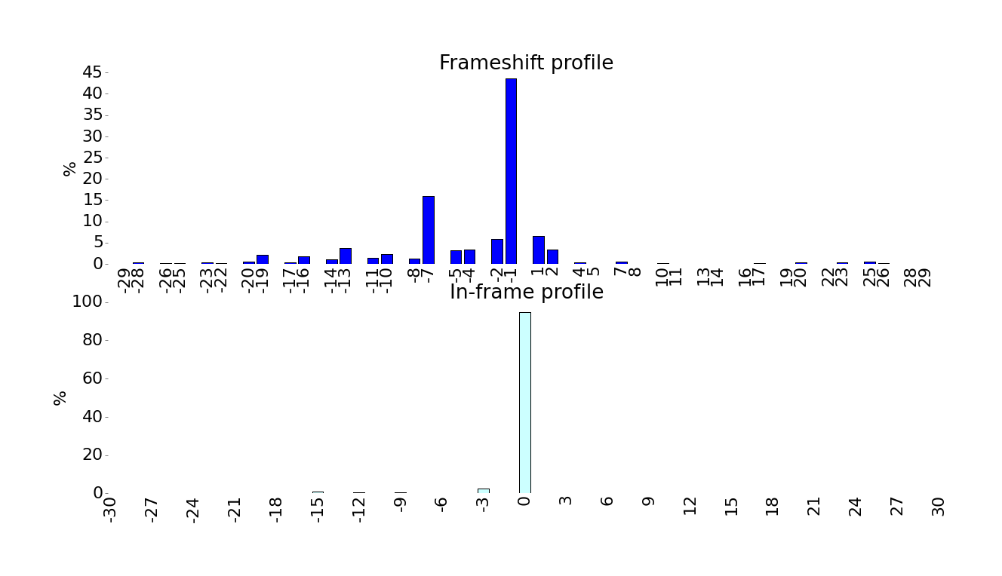
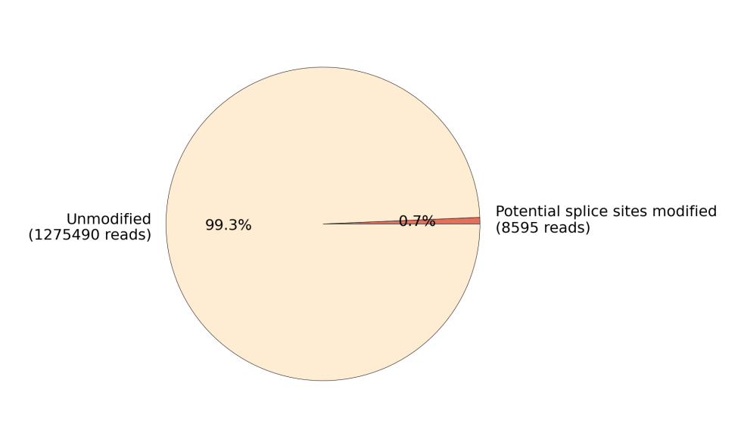
Frameshift and splice site analysis

Slide 49
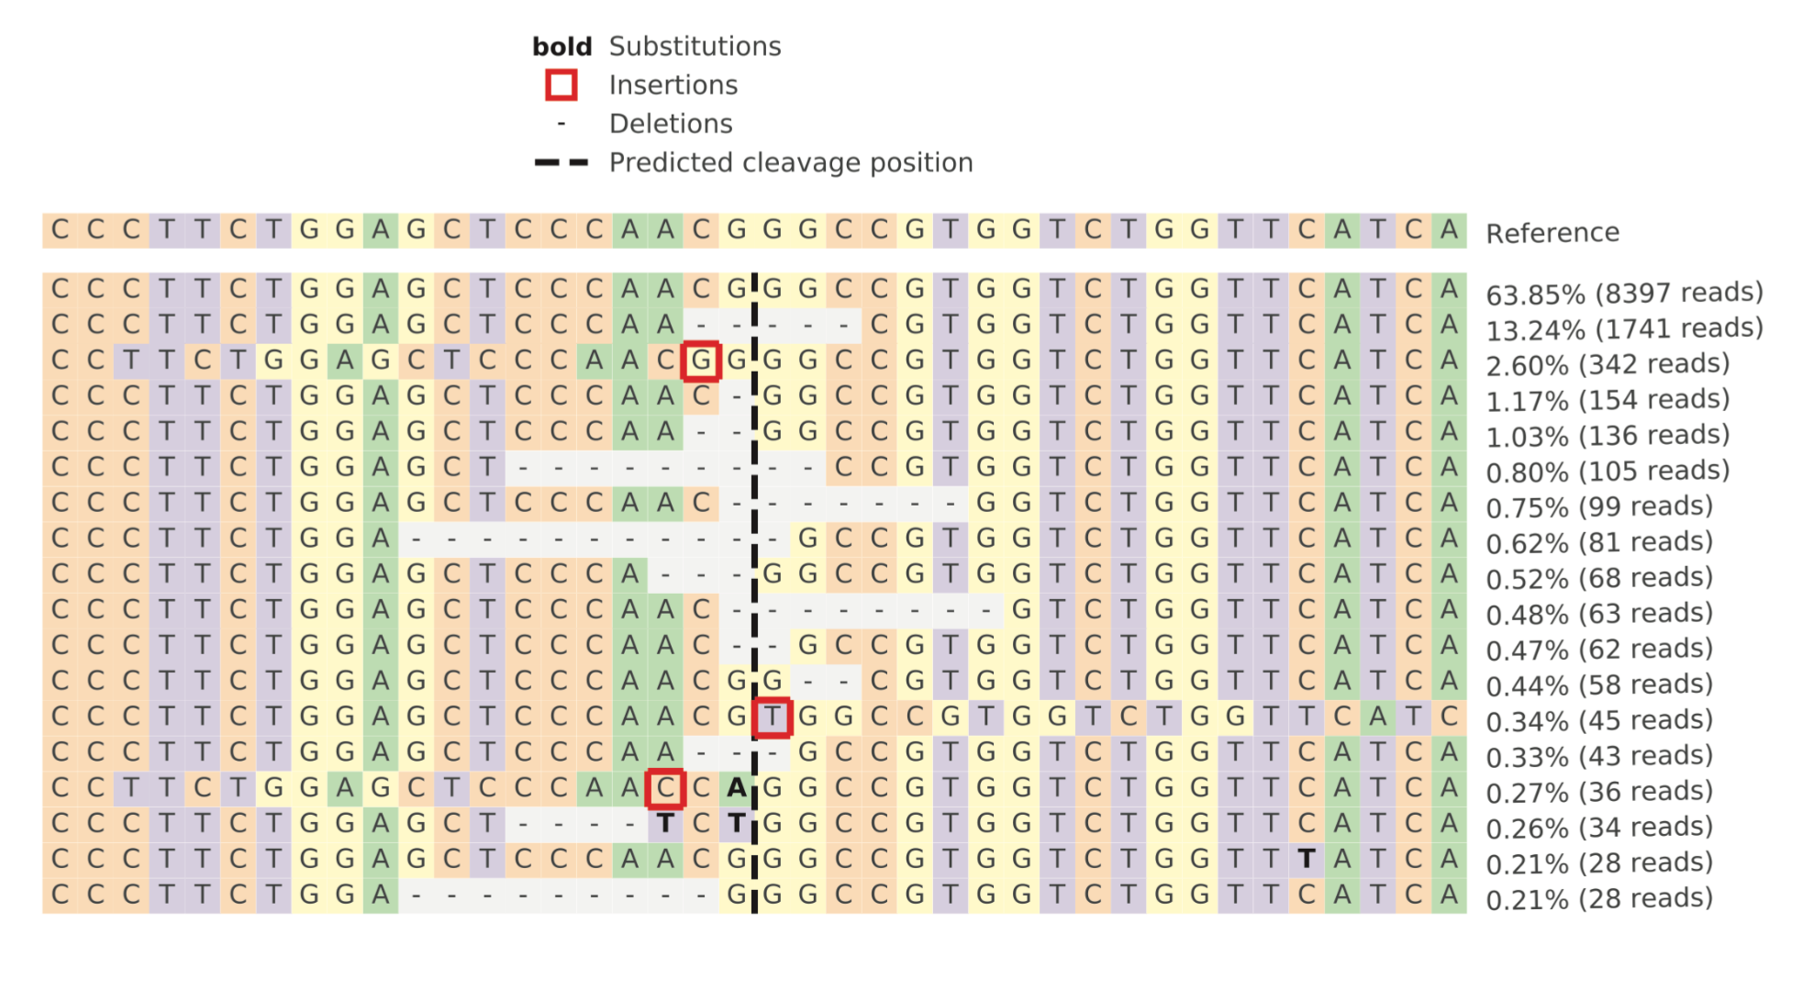
Alleles distribution

Slide 50
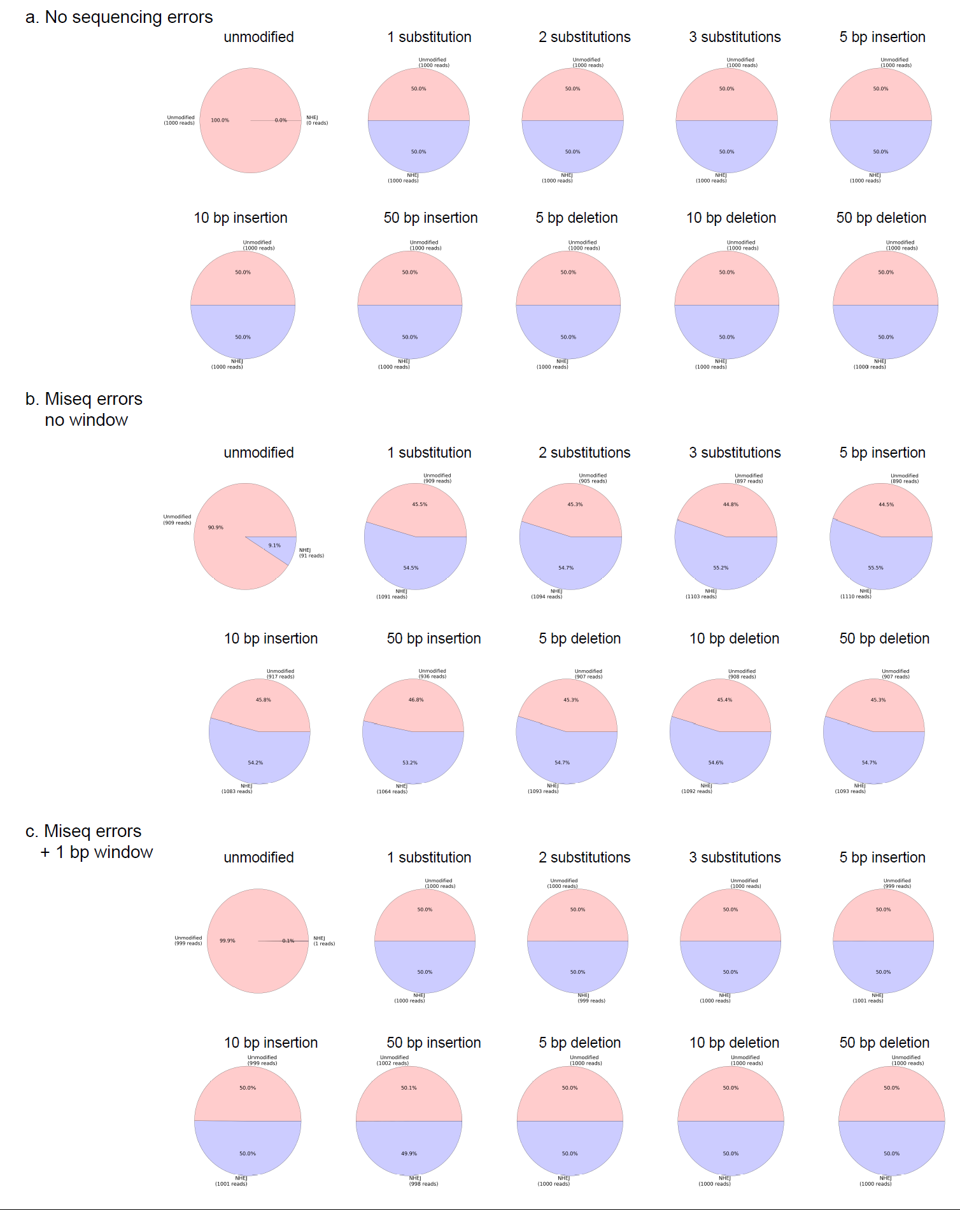
How to mitigate false positives due to sequencing errors?
We generated several simulated datasets with predefined editing efficiency and mutagenesis profiles:
1000 unmodified reads and
1000 modified reads (different insertions, deletions, substitutions) with and without sequencing errors

Slide 51
How to mitigate false positives due to sequencing errors?
5-9% false positives!
<=0.1% false positives

Slide 52




The evolution of CRISPResso
Kendell
Clement
Single amplicon
Pooled Amplicons & WGS data
Frameshift and splice site analysis
Multi-core supports
Possibility to subset the analysis based on
any combination of ins/del/sub
Single amplicon
Reduced false positive in the quantification of indels
Pooled Amplicons & WGS data
Ultra fast and biological informed alignment
Frameshift and splice site analysis
Support for Base editing
Multi-core supports
Support for Prime Editing
Possibility to subset the analysis based on
any combination of ins/del/sub
Single amplicon
Batch mode
Single amplicon
Pooled Amplicons & WGS data
Reduced false positive in the quantification of indels
Allele Specific Quantification

Slide 53
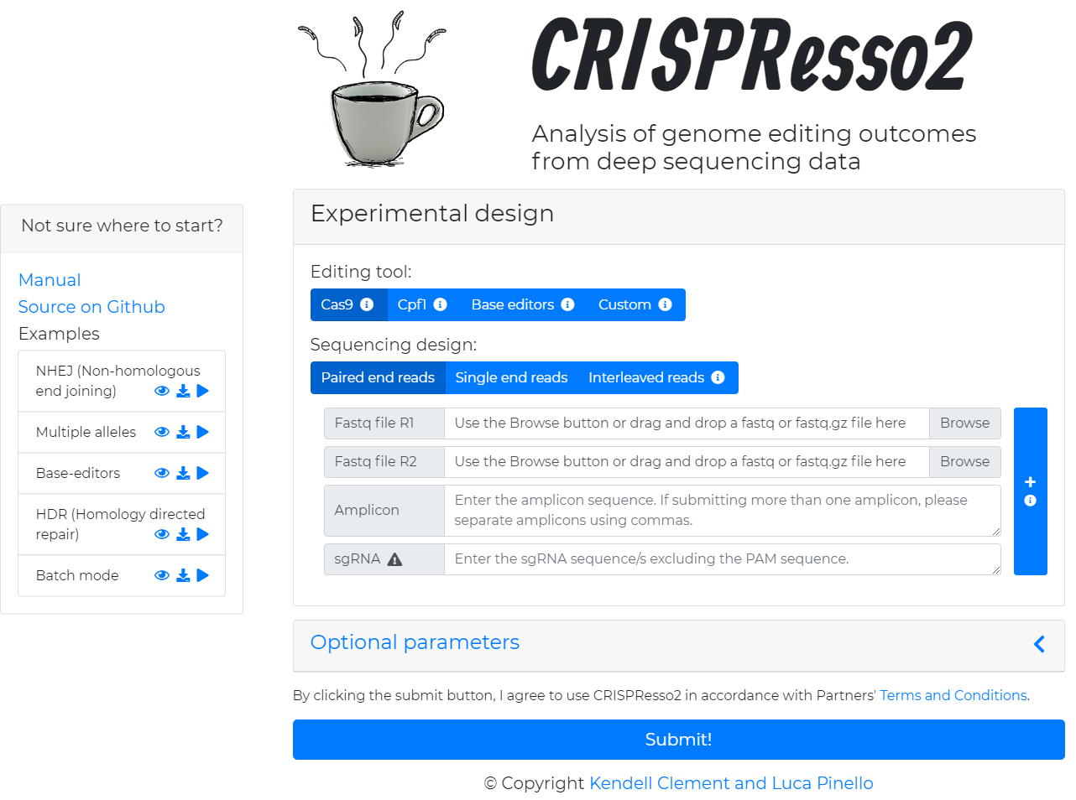
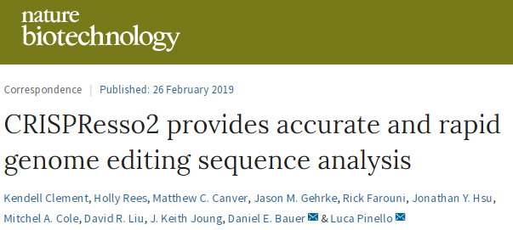
Kendell
Clement
Comprehensive analysis of sequencing data from base editors and prime editors
Batch mode for analyzing and comparing multiple editing experiments
Allele-specific quantification of heterozygous or polymorphic references
Biologically-informed alignment algorithm
Ultrafast processing time

Slide 54
http://crispresso2.pinellolab.org

Slide 55
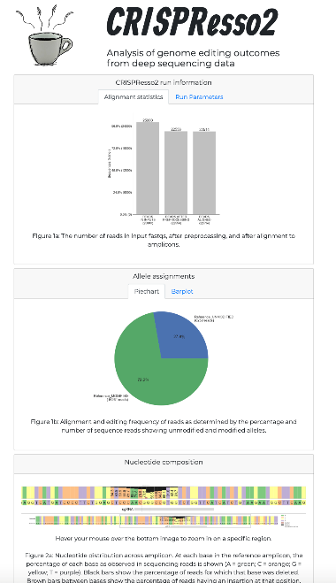
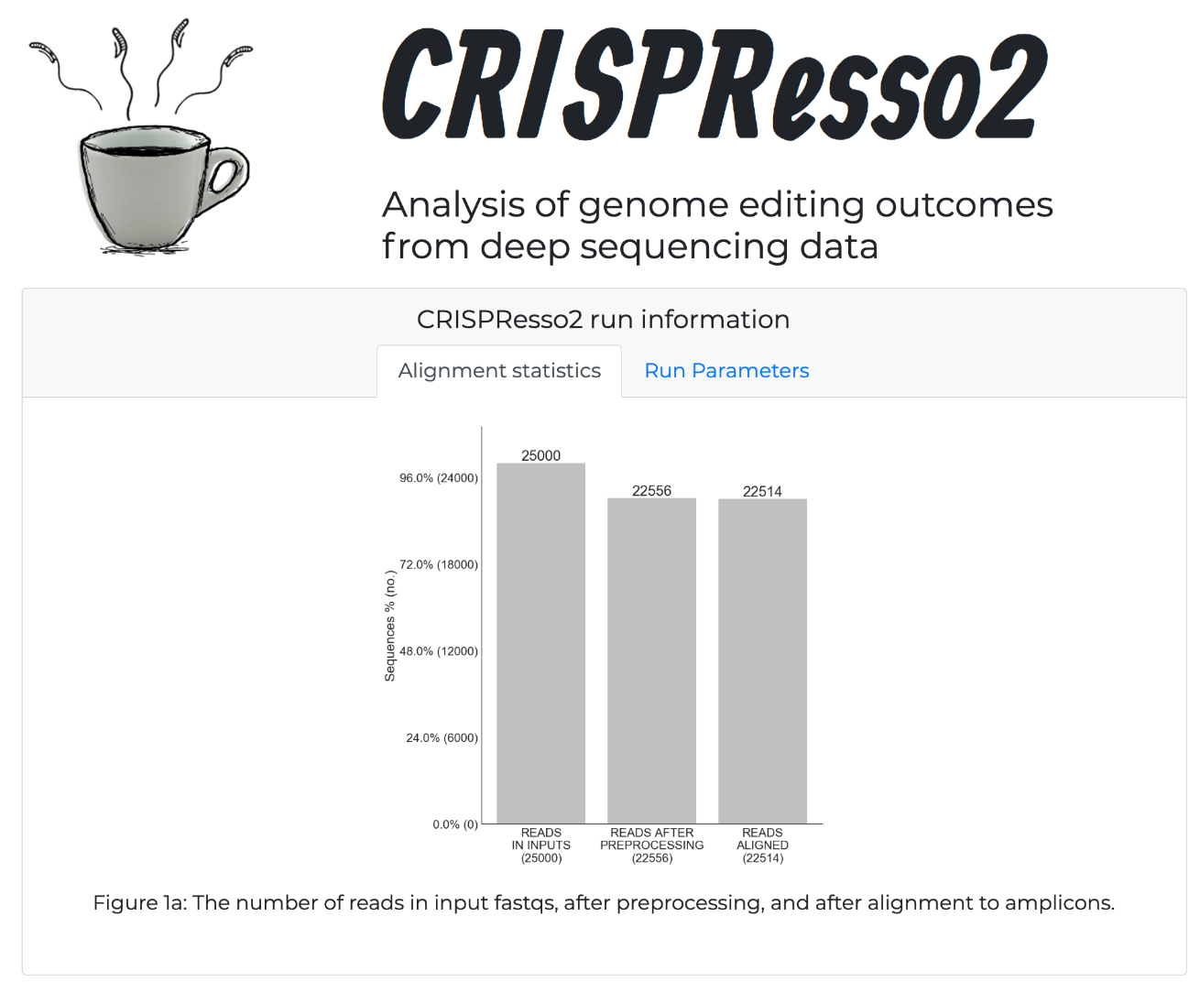
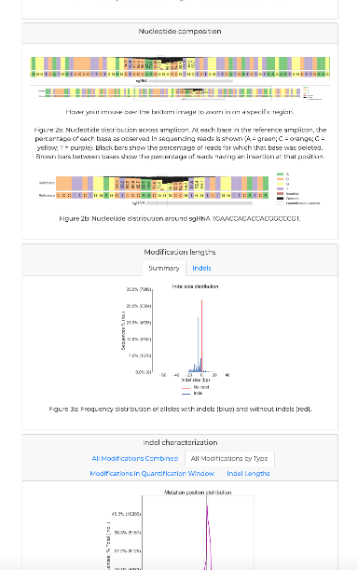
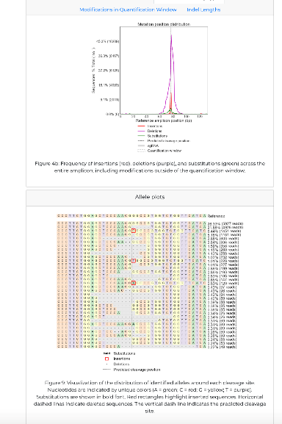
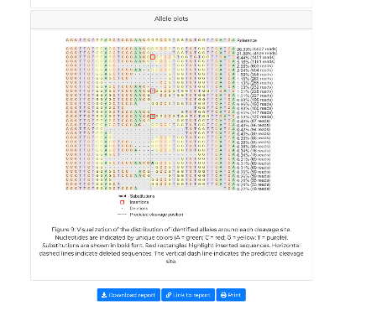

Slide 56
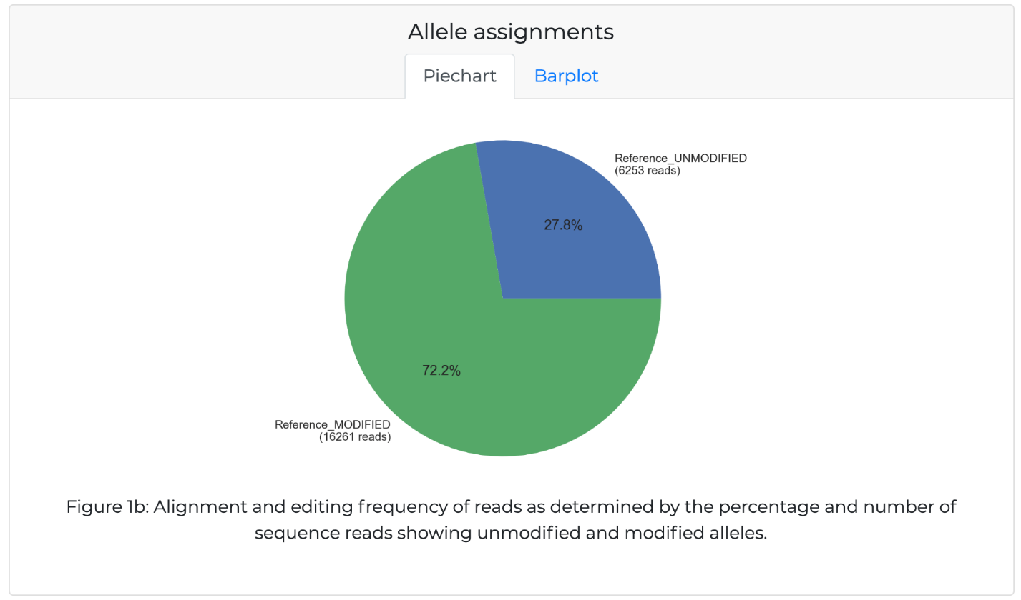

Slide 57


Slide 58


Slide 59


Slide 60

CRISPResso2 tools

Slide 61

Batch mode & support for base editors
C to T conversion percentage
Nucleotide distribution
BE4
EMX1 locus
EMX1 locus

Slide 62

Allele-specific analysis
Key Idea: Disrupt the allele associated with retinitis pigmentosa
Pinello et al. The CRISPR Journal. (2018)
Notes:
Allele-specific editing outcomes of SaCas9-KKH editing of the (Li, P. et al. The CRISPR Journal. 2018). A schematic of the two alleles is shown as well as the sgRNA sequence (top left). Reads (left) can be assigned to each allele using CRISPResso2 (right) to achieve accurate quantification of genome editing at genomic loci with multiple alleles. The pie chart (top right) shows the assignment of each read to the wild-type (red and dark blue) allele or to the P23H allele (yellow and light blue). Ambiguous alignments that could not be attributed uniquely to one of the alleles (e.g., due to a deletion at the SNP location) are shown in purple.

Slide 63

Comparison of samples

Slide 64

CRISPRessoCompare

Slide 65




CRISPResso2 summary
CRISPResso2 is an intuitive tool for quantification and visualization of genome editing sequencing data
  Website http://crispresso2.pinellolab.org
  https://github.com/pinellolab/CRISPResso2

Slide 66

Questions

Slide 67
Workshop
In this workshop we will cover:
Quantification of CRISPR/Cas9 and base editing from deep-sequencing data with CRISPResso: https://crispresso.pinellolab.partners.org/
Quantification of CRISPR/Cas9 editing from Sanger sequencing data with ICE: https://ice.synthego.com/

Slide 68
Strategy and Design of Pooled CRISPR Screens
ISMB 2022
Basheer Becerra

Slide 69

The big picture: typical workflow prior to CRISPR screen
Notes:
So first to now is that guide design is just one part with the preparation required prior to CRISPR screens. Though each step does inform how guide design is done. One thing to note is that this workflow can involve the integration of computational and experimental preparation, and each informs each-other. So while I will focus on the computational aspects in this lecture, I will still introduce necessary concepts of the experimental workflow. Which may be helpful if you are doing both computational and experimental aspects or collaborating with someone else doing the experiments.
Initially, the first step is identifying your targets which is of course dependent on the experimental question. You should also have some sense of how you want to interrogate your targets. Perhaps you want to knockout or knockdown these genes, or over-express, or mutate a certain region within the gene, again depending on the experimental question.
CFD review paper: https://www.nature.com/articles/nbt.3437
Rational design of highly active sgRNAs for CRISPR-Cas9-mediate gene inactivation: https://pubmed.ncbi.nlm.nih.gov/25184501/
Indelphi: https://www.ncbi.nlm.nih.gov/pmc/articles/PMC6517069/
BE-Hive: https://www.sciencedirect.com/science/article/pii/S0092867420306322
CRISPOR: https://www.ncbi.nlm.nih.gov/pmc/articles/PMC6030908/, https://genomebiology.biomedcentral.com/articles/10.1186/s13059-016-1012-2

Slide 70

The big picture: typical workflow prior to CRISPR screen
Notes:
Along with informing how the guides will be designed, this will mainly inform what CRISPR editor you want to use. Once this is known, the editor-expressing cell-line could start to be prepared as soon as possible since this process could take months especially if CRISPR isn’t already established in the lab.
Once the targets are known, next is the guide design, which I will focus on soon. After the guides are designed, the oligos with the guide sequences need to be ordered and synthesized. For effective guide deliver in cells, the guide oligos need to be cloned into a vector that contains other important elements for guide expression, for example a promoter. Then these oligo vectors are packaged in a delivery vector so that they may be integrated in cells – typically this is lentivirus. Of course, these last here steps are primarily experimental, though it can influence guide design and downstream analysis of the screen.
Especially if you have a large library of guides, it may be too expensive to start with the full library from the start, so it could be advisable to begin with a smaller pilot library or even just the positive controls guides. You could also get creative with the experimental design, such as starting with a smaller library of targets, then use the results of the smaller library to inform the targets for the full library.

Slide 71


The critical guide design component: protospacer + PAM
Protospacer
The guide RNA sequence for Cas9 binding, typically 20nt
PAM (“Protospacer Adjacent Motif”):
3’-flanking sequence fulfilling Cas9 PAM criteria (WT: -NGG)
Objective: design this guide oligo
Notes:
Now that we’ve covered the big picture, let’s start to focus on the guide design step. In all guide design, the most critical and fundamental step is to design your protospacer sequence, as this is what tells the Cas enzyme where to edit.
If you look at the illustration on the left, it shows Cas9 containing the guide RNA which is bound to the genomic DNA. To design the guide RNA sequence, we need to design the sequence that is bound to the genomic DNA, which is typically 20nt long. This is what is called the protospacer in orange that will need to be designed. Note that the orientation of the sequence is important, we won’t be designing the sequence in purple, but actually the reverse complement which is equivalent to what is in orange, in other words, the anti-sense orientation.
For Cas9, the edit occurs at around position 16 of the protospacer, and the position of the editing are different for different editors. Therefore, the protospacer will have to be designed keeping in mind of where the edit is expected to occur.
Another important consideration is the PAM sequence, or the protospacer adjacent motif. Just like it sounds, this is the sequence just right of the protospacer. A caveat of many editors is that they require a certain PAM for editing to occur, specifically an NGG PAM. This limits what loci can be targeted, and if you are using one of these NGG editors, you may need to filter out protospacers that do not contain an NGG PAM.
There do exist variants of editors that have reduced PAM restrictions, which extends what loci can be targeted. However typically, editing efficiency of these editors will greatly vary depending on what the PAM is. So if you want to design a few guides targeting a specific element, prioritizing guides that have an optimal PAM may be nice.
So in general, the final oligo sequence that you design for each guide will contain the protospacer that is will vary based on your targeted sequence, then the guide RNA hairpin which will be constant across all your guides.

Slide 72
The critical guide design component: protospacer + PAM
Considerations affecting guide design
Editor
Target Type
Unintentional Targets
Experimental Design
Objective: design this guide oligo
Notes:
So far, computationally generating the protospacer is relatively trivial. If you have the reference genome and the coordinates of where you want to target, it’s not too hard to pull candidate protospacer sequences – and we’ll cover the skills for doing this in the workshop. What’s more difficult is what do you want to target and in what way do you want to edit the target. Then there are technical considerations such as unintentional off-targets, or if there are SNPs in the region you want to target.
There are other considerations to be made with designing protospacers, specifically the editor, target-type, considering unintentional targets, and the experimental design of your guide library. Some of these considerations are subjective and based on the scientific question you want to ask, and some are just technical considerations that you should typically think about for all screens.

Slide 73

Considerations of guide design: editor
Impact on design:
Editing Type
Editing Resolution
Editing Efficiency
Knockout Strategy/Strength
Targeted Position
Guide RNA Scaffold
Notes:
The editor is probably the biggest consideration. Each editor performs different types of edits, for example.
Cas9 performs insertion and deletions, prime editing can insert or replace whole sequences, base-editor performs base substitutions. CRISPRi and CRISPRa are epigenetic editors, where CRISPRi silences the region while CRISPRa amplifies a region.
The effect resolution of these editors are different, for example, base editors can make precise base substitutions, while CRISPRi can silence a relatively large region.
The editing efficiency of the genomic editors can vary. While prime-editing could theoretically perform base substitutions by replacing a sequence with a modified sequence, the editing efficiency of prime editors are typically lower than base-editors.
The type, resolution, and efficiency can play a large role on how you want to knockout certain genes. Some editors may be better and knockout genes compared to others. Additionally, the certainty of knockout is different between editors, for example, Cas9 or CRISPRi edits may more certainly knockout a gene compared to base-editors, so in your guide design you may design more candidate guides to knockout a gene for base-editors compared to Cas9. Perhaps 5-10 guides per gene, compared to maybe 2-5 guides per gene for Cas9 or CRISPRi.
The position of the edit within the protospacer sequence is a technical consideration, for instance, Cas9 typically edits at position 16, whereas base-editors typically edits at position 6. [Expand on this, make more comprehensive]
Another technical consideration especially when designing an oligo and choosing a guide vector is difference in the whereas guide RNA scaffold. [Expand on this, make more comprehensive]
[Have a separate slide for each of the above considerations.]

Slide 74

Considerations of guide design: editor – Cas9
Edit
Performs insertions or deletions (ranging up to 10nt long)
Outcome
Frameshifts, binding site disruption
Advantages
Effective for gene knockout screens
Disadvantages
Unable to test precise alleles

Slide 75


Considerations of guide design: editor – CRISPRi/CRISPRa
Edit
“Epigenetic” edit for silencing or activation
Outcome
Decreased/increased DNA accessibility
Advantages
No DNA damage
Disadvantages
Requires maintained expression
May not be precise (1-2kb resolution)
Unable to test precise alleles

Slide 76

Considerations of guide design: editor – prime editing
Edit
“Search-and-replace” genomic editing
Outcome
Precise insertion of given sequence
Advantages
Able to test precise alleles and sequences
Disadvantages
Relatively low editing efficiency (~20-30%)

Slide 77
Considerations of guide design: editor – base editing
Edit
Deamination of cytosine or adenine
Outcome
C->T or A->G transition mutation
Advantages
Installation of transition mutation at relatively high efficiency
Disadvantages
Bystander affects of neighboring C/As
Potential toxicity from spurious RNA deamination

Slide 78

Considerations of guide design: target type
Notes:
The target type and how you want to edit the target will influence the guides you design.
For enhancers, these may be designed based on epigenetic profiling such as ChIP-seq of a transcription factor, histone marks, of enhancer activity, DNA accessibility, enrichment of non-coding GWAS variants, etc, therefore how you target these enhancers are subjective and may heavily be based on orthogonal epigenetic data.
For instance, to see the affect of enhancers, you may design 2-5 CRISPRi guides directly on ChIP-seq or accessibility peak coordinates.
For coding sequences, this may be to induce a frameshift for protein disruption, deleting or disrupting a specific protein domain to assess its function, or installing a non-synonymous variant to assess its affect.

Slide 79


Considerations of guide design: target type – non-coding
1. Guide Design from Epigenetic Profiling
2. “Multi-level” non-coding screening
See Canver et al., Nature (2015) for example
Notes:
The target type and how you want to edit the target will influence the guides you design.
- When talking about the multi-level, can talk about the different editors and their resolutions.
For enhancers, these may be designed based on epigenetic profiling such as ChIP-seq of a transcription factor, histone marks, of enhancer activity, DNA accessibility, enrichment of non-coding GWAS variants, etc, therefore how you target these enhancers are subjective and may heavily be based on orthogonal epigenetic data.
For instance, to see the affect of enhancers, you may design 2-5 CRISPRi guides directly on ChIP-seq or accessibility peak coordinates.
For coding sequences, this may be to induce a frameshift for protein disruption, deleting or disrupting a specific protein domain to assess its function, or installing a non-synonymous variant to assess its affect.

Slide 80

Considerations of guide design: target type – gene
Guide Design from Gene Annotation
Notes:
The target type and how you want to edit the target will influence the guides you design.
For exon deletion
- Can look at primedel for precise deletions (Jay Shendure), the other from John Doench for two-guide vector construct to look at interactions.
- There is paper that introduce stop codon, base-editing.
For enhancers, these may be designed based on epigenetic profiling such as ChIP-seq of a transcription factor, histone marks, of enhancer activity, DNA accessibility, enrichment of non-coding GWAS variants, etc, therefore how you target these enhancers are subjective and may heavily be based on orthogonal epigenetic data.
For instance, to see the affect of enhancers, you may design 2-5 CRISPRi guides directly on ChIP-seq or accessibility peak coordinates.
For coding sequences, this may be to induce a frameshift for protein disruption, deleting or disrupting a specific protein domain to assess its function, or installing a non-synonymous variant to assess its affect.

Slide 81
Considerations of guide design: unintentional targets

Slide 82


Considerations of guide design: off-targets
Off-targets arise from genomic sequences similar to the on-target, resulting in activity
Due by chance or by homology
A
B
Off-target activity depends on (A) number of mismatches
and (B) mismatch type
Notes:
Mention that editing activity influenced by complementarity

Slide 83

Considerations of guide design: off-target prediction
Popular off-target prediction method, “CFD” (cutting frequency determination)
Doench et al., Nat Biotech (2016)
For ground-truth determination of off-targets (i.e. therapeutics), perform off-target assay:
GUIDE-seq (Tsai et al., Nat Biotech 2015)
rhAmpSeq (IDT)
UDiTaS (Giannoukos et al., BMC Genomics 2018)
Notes:
Mention that editing activity influenced by complementarity
Checkout review molecular cell kendall on off-target. Nice figure to include.

Slide 84


Considerations of guide design: endogenous variants
Genetic variation in human population, patients, and cell-lines can cause:
If VCF available for patient or cell-line, can be used for correction
Can perform CRISPRme guide design to consider population-level variants
Human genetic diversity modifies therapeutic gene editing off-target potential
Notes:
Discuss CRISPRme when talking about variants -> especially for therapeutic application for genetic variants.

Slide 85

Considerations of guide design: experimental design
Most important experimental design aspects:
Editor
Readout
System
Controls
Notes:
Luca: Can discuss the scale of the experiment

Slide 86


From protospacer to guide oligos to guide vector
1. Oligo Design/Synthesis
Oligo Synthesis Services
Genewiz
IDT
Twist
2. Guide Vector Cloning

Slide 87

From protospacer to guide oligos to guide vector
How large can the oligo be?
Enough to fit protospacer, other variable sequences, and homology arms for cloning.
Financial consideration (smaller oligos are cheaper)
How many guides can I have?
Depends on experimental design
Financial consideration (less guides is cheaper)
Twist oligo pool order price specification FYI
Notes:
Along with discussing cost, can also discuss the timeline for each steps.

Slide 88


From guide vector to guide-expressing cells
1. Library Cloning
2. Lentivirus Packaging

Slide 89


How to get editor-expressing cells: standard two-vector setup
1. Choose editor and guide vectors:
2. Prepare editor-expressing cells
“pLentiCas9-Blast”
3. Prepare guide-expressing cells from editor-expressing cells
“pLentiGuide-Puro”
Sanjana et al., Nat Methods 2014
Notes:
TODO: Add Annotation on vector, animate the annotations

Slide 90

How to get editor-expressing cells:
standard two-vector setup
1. Choose editor and guide vectors:
2. Prepare editor-expressing cells
“pLentiCas9-Blast”
3. Prepare guide-expressing cells from editor-expressing cells
“pLentiGuide-Puro”
Sanjana et al., Nat Methods 2014
Notes:
TODO: Add Annotation on vector, animate the annotations
Perhaps discuss number of cells needed as another benefit of having smaller libraries.

Slide 91
RECAP:
The big picture: typical workflow prior to CRISPR screen
Notes:
Along with informing how the guides will be designed, this will mainly inform what CRISPR editor you want to use. Once this is known, the editor-expressing cell-line could start to be prepared as soon as possible since this process could take months especially if CRISPR isn’t already established in the lab.
Once the targets are known, next is the guide design, which I will focus on soon. After the guides are designed, the oligos with the guide sequences need to be ordered and synthesized. For effective guide deliver in cells, the guide oligos need to be cloned into a vector that contains other important elements for guide expression, for example a promoter. Then these oligo vectors are packaged in a delivery vector so that they may be integrated in cells – typically this is lentivirus. Of course, these last here steps are primarily experimental, though it can influence guide design and downstream analysis of the screen.
Especially if you have a large library of guides, it may be too expensive to start with the full library from the start, so it could be advisable to begin with a smaller pilot library or even just the positive controls guides. You could also get creative with the experimental design, such as starting with a smaller library of targets, then use the results of the smaller library to inform the targets for the full library.

Slide 92


Don’t reinvent the wheel: available Cas9 genome-wide guide libraries
Rule Set 1 Model: Doench et al., Nat Biotechnology 2014
GeCKOv2: Doench et al., Nat Biotechnology 2016
GeCKOv2: Genome-wide CRISPR-Cas9 library
6 sgRNAs per gene – targeting constitutively expressed exons
hCRISPRi-v2: Genome-wide CRISPRi library
hCRISPRa-v2: Genome-wide CRISPRa library
Notes:
https://elifesciences.org/articles/19760
LEFTOFF: Look for more public libraries

Slide 93


Available guide design computational tools: activity prediction
BE-Hive: Base-Editor Prediction
Indelphi: Cas9 Nuclease Prediction
Arbab et al., Cell 2020
Shen et al., Nature 2020
Notes:
Luca has slides on this that I can reuse: discusses CRISPOR, consideration of different tools,
Can touch that some of these preparation effects can introduce batch effects – will be focused in Jayoung’s lecture.
Might be tool from Neville S for getting guides from previous screens

Slide 94



Available guide design computational tools: guide generation
Human genetic diversity modifies therapeutic gene editing off-target potential
Notes:
CRISPOR and CRISPRpeak on this slide
- Start from CRISPRpeak, CRISPOR, CRISPRme.

Slide 95
Questions?
Notes:
May add slide on suggestions for review
I.e. the Weissman high content screening review paper, the doench off-target and on-target paper, some of the Pinello labs reviews, etc.

Slide 96

Workshop:
Choose either option: Application or Programmatic
Application
  Design guides targeting BCL11A using CRISPOR and CRISPRme
Programmatic
  Using preferred language, design guides tiling the ZNF410 locus using Colab
https://bit.ly/3OMT1b0
Copy to your Google Drive to start:
Notes:
Check out https://github.com/lucapinello/CRISPR-meets-Docker
- All command line.
CIRPSRpick: https://portals.broadinstitute.org/gppx/crispick/public
TODO: Add one slide on the workshop description.

Slide 97
Analysis of pooled CRISPR screens
ISMB 2022
Jayoung Ryu

Slide 98
Contents
Different types of screens
  Genetic element: gene, enhancer, coding sequence, variants, ...
Quality control of data
Guide read count mapping
  Bowtie, MAGeCK count
Guide/targeted element enrichment calculation
  Mean log fold change, DESeq2, MAGeCK-RRA, MAGeCK-MLE, CRISPhieRmix, ....

Slide 99
Bulk CRISPR screens
Identifying causal genetic elements that causes changes in phenotype of interest
Genetic elements
Enhancer/cis-regulatory elements (CRISPRi)
Specific part of enhancer (CRISPRi)
Gene (Cas9)
Coding/noncoding variants (Base editor)
Phenotype of interest
Gene expression (CRISPR-FlowFISH)
Survival
→ Guide design, CRISPR-Cas system
→ Selection

Slide 100

Case study (1) Toronto Knock-Out (TKO)
Hart et al., Cell (2015)
  Goal: identify essential genes for all cell types
  System: Genome-wide knock-out (Cas9) screen across 6 human cell lines
  Guide design: Each gene exon was assigned with 6 guides without off-targets
  Selection: Fitness screen, sampling 0, 6, 12, 15, 18 days after transfection
Notes:
Figure from the paper and main conclusions

Slide 101

Case study (2) CRISPRi-FlowFISH
Fulco et al., Nature Genetics (2019)
  Goal: identify functional enhancers that regulate specific gene’s expression
  System: CRISPRi (KRAB-dCas9) screen
  Guide design: Each candidate enhancer is targeted with many gRNAs (median n=55)
  Selection: FACS sorting by FISH signal into 6 sorting bins
Notes:
Figure from the paper and main conclusions

Slide 102

Case study (2) CRISPRi-FlowFISH
Fulco et al., Nature Genetics (2019)
  Goal: identify functional enhancers that regulate specific gene’s expression
  Guide design: Each candidate enhancer is targeted with many gRNAs (median n=55)
Notes:
Figure from the paper and main conclusions

Slide 103

Bulk CRISPR screens
Selected library
treatment
Guide infection/
selection
Genome editing
survival(cell viability) screen
FACS sorting
Plasmid library
Cas enzyme transfected cells
Pre-sort(bulk)
Phenotype
Sorted library

Slide 104
Bulk CRISPR screens
Selected library
treatment
Guide infection/
selection
Genome editing
survival(cell viability) screen
FACS sorting
Plasmid library
Cas enzyme transfected cells
Library design
  Known sgRNA – gene mapping
  Tiling screen
Pre-sort(bulk)
Phenotype
Sorted library

Slide 105
Analysis steps
Guide→target assignment
.fastq file
Guide read count
Guide/gene enrichment
Read mapping
Enrichment calculation
Sequencing
Bowtie2
MAGeCK count
MAGeCK
DESeq2
QC
MAGeCK-VISPR

Slide 106
Analysis steps
Guide→target assignment
.fastq file
Guide read count
Guide/gene enrichment
Read mapping
Enrichment calculation
Sequencing
Bowtie2
MAGeCK count
MAGeCK
DESeq2
QC
MAGeCK-VISPR

Slide 107

NGS Sequencing
index
(demultiplex)
Promoter
(fixed)
gRNA spacer
(variable)
sgRNA hairpin
(fixed)
Notes:
Show the raw sequencing data

Slide 108


QC
Sequence
  Usual NGS sequence quality control- FastQC
Read count
Sample
Gene / targeted element
(MAGeCK-VISPR, 2015)

Slide 109
Analysis steps
Guide→target assignment
.fastq file
Guide read count
Guide/gene enrichment
Read mapping
Enrichment calculation
Sequencing
Bowtie2
MAGeCK count
MAGeCK
DESeq2
QC
MAGeCK-VISPR

Slide 110
Read mapping
Map the gRNA spacer to your library of sgRNAs to get read counts
Considerations:
  How many mismatch do I want to allow?
    Start with 0 mismatch, usually up to 1
  Base editing screen: should allow for base edits
Input
Two methods
  MAGeCK (mageck count)
    Automatically determines gRNA spacer start/end
  Classic read mapping methods (ex. bowtie)
    Requires read trimming based on known start/end position or sequence
spacer

Slide 111


QC
Guide count distribution
Sequence
Read count
  % mapped reads > 65%
  Library diversity
    Gini index across gRNAs (< 0.1 before selection, <0.2 after)
    Variance of read counts
    # of guides without any reads (<1%)
  Mean/median read count
Sample
  Guide count correlation (>0.8 for replicates)
Gene / targeted element
Sample correlation
MAGeCK-VISPR (2015)
Notes:
PCR
How many cells -> reads?
How many genomes per guide?
UMI?

Slide 112
Analysis steps
Guide→target assignment
.fastq file
Guide read count
Guide/gene enrichment
Read
mapping
Enrichment
Calculation
Sequencing
Bowtie2
MAGeCK count
MAGeCK
DESeq2
QC
MAGeCK-VISPR

Slide 113
Analysis steps
Known guide → gene/variant assignment
  Genome-wide K/O screen
Unknown guide → gene/variant assignment
  Noncoding element tiling screen
Guide→target assignment
.fastq file
Guide read count
Guide/gene enrichment
Read
mapping
Enrichment
Calculation
Sequencing
Bowtie2
MAGeCK count
MAGeCK
DESeq2
QC
MAGeCK-VISPR

Slide 114
Enrichment calculation
Baseline approach: mean log fold change calculation per guide
Calculate guide read fraction per sample
Get log fold change per guide between treatment / control
  Recommend removing guides with too small number of reads in both samples or add pseudocounts
Get the mean or median of the log fold change
Guides that target gene A
Mean LFC of gene A = 1.25
LFC(p_{treat}/p_{ctrl})

Slide 115


Enrichment calculation
Boodapati et al., Genome Biology (2020)
Recommends MAGeCK-RRA for most cases
MAGeCK-RRA doesn’t work well with highly variable guide editing efficiency → Use CRISPhieRmix
Notes:
RSA: similar to RRA
HiTSelect: guide activity=log fold change. Dual objective of overall gene LFC and proportion of enriched guides that targets the gene.

Slide 116
Other analysis methods: strengths & limitations
(Boodapati et al., Genome Biology (2020))
DESeq2 per each guide and t-test against control
  Should have multiple guides per gene and negative controls
RSA, MAGeCK RRA:
  Assume uniform distribution of log fold change of guides.
  Requires multiple guides per gene
  Only gives you the p-value
MAGeCK MLE
  Generalized linear model to fit the condition-specific coefficient
BAGEL:
  Based on the log fold change distribution of the ‘truth set’ of essential & non-essential genes
  Depends on the truth set, only for the genome-wide KO survival screen
CERES
  With the data from multiple cell line, regress out the cell line specific effect
  Requires multiple screen data to different cell lines with known and distinct copy number profiles.
CRISPhieRmix
  Fit gRNA enrichment as mixture distribution vs null distribution
  Only gives the FDR, not the effect sizes
JACKS
  Models LFC as normal distribution, mainly designed for more robust inference by combining multiple samples.
Notes:
RSA: similar to RRA
HiTSelect: guide activity=log fold change. Dual objective of overall gene LFC and proportion of enriched guides that targets the gene.

Slide 117


Enrichment calculation
Baseline approach: mean log fold change calculation per guide
Calculate guide read fraction per sample
Get log fold change per guide between treatment / control
Get the mean or median of the log fold change
Has been handled by DE analysis methods for count data!
DESeq2
limma
voom
...
$$y_{gj} \sim NB\left(s_{j}p_{gj}, φ\right)$$
$$p_{gj}=β_{0}+β_{1g}x_{j}$$
$y_{gj}$: guide counts at sample j
$x_{j}∈\{0, 1\}$: condition (pre-sort/sort, control/selected)
guide proportion
$$β_{g}$$
1
Ctrl
Treat

Slide 118



Enrichment calculation
Per targeted element:
Calculate guide read fraction per sample
Get log fold change per guide between treatment / control
Get the mean or median of the log fold change
MAGeCK-MLE:
extension to calculate per-gene/target element score
$$y_{gj} \sim NB\left(s_{j}p_{gj}, φ\right)$$
$$p_{gj}=β_{0}+β_{1t}x_{j} | target\left(g\right)=t$$
$y_{gj}$: guide counts at sample j
$x_{j}∈\{0, 1\}$: condition (pre-sort/sort, control/selected)
$$p_{g|target\left(g\right)=t}$$
$$β_{t}$$
Fit shared slope
1
Ctrl
Treat

Slide 119




Enrichment calculation
Beyond comparing two conditions
Calculate guide read fraction per sample
Get log fold change per guide between treatment / control
Get the mean or median of the log fold change
MAGeCK-MLE:
extension to calculate per-gene/target element score
$$y_{gj} \sim NB\left(s_{j}p_{gj}, φ\right)$$
$$p_{gj}=β_{0}+β_{1t}x_{1j}+ …+β_{kt}x_{kj} | target\left(g\right)=t$$
$y_{gj}$: guide counts at sample j
$x_{j}$: condition
$$β_{t}Δt$$
+ Can be extended beyond treatment/control comparison
- Enrichment trend has to be linear
- Problem with dispersion fitting and editing efficiency estimation
$$p_{g|target\left(g\right)=t}$$
$$Δt$$
0
8
18
time (h)
Notes:
Design matrix

Slide 120

Enrichment calculation
Alternative approach: Log fold change rank-based
  RSA, MAGeCK-RRA
    Requires guide to gene assignment
    Works only for treatment vs control setting
  Get p-value of treatment count assuming control sample is the truth.
  Rank the p-values of all genes
  Test if the p-values are uniformly distributed across all guides.
MAGeCK (2014)

Slide 121


CRISPR saturation mutagenesis screens tiled perturbations enable discovery of functional genomic elements
Coding genome
saturation mutagenesis
Non-coding genome
saturation mutagenesis

Slide 122





CRISPR saturation mutagenesis screens design and experiments behind tiling screens
Design
Experiment
Sequencing
Lentiviral Transduction
Gene of Interest
Design sgRNAs
Phenotypic Enrichment

Slide 123


CRISPR saturation mutagenesis screens analytical challenges
?
FDR < 0.05
Genomic Alignment
Scoring
Normalization
Smoothing Operation
Significance Testing
….

Slide 124



Enrichment calculation in tiling screen with CRISPR-SURF
We can recover the functional (sub)regions by a deconvolution process that considers the perturbation profile
https://crisprsurf.pinellolab.partners.org/
Hsu et al., Nature Methods, 2018

Slide 125
Enrichment calculation in tiling screen
enhancer
coding sequence
...
...
CRISPR-SURF (2018)

Slide 126

QC
Gene enrichment
Sequence
Read count
Sample
  Guide enrichment correlation across sample
Gene / targeted element
  Gene enrichment correlation across sample
MAGeCK-VISPR (2015)

Slide 127
Summary
Guide→target assignment
.fastq file
Guide read count
Guide/gene enrichment
Read
mapping
Enrichment
Calculation
Sequencing
Bowtie2
MAGeCK count
MAGeCK
DESeq2
QC
MAGeCK-VISPR

Slide 128
Limitations & Future Perspective
Accurate incorporation of guide editing rate into scoring genes
  Experimental works: base editor sensors (Sánchez-Rivera et al., Nat Biotech 2022, Kim et al., Nat Biotech 2022)
  Computational works: CRISPhieRmix, under development
Going beyond linear model of pairwise comparison
  BAGEL if we know negative control

Slide 129
Method under development
Accounts for editing rate and pattern or infer those with or without reporter sequence data
  Correct identification of target variant
  Correct quantification of target variant effect on phenotype
Contact Jayoung_ryu@g.Harvard.edu for application!

Slide 130
Workshop
In this workshop using Colab, we’ll cover
  Read mapping
  Log fold change analysis
  MAGeCK-RRA, MLE

Slide 131
Single-cell pooled CRISPR screens
ISMB 2022
Lucas Ferreira da Silva & Maya Talukdar

Slide 132
AIMS
To introduce single-cell pooled CRISPR screens and their applications
To explore important considerations in the experimental design and analysis of such screens

Slide 133



Overview of single-cell pooled CRISPR screens
Transcriptome
(Usually) high MOI transduction
Barcoding, Sequencing
Preprocessing
Lentiviral gRNA library
Cells
Guides

Slide 134


Reading out single-cell transcriptome

Slide 135

Reading out single-cell transcriptome

Slide 136

Reading out guide assignment
Perturb-seq/CRISPR-seq construct
  Produces two distinct transcripts: 1) sgRNA, and 2) a guide barcode, which is linked to a cell barcode
  Guide barcode acts as a proxy for identity of sgRNA within cell, but errors can be induced by lentiviral recombination between the two

Slide 137

Reading out guide assignment
Perturb-seq/CRISPR-seq construct
  Produces two distinct transcripts: 1) sgRNA, and 2) a guide barcode, which is linked to a cell barcode
  Guide barcode acts as a proxy for identity of sgRNA within cell, but errors can be induced by lentiviral recombination between the two
CROP-seq construct
  Produces a singular transcript that encodes the sgRNA, allowing the sgRNA to be directly detected when performing scRNA-seq on each cell
  Addresses lentiviral recombination problem, but causes identification of sgRNA to be linked to transcriptomic sequencing depth

Slide 138


Reading out guide assignment
Direct capture Perturb-seq construct
  <LUCAS FILL IN>
Direct-capture Perturb-Seq
Allows the barcoding of nonpolyadenylated sgRNAs by addition of guide-specific primers during RT
Target-specific primers anneal to capture sequences in modified sgRNA constant regions and thus enable RT of sgRNAs and efficient recording of sgRNA sequences

Slide 139
Obtaining readout of single-cell pooled CRISPR screens
Essentially, scRNA-seq w/ an additional readout of genotype!

Slide 140

Design and analysis decisions of single-cell CRISPR screens:
Case Study #1
Design Decisions
What kind of perturbations are we interested in studying?
Analysis Considerations
How do we maximize statistical power?

Slide 141

Design and analysis decisions of single-cell CRISPR screens:
Case Study #1
Design Decisions
What kind of perturbations are we interested in studying?
Analysis Considerations
How do we maximize statistical power?
CRISPRi of enhancers reveals that putative target genes tend to be proximally close to their associated enhancers

Slide 142

Design and analysis decisions of single-cell CRISPR screens:
Case Study #1
Design Decisions
What kind of perturbations are we interested in studying?
Analysis Considerations
How do we maximize statistical power?
Increasing the number of perturbations per cell markedly increases statistical power to determine the gene-by-gene effects of these perturbations

Slide 143

Design and analysis decisions of single-cell CRISPR screens:
Case Study #2
Design Decisions
Are we interested in perturbing a target set of genes or all genes?

Slide 144
Design and analysis decisions of single-cell CRISPR screens:
Case Study #2
Design Decisions
Are we interested in perturbing a target set of genes or all genes?

Slide 145

Design and analysis decisions of single-cell CRISPR screens:
Case Study #2
Design Decisions
Are we interested in perturbing a target set of genes or all genes?
Genome-wide perturb-seq recapitulates known functional/structural modules within the Integrator complex and identifies the role of a previously uncharacterized gene within Integrator

Slide 146


Design and analysis decisions of single-cell CRISPR screens:
Case Study #3
Design Decisions
Are we interested in scRNA-seq readout for a target set of genes or all genes?
Analysis Considerations
How do we deal with transcriptional sparsity?

Slide 147
Design and analysis decisions of single-cell CRISPR screens:
Case Study #3
Design Decisions
Are we interested in scRNA-seq readout for a target set of genes or all genes?
Analysis Considerations
How do we deal with transcriptional sparsity?

Slide 148


Design and analysis decisions of single-cell CRISPR screens:
Case Study #3
Design Decisions
Are we interested in scRNA-seq readout for a target set of genes or all genes?
Analysis Considerations
How do we deal with transcriptional sparsity?
TAP-seq successfully identifies a greater number of pre-designated perturbations as compared to Perturb-seq with markedly fewer reads

Slide 149
Why use CRISPRi screens?
(1) Compared with gain-of-function perturbations, a higher proportion of loss-of-function perturbations yield phenotypes in growth and chemical-genetic screens, especially for members of protein complexes.
(2) CRISPRi allows direct measurement of the efficacy of genetic perturbation—knockdown—by scRNA-seq.
(3) CRISPRi tends to yield more homogeneous perturbation than CRISPR knockout (which can generate active in-frame indels).
(4) Unlike CRISPR knockout, CRISPRi does not lead to activation of the DNA damage response which can alter transcriptional signatures (Haapaniemi et al., 2018).

Slide 150



Design and analyses of pooled single cell screens
?????????????

Slide 151




Perturb-Seq Overview (Case Study #1)
Barcoding
Sequencing
Transcriptome
scRNA FASTQ
(R1,R2)
Ex:
10 % total RT product
(Guide enrichment)
Quantifying Perturbations
Guide FASTQ
(R1,R2)
Guides
Ex: 10X Chromium device using
10X V2 Single Cell 3′ Solution reagents

Slide 152



The amplicon base composition can indicate fail on the PCR steps
​
Chromium 10x 3’
% Base READ1
https://assets.ctfassets.net/an68im79xiti/1CnKSfa7taoQwIEe0WaA4m/8635b2c9ee86c022e731b6fb2e13fed2/CG000080_10x_Technical_Note_Base_Composition_SC3_v2_RevB.pdf
% Base READ1​

Slide 153
From raw data to count matrices
Guide reference
Guide FASTQ
(R1,R2)
scRNA FASTQ
(R1,R2)
Transcriptome reference
Read Count
Read Count
Raw counts
Raw counts
Preprocessing
Preprocessing
QC and Filtering
QC and Filtering
Guides
Transcriptome

Slide 154
Preprocessed count data
Guides
Transcriptome

Slide 155

Quality control (1)
  Percentage of mitochondrial reads: This rate can indicate Damage/dying cells and can be useful as a differential perturbation covariate (< 20% mitochondria) (Morris et al, Biorxiv 2021)
  Unique gene UMI per cell: At least 850 unique gene UMIs (Morris et al, Biorxiv. 2021)
  sgRNA calling signal/noise: Cells should present at least 5 UMI per guide (Morris et al., Biorxiv 2021, Gasperini et al., Cell 2019)

Slide 156
Quality control (2)
  Filter doublets and multiplets (ex: Scrublet)
  ScRNA-seq library saturation: The scRNA-seq library should have at least 20% sequencing saturation (Morris et al, Biorxiv 2021)
  Our strong recommendation is to include >10 gRNAs per element (promoter or enhancer) to deal with variance resulting from differences in efficiency of different gRNAs.

Slide 157
Preprocessed count data and auxiliary imformation
Guides
Covariates
Transcriptome
Bath_number
Percent_mito
Log_n#_of_detected_genes
Log_total_gene_count
Log_total_guide_count

Slide 158

Why should we treat for a covariate (confounders)?
-Bath number
-Percent mito
-Number of detected genes
-Total gene count per cell
-Total guide count per cell
Guide abundance is correlated
with Transcription abundance
Covariate Matrix
Covariates

Slide 159
Positive and Negative controls
Positive controls:
  - CRISPRi Guides targeting promoter of expressed genes.
  - Design guides for well-studied enhancers present in your model(case study #1).
  - Design guides for well-studied networks regulators (case study #2)
Negative controls:
- Non-targeting
- Safe-targeting gRNAs as negative controls
Notes:
-Try to Design >5% of gRNAs as controls

Slide 160
Time Point considerations
Earlier time point advantages:
  Libraries remain more balanced (Less dropout on essential genes)
  The "Direct’’ phenotypic consequences of the genetic perturbation are observed
  Later time point advantages:
  Additional time for CRISPR machinery to be expressed, the genetic perturbation to occur (in this case CRISPRi), and finally protein depletion to occur.
  For some perturbations, longer time points might be required in order to observe a phenotype (e.g., perturbations that result in buildup of cellular metabolites).

Slide 161


Limitations
Perturb-seq is constrained by the cost of generating and sequencing scRNA-seq libraries (replicates?)
Cell number per sgRNA is a limitation (Trade-off between maximizing the number of sgRNAs and the perturbation detection)
ScRNA-Seq is still a limited way to observe phenotypes (ATAC-Seq, Proteins)
Computational tools are still on their early days

Slide 162
How can we detect the perturbation effect on a given gene?
No Guide X
Guide X presence
Cells
Guide targeting Gene A regulatory element
Gene A
expression
~
~
~
Gene A transcript
~
~
~
~
~
~
~
~
Gene A transcripts distribution
Is the Gene A differentially perturbed?
Number of transcripts
per cell
Number of transcripts
per cell

Slide 163

Normalizing count data
UMI count
TPM
Log(TPM+1)
Frequency
Frequency
TPM
Log(TPM)
Differential perturbation
Visualization(PCA)
https://shanguangyu.com/articles/differences-between-RPKM-FPKM-and-TPM/

Slide 164

Differential perturbation using Log Fold Change
Log2(TPM+1/TPM+1)
Log fold change on lower expressed genes
https://bioboot.github.io/bggn213_f17/

Slide 165

Differential perturbation using T-test
T-test
PRO CONS
Easy to perform
Needs to assume normality
Covariates are not used
Number of transcripts
per cell
Count data is usually skewed - many smaller values, few higher values
Cell without Guide
Cell w/Guide
X= Mean counts
S= Count standard deviation
n= Total number of cells
Can the difference between the mean counts be higher than the expected standard deviation?

Slide 166


Differential perturbation using ScMAGeCK
PRO CONS
Effect (+ , -)
Guide presence
Transcriptome
Captures the effect direction
Covariates are not used
Slow (p-value resampling)
P-value inflation
Not treating the overdispersion problem
Genes
Guides
Genes
Guides
Cells
Cells
Yang, L., Zhu, Y., Yu, H. et al. scMAGeCK links genotypes with multiple phenotypes in single-cell CRISPR screens. Genome Biol 21, 19 (2020). https://doi.org/10.1186/s13059-020-1928-4

Slide 167

Differential perturbation using Monocle2/DESeq2
Treating the overdispersion problem
Dispersion between cells/replicates
Expression level
Lower expression = high dispersion
Gasperini M, Hill AJ, McFaline-Figueroa JL, Martin B, Kim S, Zhang MD, Jackson D, Leith A, Schreiber J, Noble WS, Trapnell C, Ahituv N, Shendure J. A Genome-wide Framework for Mapping Gene Regulation via Cellular Genetic Screens. Cell. 2019 Jan 10;176(1-2):377-390.e19. doi: 10.1016/j.cell.2018.11.029. Epub 2019 Jan 3. Erratum in: Cell. 2019 Mar 7;176(6):1516. PMID: 30612741; PMCID: PMC6690346.

Slide 168

Differential perturbation using Monocle2/DESeq2
Biological count data can be fitted using a negative binomial distribution
PRO CONS
P-value inflation
Dealing with the overdispersion (NB)
Covariates are used
Fast
A gene count in a given samples is a combination between the observed counts + how deep the cell was sequenced , covariate effects and the expected dispersion.
Gasperini M, Hill AJ, McFaline-Figueroa JL, Martin B, Kim S, Zhang MD, Jackson D, Leith A, Schreiber J, Noble WS, Trapnell C, Ahituv N, Shendure J. A Genome-wide Framework for Mapping Gene Regulation via Cellular Genetic Screens. Cell. 2019 Jan 10;176(1-2):377-390.e19. doi: 10.1016/j.cell.2018.11.029. Epub 2019 Jan 3. Erratum in: Cell. 2019 Mar 7;176(6):1516. PMID: 30612741; PMCID: PMC6690346.

Slide 169

Differential perturbation using Monocle2/DESeq2
Q-Q plot of the differential perturbation showing p-value inflation effect
Candidate enhancer-targeting gRNAs
Negative control guides

Slide 170


Differential perturbation using Sceptre
PRO CONS
Slow
Can be faster with huge amount of resources
(500 processors -> 2.5 M tests -> 24h)
Dealing with the overdispersion (NB)
Covariates are used
Resampling using covariate information
Using sequencing depth as a covariate (Monocle2 use as normalizer).
Permutation using covariate information can generate more realistic null distributions.

Slide 171

Differential perturbation using Sceptre
Q-Q plot of the differential perturbation
PRO CONS
Slow
Can be faster with huge amount of resources
(500 processors -> 2.5 M tests -> 24h)
Dealing with the overdispersion (NB)
Covariates are used
Resampling using covariate information
Using sequencing depth as a covariate (Monocle2 use as normalizer)
Improvement in the negative binomial dispersion estimation can alleviate the inflation problem

Slide 172

Differential perturbation results
Pair (Guide-Gene) p-value, effect size and direction
Gasperini M, Hill AJ, McFaline-Figueroa JL, Martin B, Kim S, Zhang MD, Jackson D, Leith A, Schreiber J, Noble WS, Trapnell C, Ahituv N, Shendure J. A Genome-wide Framework for Mapping Gene Regulation via Cellular Genetic Screens. Cell. 2019 Jan 10;176(1-2):377-390.e19. doi: 10.1016/j.cell.2018.11.029. Epub 2019 Jan 3. Erratum in: Cell. 2019 Mar 7;176(6):1516. PMID: 30612741; PMCID: PMC6690346.
Discovery of target genes and pathways of blood trait loci using pooled CRISPR screens and single cell RNA sequencing. John A. Morris, Zharko Daniloski, Júlia Domingo, Timothy Barry, Marcello Ziosi, Dafni A. Glinos, Stephanie Hao, Eleni P. Mimitou, Peter Smibert, Kathryn Roeder, Eugene Katsevich, Tuuli Lappalainen, Neville E. Sanjana bioRxiv 2021.04.07.438882; doi: https://doi.org/10.1101/2021.04.07.438882

Slide 173


In cis differential perturbation
Example of in cis perturbation
Guide coordinate
Gene affected
Discovery of target genes and pathways of blood trait loci using pooled CRISPR screens and single cell RNA sequencing. John A. Morris, Zharko Daniloski, Júlia Domingo, Timothy Barry, Marcello Ziosi, Dafni A. Glinos, Stephanie Hao, Eleni P. Mimitou, Peter Smibert, Kathryn Roeder, Eugene Katsevich, Tuuli Lappalainen, Neville E. Sanjana bioRxiv 2021.04.07.438882; doi: https://doi.org/10.1101/2021.04.07.438882

Slide 174


In trans differential perturbation
Example of in trans perturbation
GFL1B
In trans activated genes
NFE2
In trans activated genes
-Needs hundreds of cells (> 300 cells)​
-Analyze using transcriptional profiles (Replogle et al., Cell 2022)​
- Computationally expensive
Discovery of target genes and pathways of blood trait loci using pooled CRISPR screens and single cell RNA sequencing. John A. Morris, Zharko Daniloski, Júlia Domingo, Timothy Barry, Marcello Ziosi, Dafni A. Glinos, Stephanie Hao, Eleni P. Mimitou, Peter Smibert, Kathryn Roeder, Eugene Katsevich, Tuuli Lappalainen, Neville E. Sanjana bioRxiv 2021.04.07.438882; doi: https://doi.org/10.1101/2021.04.07.438882

Slide 175


Power calculation
Power calculation: This can help estimate the needed number of cells to have an expected size effect when testing a gene presenting a specific transcriptional range.
in cis power calculation (Gasperini et al., 2019):
in trans power calculation (Morris, 2021):

Slide 176
Workshop
Reanalyzing the Gasperini 2019 dataset (in cis perturbations): Colab
Create a copy of each Colab into your drive using the ”Copy to Drive” button
  Creating the guide and reference transcriptomes
  Count reads and assign barcodes for each cell
  Data Pre-processing using pandas and Scanpy
  Perturbation Differential analysis comparisons
    Log Fold change, T-test, and Sceptre

Slide 177
Thank you!
Basheer Becerra,
Lucas Ferreira da Silva,
Jayoung Ryu,
Maya Talukdar &
Luca Pinello
Please participate in the tutorial feedback here.
Additional questions to lpinello@mgh.harvard.edu
ISMB 2022

