Slide 1
www.iscb.org/ismbeccb2019

Slide 2
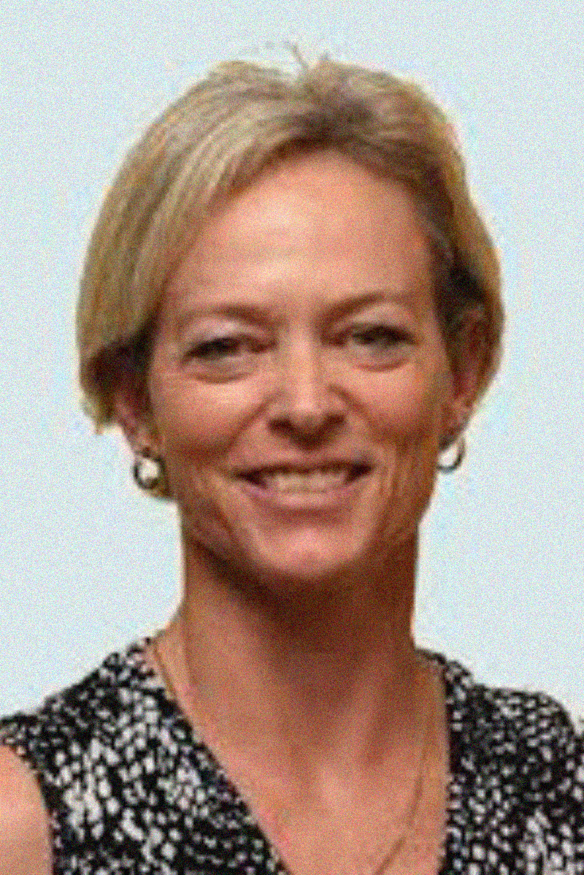
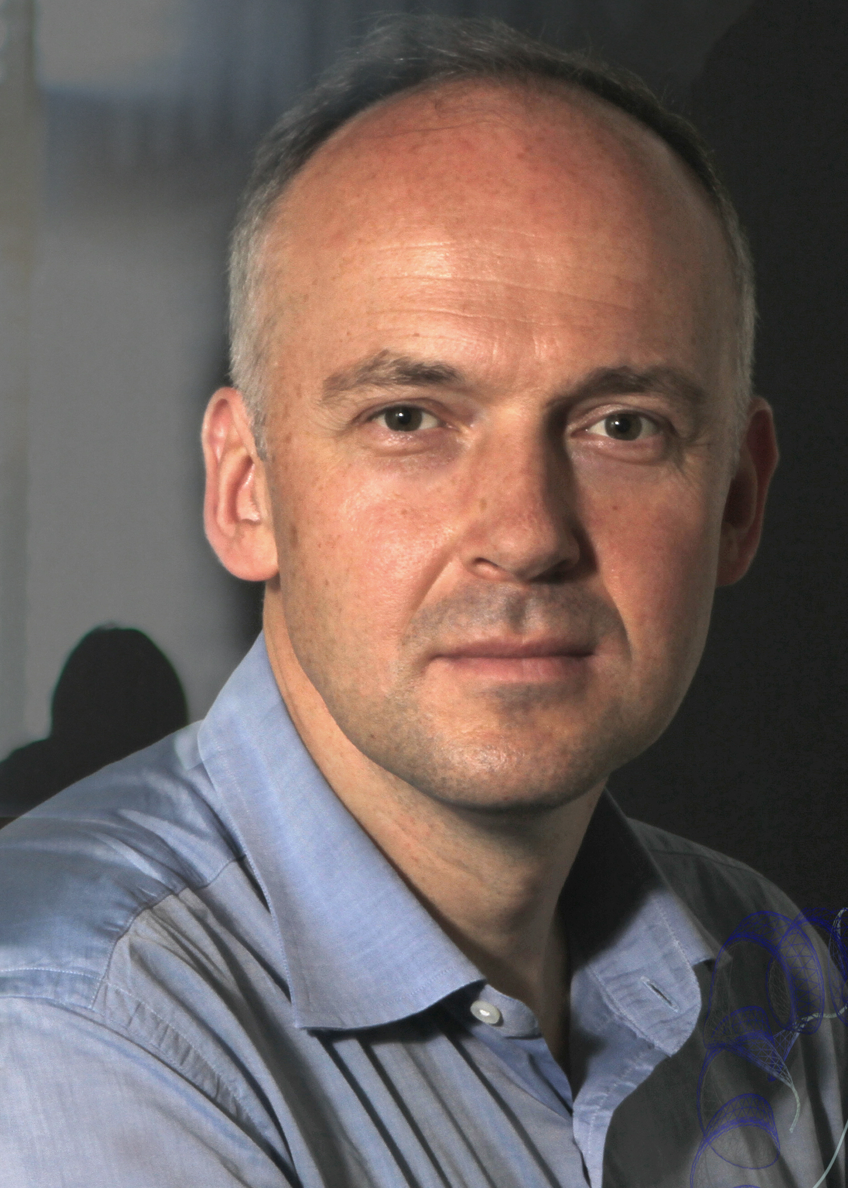
Conference Co-chairs
Nicola Mulder
University of Cape Town,
South Africa
Torsten Schwede
Biozentrum, University
of Basel & SIB Swiss Institute of Bioinformatics, Switzerland
www.iscb.org/ismbeccb2019

Slide 3
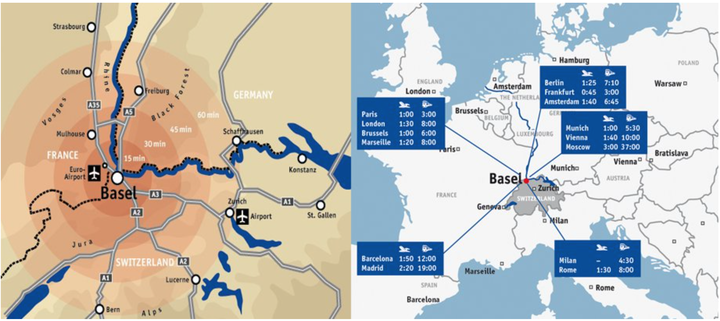
Located in the triangle where
Switzerland, France and Germany meet.
www.iscb.org/ismbeccb2019

Slide 4
Easy access via Euroairport Basel or Zurich Airport (1.25 hours by train).
www.iscb.org/ismbeccb2019

Slide 5
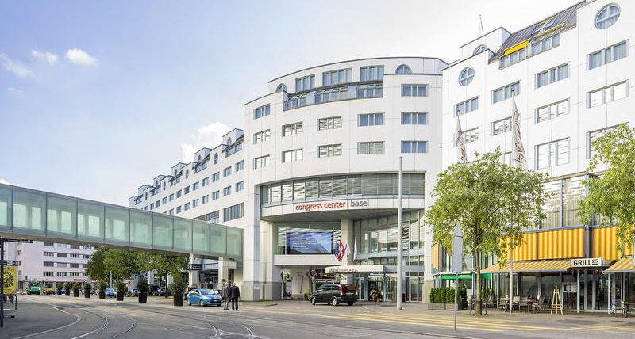
Congress Center Basel is located in the heart of the city.
www.iscb.org/ismbeccb2019

Slide 6
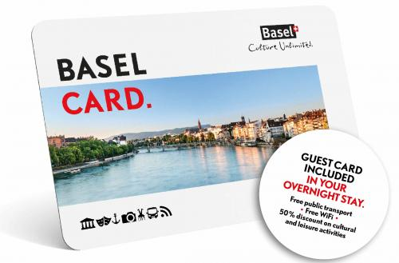
BASELCARD
Free public transportation, 50% discount to Basel’s museums, Basel Zoo, Theater Basel and much more.
www.iscb.org/ismbeccb2019

Slide 7
Mark Your Calendar
www.iscb.org/ismbeccb2019

