Slide 1
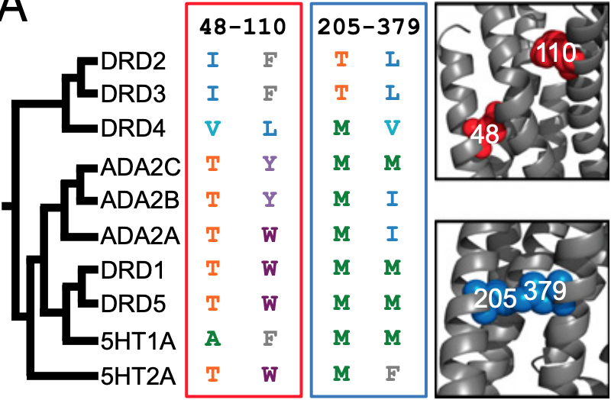
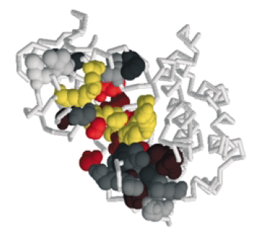
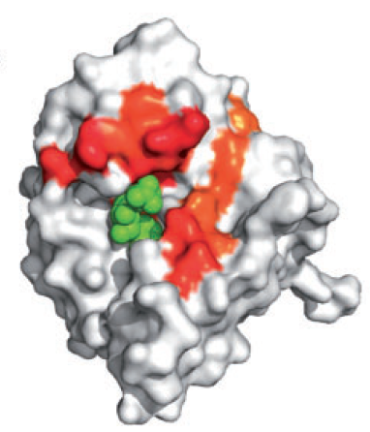
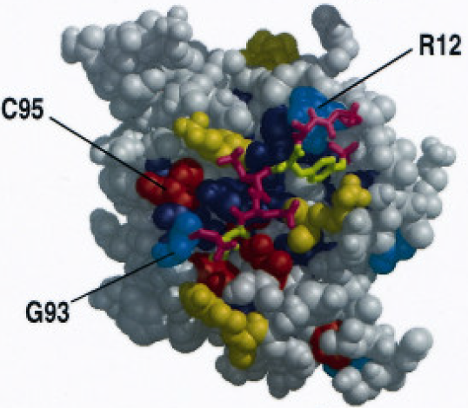

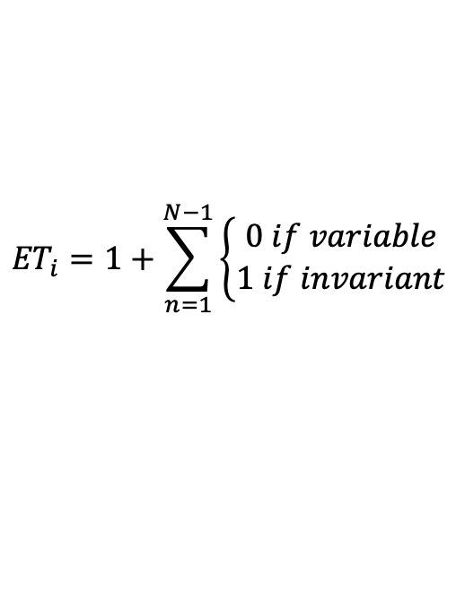
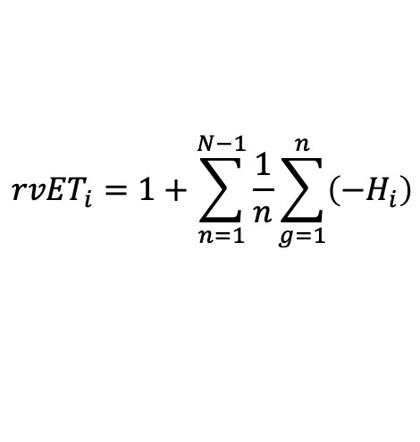
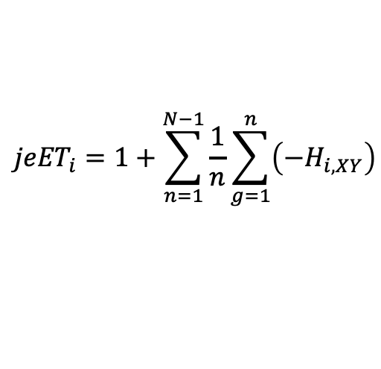
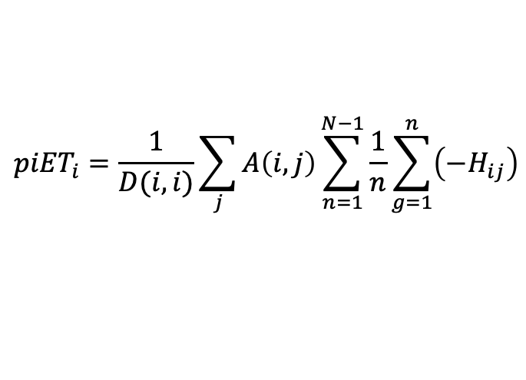
Evolutionary Trace: Intuition and Applications
Combining the Evolutionary Trace Algorithm and Covariation Metrics Yields Improved Structural Predictions
Residues:
1 …3 …5…7…
Evolutionary Trace identifies
Key functional residues
Binding interfaces
Active sites
Residue | 1 | 3 | 5 | 7
Score | 0 | 0 | 0 | 0
Residue | 1 | 3 | 5 | 7
Score | 1 | 2 | 3 | 11
Residue | 1 | 3 | 5 | 7
Score | 1 | 2 | 3 | 4
Residue | 1 | 3 | 5 | 7
Score | 1 | 2 | 3 | 3
Residue | 1 | 3 | 5 | 7
Score | 1 | 2 | 2 | 2
Residue | 1 | 3 | 5 | 7
Score | 1 | 1 | 1 | 1
M…E…K…G…
M…E…K…A…
$${ET}_{i}=1+\sum_{n=1}^{N−1}{\left\{\begin{aligned}0 if variable \\ 1 if invariant\end{aligned}\right.}$$
M…E…K…V…
Daniel Konecki
Lichtarge Lab
Quantitative and Computational Biosciences
Baylor College of Medicine
Houston, Texas
Lichtarge et al. (1996)
M…D…H…L…
$${rvET}_{i}=1+\sum_{n=1}^{N−1}{\frac{1}{n}\sum_{g=1}^{n}{\left(−H_{i}\right)}}$$
M…D…H…I…
M…D…H…F…
Mihalek, Reš, Lichtarge (2004)
$${jeET}_{i}=1+\sum_{n=1}^{N−1}{\frac{1}{n}\sum_{g=1}^{n}{\left(−H_{i,XY}\right)}}$$
M…D…H…W…
M…D…H…P…
Mihalek, Reš, Lichtarge (2007)
M…D…H…S…
$${piET}_{i}=\frac{1}{D(i, i)}\sum_{j}{A\left(i,j\right)\sum_{n=1}^{N−1}{\frac{1}{n}\sum_{g=1}^{n}{\left(−H_{ij}\right)}}}$$
Lichtarge et al. (1996)
Mihalek, Reš, Lichtarge (2004)
Wilkins et al. (2013)
M…D…R…T…
Lichtarge Lab
Wilkins et al. (2013)

Slide 2
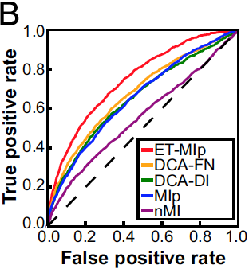
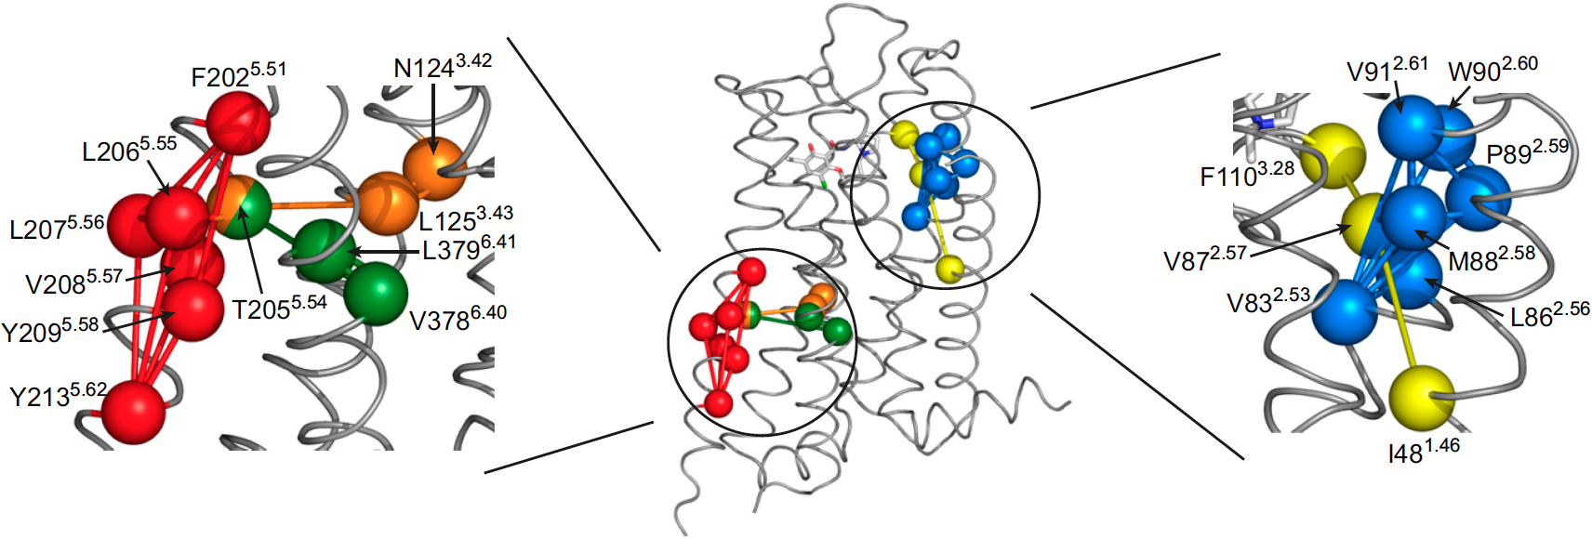
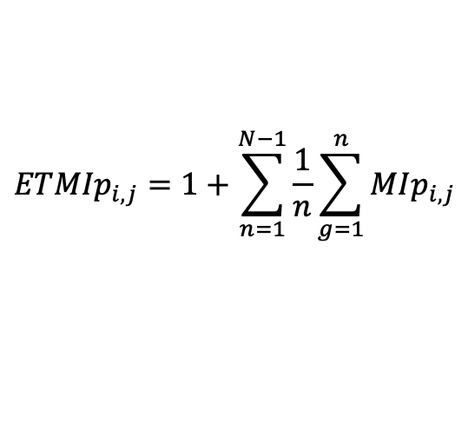
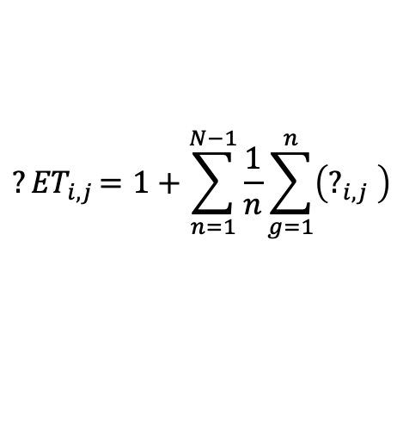
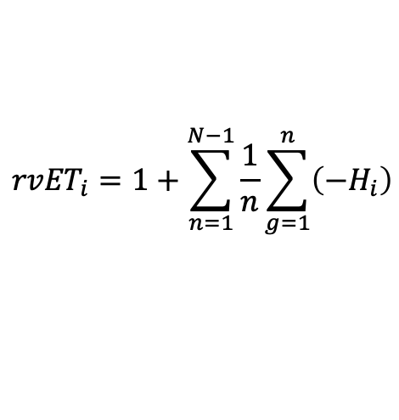
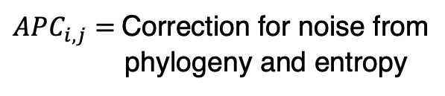


Can Evolutionary Trace be used in Covariation Prediction?
Can Evolutionary Trace be used in Covariation Prediction?
Yes!
Allosteric Interactions
Contact Prediction
$${rvET}_{i}=1+\sum_{n=1}^{N−1}{\frac{1}{n}\sum_{g=1}^{n}{\left(−H_{i}\right)}}$$
$${?ET}_{i,j}=1+\sum_{n=1}^{N−1}{\frac{1}{n}\sum_{g=1}^{n}{\left(?_{i,j} \right)}}$$
$${ETMIp}_{i,j}=1+\sum_{n=1}^{N−1}{\frac{1}{n}\sum_{g=1}^{n}{MIp_{i,j}}}$$
$$MIp_{i,j}=MI_{ij}−APC_{i,j}$$
$$MI_{i,j}=H_{i}+H_{j}−H_{ij}$$
$APC_{i,j}=$ Correction for noise from
phylogeny and entropy
Sung et al. (2016)
Terrón-Díaz et al. (2019)
Notes:
2AIV

Slide 3
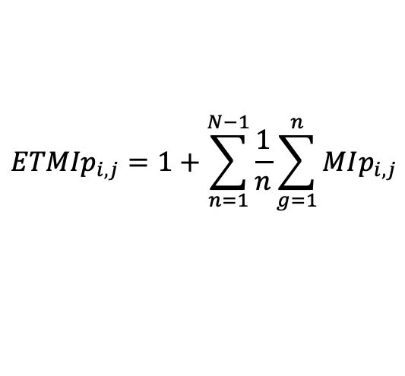

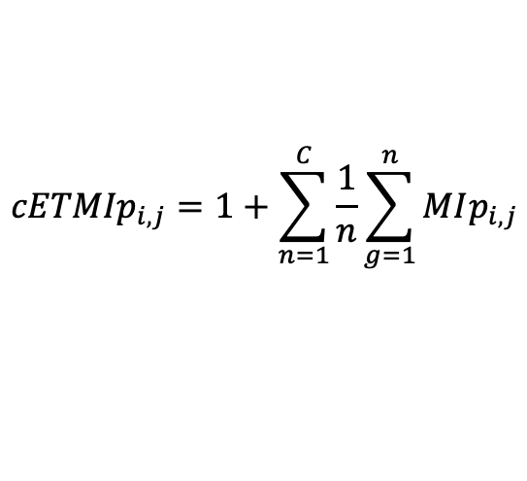
How can ET-MIp be Improved?
Problem:
Method limited by computational resources and time (days – week for large proteins/alignments).
Solution:
By subsampling the phylogenetic tree we can reduce computation costs, without losing predictive accuracy
Can computation time be reduced without losing predictive accuracy?
$${ETMIp}_{i,j}=1+\sum_{n=1}^{N−1}{\frac{1}{n}\sum_{g=1}^{n}{MIp_{i,j}}}$$
0.8
0.8
0.7
0.7
Contact Prediction AUROC
$${cETMIp}_{i,j}=1+\sum_{n=1}^{C}{\frac{1}{n}\sum_{g=1}^{n}{MIp_{i,j}}}$$
0.6
0.6
0.5
0
100
200
300
400
0.5
0
100
200
300
400
$$C=\{1, 2, 3, 5, 7, 10, 25\}$$
Tree Depth
Tree Depth
Notes:
2AIV

Slide 4
cET-MIp Reduces Computation Time
cET-MIp Reduces Computation Time
and Improves Structural Predictions
Small Data Set (23 Protein Families)
Larger Data Set (169 Protein Families)
0.9
10⁶
0.8
DCA
cET-MIp
10⁴
40
0.7
Contact Prediction AUROC
Time (sec)
30
0.6
10²
Frequency
20
10
0.5
10⁰
0
MI
DCA
-0.04
-0.02
0.00
0.02
0.04
0.06
0.08
0.10
0.12
0.14
0.16
ET-MIp
cET-MIp
cET-MIp
ET-MIp
EVCouplings
ΔAUROC(cET-MIp – DCA)
Algorithm
Algorithm
Notes:
2AIV

Slide 5
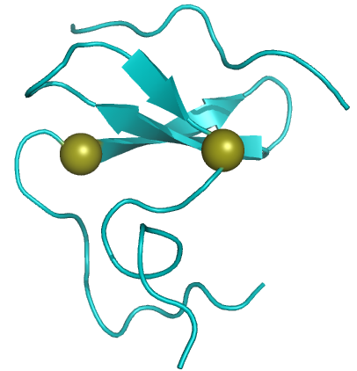
cET-MIp also Improves on Epistatic Predictions
cET-MIp also Improves on Epistatic Predictions
and Identifies Compensatory Triplets
WW Domain
550 Single Mutants
~10,000 Double Mutants
TEM-1 Beta-Lactamase
PDB: 1JMQ
Araya and Fowler (2012)
PDB: 1AXB
0.70
DCA
ET-MIp
cET-MIp
40
0.65
30
Prediction of Epistatic Pairs (AUROC)
0.60
Frequency (%)
20
0.55
10
0.50
0
Minimum
Product
Log
Addition
-3.5
-2.5
-1.5
-0.5
0.5
1.5
2.5
3.5
Epistasis Model
Binned cET-MIp Scores
Notes:
2AIV

Slide 6
Conclusions and Implications
Conclusions:
Evolutionary Trace improves covariation predictions
Most improvement is observed early in the trace
Structure and function prediction are improved by sub-sampling the tree
Implications:
Better covariation predictions may be possible if Evolutionary Trace is combined with other covariation metrics
These predictions provide orthogonal features for ML pipelines used for ab initio structural modeling
These predictions provide a rich feature with the potential to improve ML models predicting protein structure
Thank You!
Please visit poster #40 to discuss further!
konecki@bcm.edu
Notes:
2AIV

