Slide 1

Deep learning enables in silico chemical effect prediction
Pic: CMFE News, Rohit Bhisey, June 6 2018
Dr. Jana Schor
Head of Bioinformatics
Dep. Molecular Systems Biology
Dec, 06 2019

Slide 2



Chemicals in our Environment and the Risk of Exposure
Harm our environment
Harm us humans
Food + endogenous chemicals
Pharmaceuticals, Pesticides, …
Raw materials, compounds
Complex mixtures
Improve our standard of living
Many chemicals are associated to the
risk of developing severe diseases

Slide 3




Regulation is overwhelmed by vast amount of chemicals
Society expects a
non-toxic environment
~800T
Chemicals
listed
6,6
Trill.€
2030
<10T
Chemicals
screened
3,4
Trill.€
2017
Regulations cannot keep up
Steady Increase
in numbers/amount of chemicals
Dynamics in application and
complex exposure
Need for
systematic prediction

Slide 4

Start Small, Learn Deep, and Think Big
Predict Association
of individual chemicals to certain effect, disease, etc.
with Deep Learning on simple chemical structure representations
Hypothesis:
Deep learning enables in silico chemical effect prediction
of hundreds of thousands of chemicals.

Slide 5
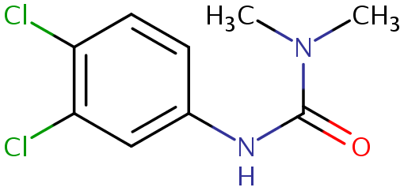
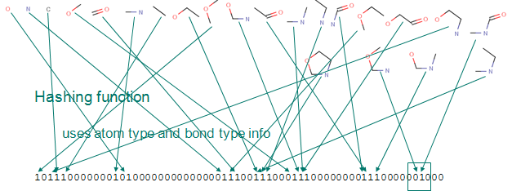
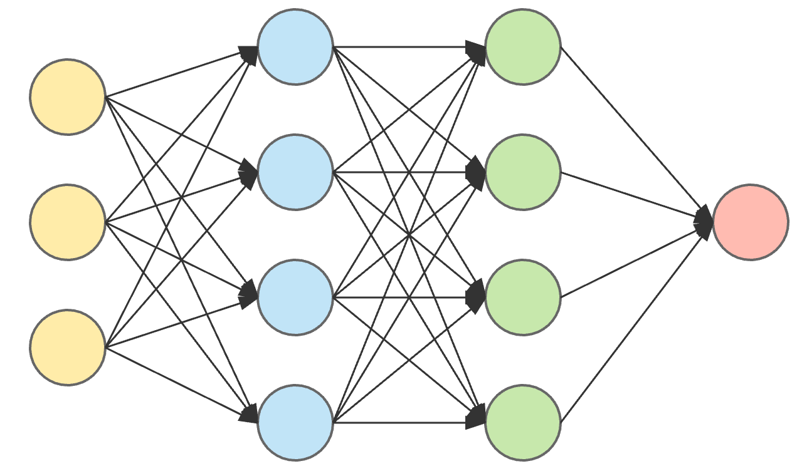
How does it work?
Diuron
---------------
Mol.Formula: C₉H₁₀C_{l2}N_{2O}
Avg.Mass: 233.09g/mol
SMILES: CN(C)C(=O)NC1=CC(Cl)=C(Cl)C=C1
001000 … 0101110011
Binary fingerprint of chemical substance
Effect [0,1]
Gene
Chemical substance

Slide 6
How good does it work?
deepFPlearn
Trained on:
~7,000 chemicals + 6 target genes
1,000 epochs
→ avg. Accuracy > 92%
Big step towards predictive toxicology
Thx.
Page 6

