Slide 1
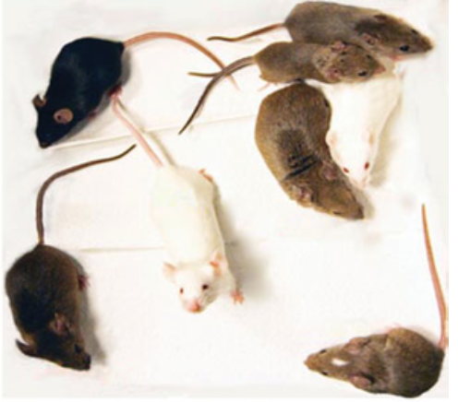
Identifying optimal mouse models for human asthma using a novel modeling approach
Yihsuan Tsai (Shannon)
Rocky 2019
Notes:
Asthma is a very common chronic inflammatory disease in human, more than 3 million cases in US per year. In asthma patients, you can see this inflamed/thickened airway wall, which makes it difficult to breath. It’s a complex disease influenced by both genetics and environmental factors.
so Investigators have tried to mimic these human asthmatic features in mouse models.
However, there are many different mouse models used in each study such as different mouse strains, different allergen exposed, and so on, but there is no gold standard. Therefore the goal of this project is to identify the optimal mouse model and evaluate the impact of different parameters used in different studies and understand the concordance and difference between human disease and mouse model.

Slide 2
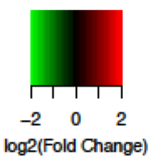
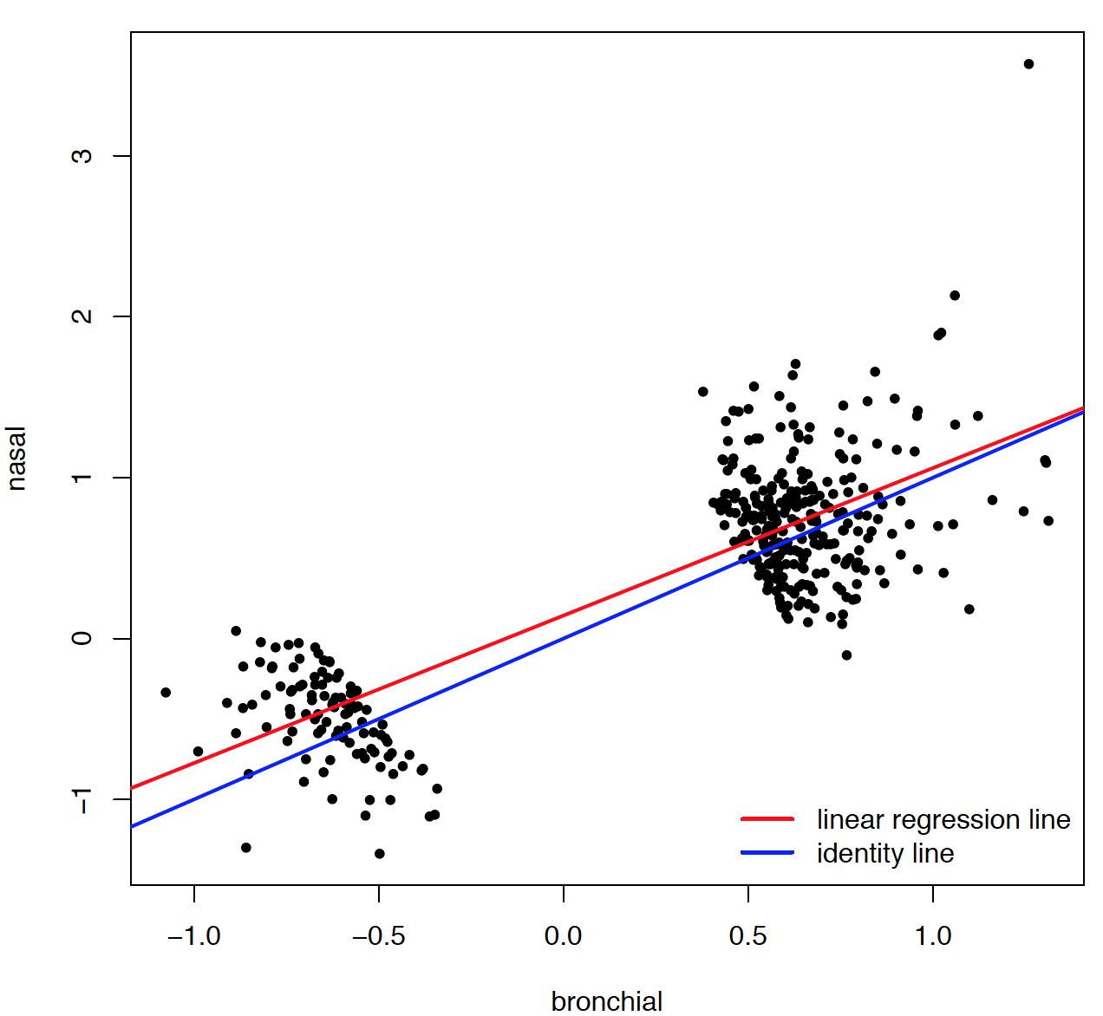

Meta-analysis of human asthma gene expression
Consistency of differential expression across studies
52 model genes from ElasticNet
Nasal
gene weight
AUC = 0.83
sensitivity = 0.91
specificity = 0.67
Bronchial
Tsai et al. Meta-analysis of airway epithelium gene expression in asthma.
Notes:
Previously we did meta analysis of human asthma gene expression using inverse variance model with random effects to identify genes that differential expressed between asthma samples and normal tissues.
From 8 studies we analyzed, we identified 450 DEGs with meta-adjust-p-value<0.05. The heatmap here shows the log2FC in each study for the DEGs we identified. We see pretty good concordance among studies, even between studies that samples were collected from different sources.
Using the 8 available human studies, splitting 2/3 into training and 1/3 testing, we build a classifier using elasticNet to classify samples into case and control groups. The final model includes 52 genes with different weights.
Boxplots show
pooled effect size
In our previous work, we identified human DEGs through meta-analysis. A lot of genes shown same changing direction

Slide 3
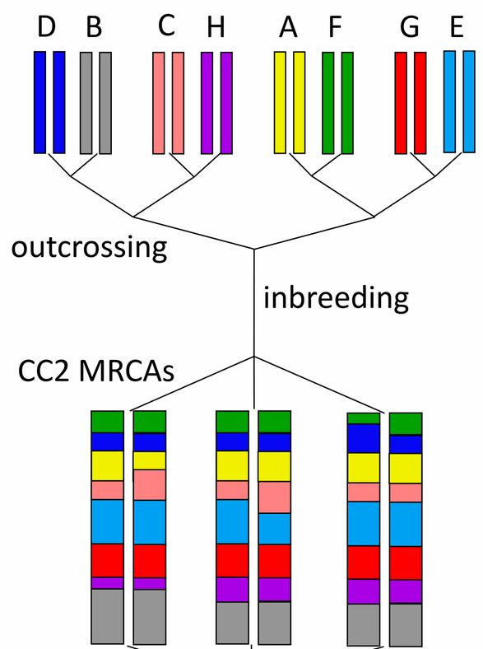
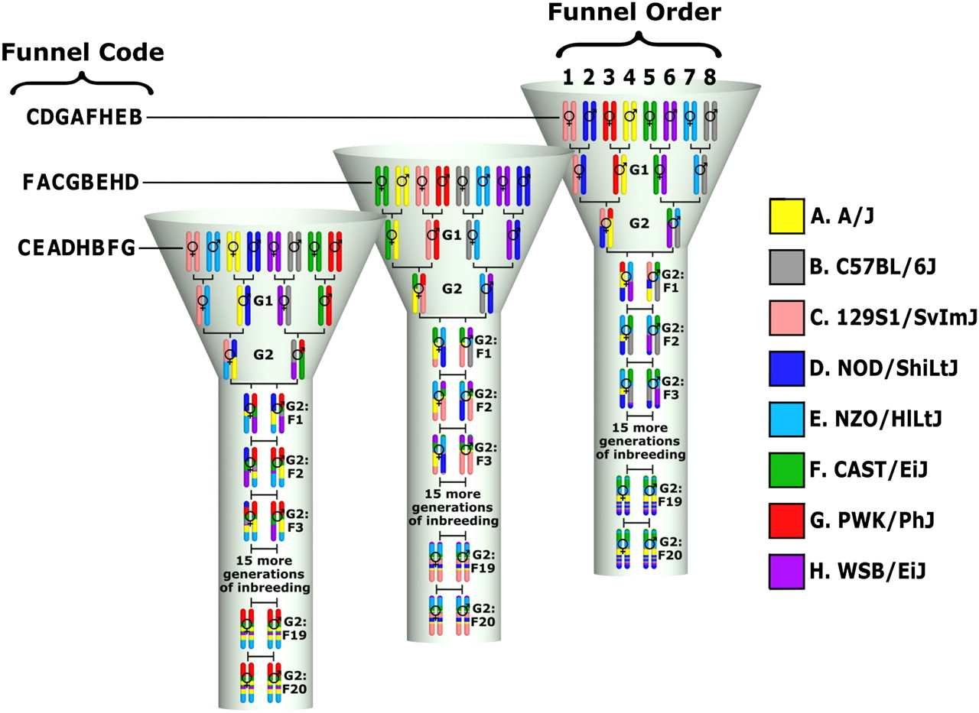
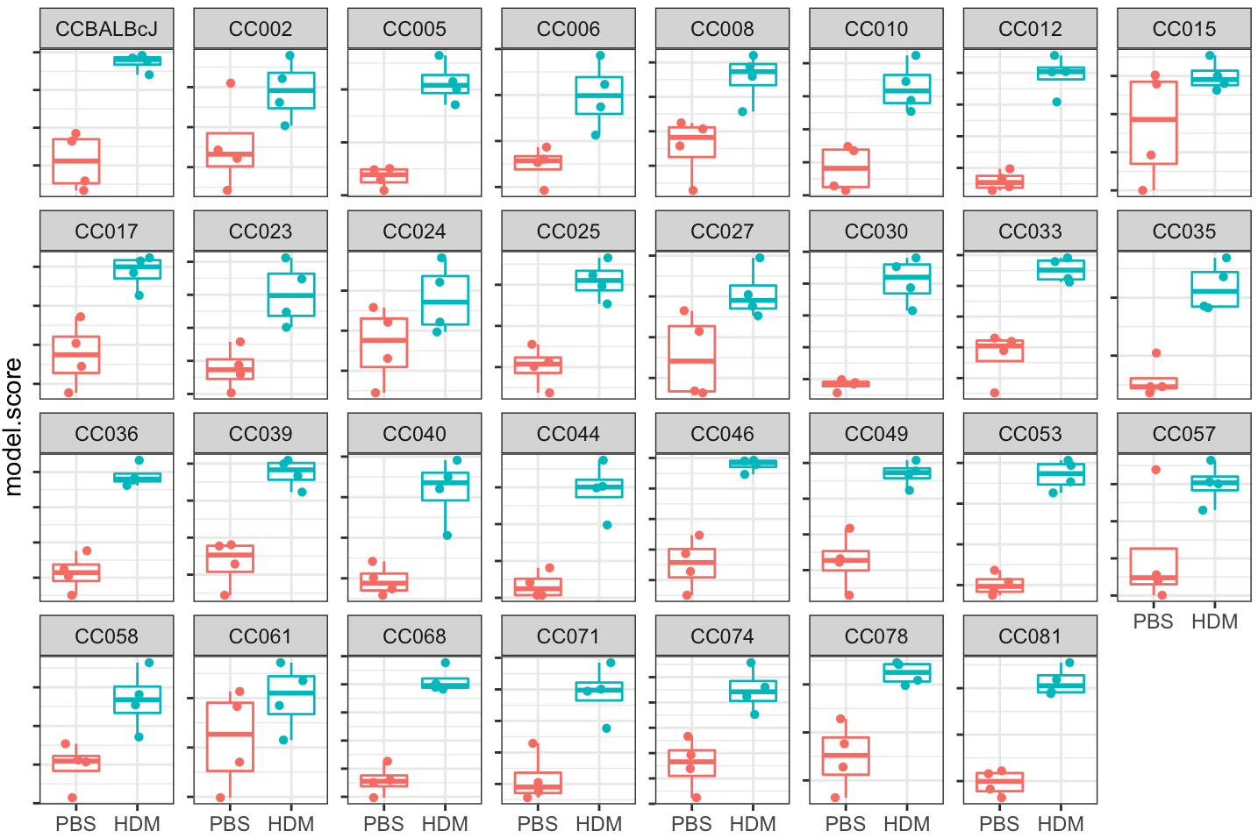
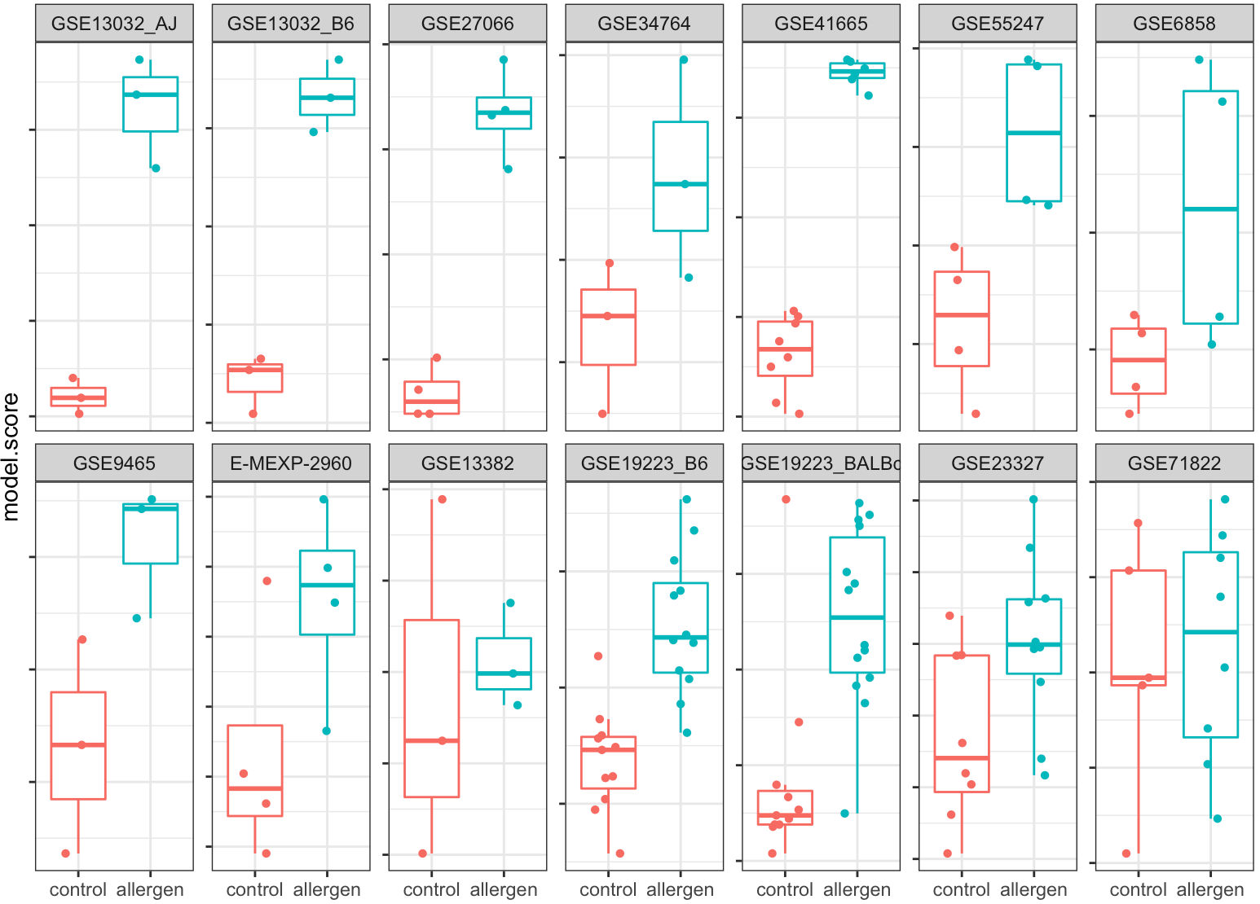

Predict onto mouse/monkey data
12 studies from GEO in microarray
30 collaborative cross (CC) +1 strains in RNAseq
GEO ID | Strain | Allergen | Duration | Sex
GSE13032 | A/J, C57BL/6J | OVA + alum | Acute | NA
GSE27066 | C57BL/6 | OVA | Chronic | F
GSE34764 | C57BL/6 | Alternaria | Acute | F
GSE41665 | BALB/c | OVA | Acute | NA
GSE55247 | B6-129S F2 | HDM | Chronic | NA
GSE6858 | BALB/c | OVA | Acute | NA
GSE9465 | A/J | OVA | Acute | M
E-MEXP-2960 | BALB/c | OVA + alum | Chronic | M
GSE13382 | C57BL/6 | OVA + alum | Acute | NA
GSE19223 | BALB/c, C57BL/6J | Der p 1 (HDM) | Acute | M
GSE23327 | Rhesus macaque | HDM | Acute | NA
GSE71822 | C57BL/6 | HDM | Acute | NA
Notes:
The model was then applied to available mouse studies. From literature and db query, we identified 12 microarray studies from GEO including 11 mouse and 1 monkey studies. These studies covered different mouse strains, different allergens used and the duration mice exposed to the allergen. One thing to note is that mice don’t naturally have asthma. In order to mimic human asthma, they have to repeatedly let the mice expose to allergen, such as house dust mite or OVA, to establish asthma mouse. On the other hand, Lauren in the lab has chose 30 mouse strains from collaborative cross and did RNAseq (4 replicate per strain and condition). When we applied our predicative model on these mouse datasets, we found majority of them have pretty good performance, in terms of separating case and control.

Slide 4
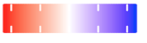
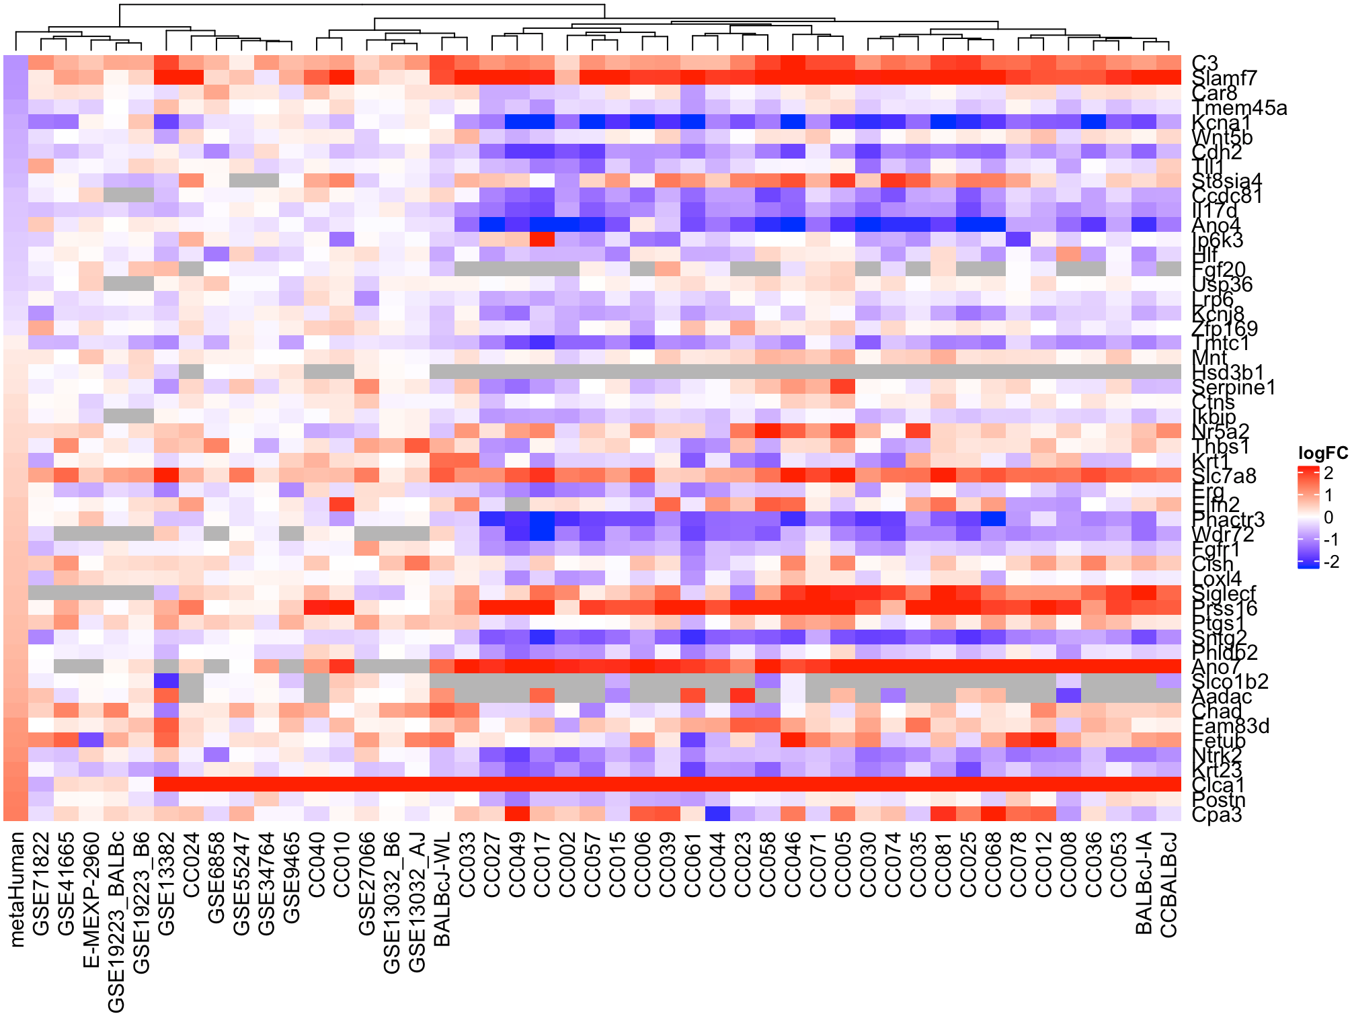
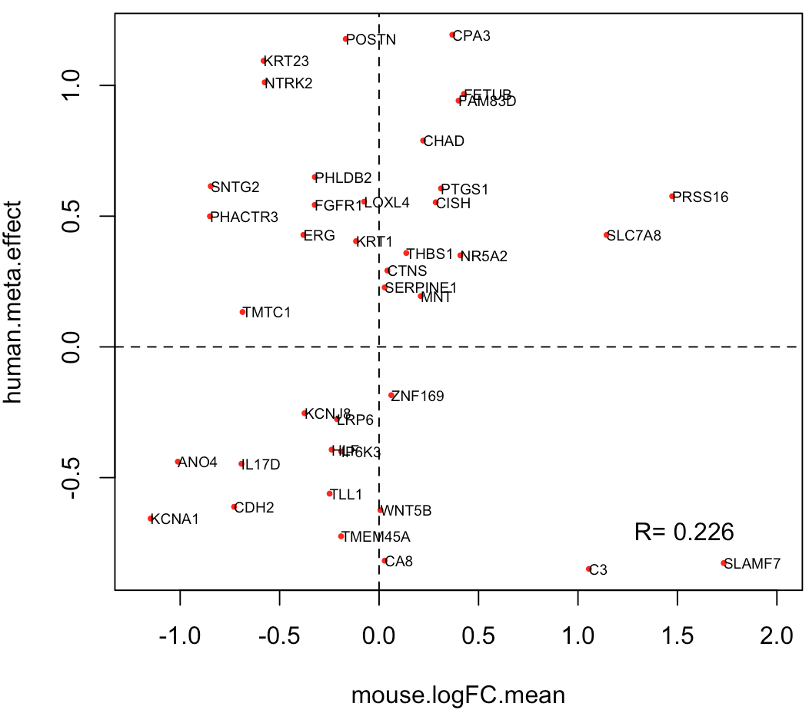
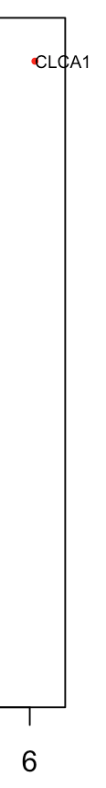
Correlations between human and mouse effects are small
52 model genes:
2 1 0 -1 -2
log2(FC)
//
Notes:
However, when we tried to look at individual genes in the model, we found the low correlations between human and mouse, even different directions. For example.
In general, we see low correlations
We see heterogeneity in mice too. For example, Cpa3 gene, Do we need to separate

Slide 5

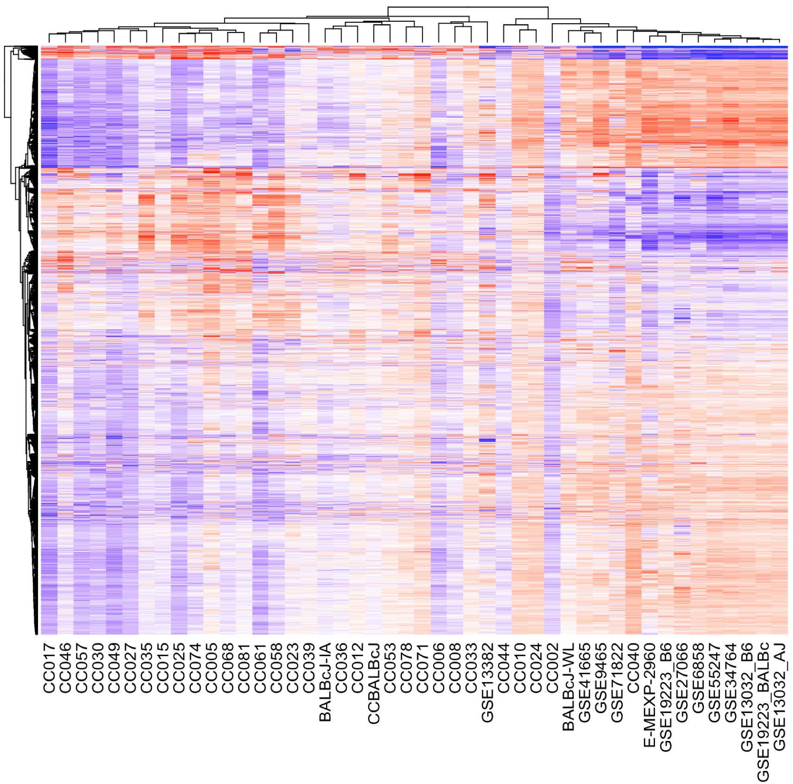
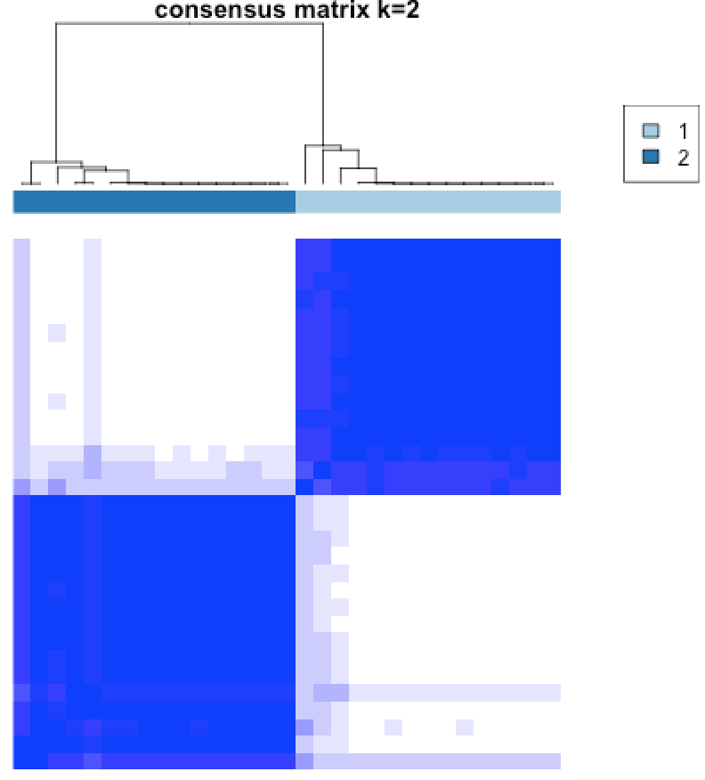
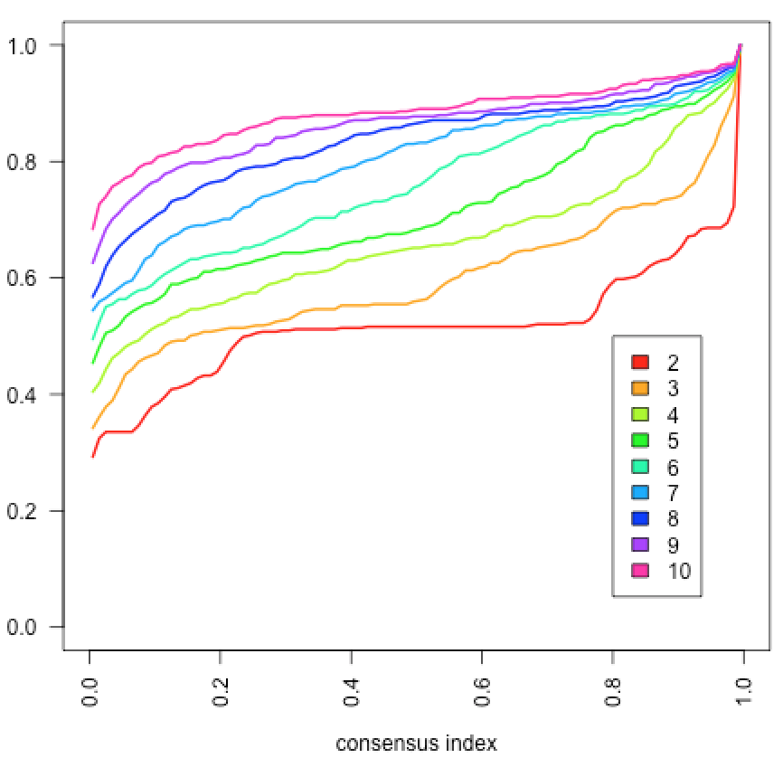
Heterogeneity in mouse studies suggests potential sub-classes
medianCtr(log2FC)
ConsensusClustering:
u₁
u₂
CDF
=> We should separate array from RNAseq data
=> There are at least 2 sub-classes in mouse CC strains
Notes:
Therefore we did formal test to check if there is heterogeneity in mouse studies. Using logFC of the top 5000 most variant genes across all mouse strains/studies, we did see some heterogeneity, the major variation was the difference between RNAseq vs. Array.
We then did ConsenesusClustering analysis in the CC data, and found there are .. Both the con…and CDF plot suggest there are two subclasses
proportion of ambiguous clustering (PAC) indicate k=2

Slide 6
Future directions
Use Consensus Clustering and SigClust to identify sub-classes in CC mouse strains.
Meta-analysis in each mouse sub-class.
Identify the optimal mouse sub-class/strain with highest correlation to key human asthma DE genes.
Identify human-mouse concordant and discordant genes in each mouse sub-class.
Acknowledgement:
Lauren Donoghue
Joel Parker
Samir Kelada
Kathryn M. McFadden
Jack Harkema
Funding: NHLBI
Poster #P79
Notes:
In summary, we found heterogeneity in mouse transcriptome
Mouse genetic background has a significant impact on expression of key human asthma DE genes.
here would be genetic differences driving subclasses in the CC whereas those would likely not exist in the GEO data or wouldn't be strong enough to detect, although I of course could be wrong. Perhaps put this toward the bottom of the list to de-emphasis it or we could discuss more.

