Slide 1



A pedigree-level examination of Schistosoma japonicum following schistosomiasis reemergence in rural China
Rocky ISCB
December 2019
LE Timm, JA Shortt, & DD Pollock

Slide 2

Acknowledgments
Pollock Lab
David Pollock
Jonathan Shortt
Sichuan Center for Disease Control & Prevention
Yang Liu
Bo Zhong
Sequencing
Todd Castoe
Drew Schield
Nicky Hales
Zachary Nikolakis
Epidemiology
Beth Carlton
Andrea Buchwald

Slide 3
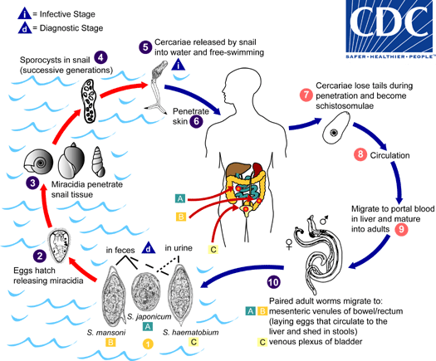
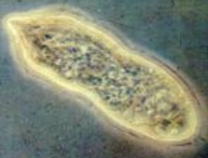
Schistosoma & Schistosomiasis
A mating pair can produce hundreds of thousands of fertilized eggs per day
FZ Hapan
Notes:
MESENTERIC VENULES of the large intestine; immune response is to hundreds of thousands of fertilized eggs released daily by a mating pair; eggs become lodged in various places as they seek to leave the body (cause different symptoms depending on where they “land”)

Slide 4
Re-emergence of Schistosomiasis in Sichuan Province, China
1950s: Schistosomiasis control programs introduced – mollusciciding & mass administration of praziquantel
2000s: recorded infections had declined 99%
However, several regions experience…
  No further declines
  Increasing infection rates
Why does infection persist?
Notes:
While schistosomiasis is a globally relevant disease, we will focus on rural Sichuan China – China stands as an example of schisto control, but infection persists

Slide 5
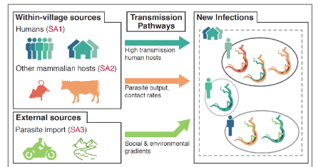
Identify sources of new infections

Slide 6
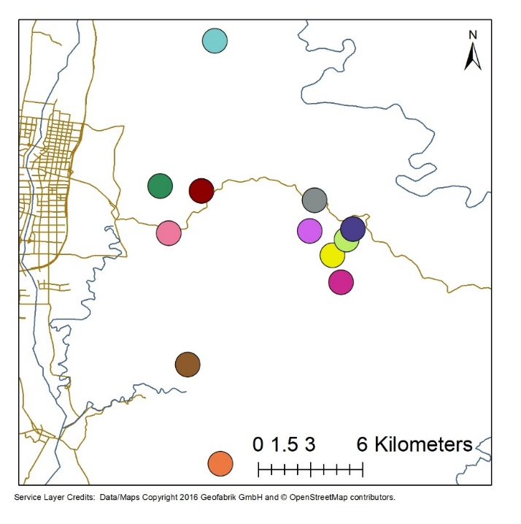
Data Generation
Whole genome amplification + ddRADseq
33,901 SNPs across 200 individuals
Notes:
GE Genomiphi

Slide 7
Genetic and Geographic Structure
Easternmost village
Westernmost village
Northernmost village
Southernmost village
Notes:
Note geographic separation of the villages seen in PCA
PC1 (x-axis) = 8.1%; PC2 (y-axis) = 5.1%

Slide 8
Why does infection persist?
Local sources of infection are implicated (as opposed to inter-village transport)
By what mechanism?
Notes:
We see pairs of miracids are more closely related when they come from the same or nearby villages

Slide 9
Inferring Relatedness between Miracidia
Unrelated
4th degree relatives
(first cousins)
3rd degree relatives
2nd degree relatives
(siblings)

Slide 10
A vignette…
Notes:
While there were a number of things we found through analyses of relatedness patterns, I’m going to focus on one in particular, which we are terming a “meta-relationship”

Slide 11
Meta-relationships
16027C
16027B
16027D
Host1
16027A
16027E
Same village
Same collection event (December 2010)
16030E
16030A
Host2
16030B
Posterior probabilities of 1st degree relationships (siblings)

Slide 12
Meta-relationships
16027C
Posterior probabilities of 2nd degree relationships
double first cousins
half-siblings
aunt/uncle-niece/nephew
16027B
16027D
16027A
16027E
16030E
16030A
16030B
Notes:
Each of the three possibilities provide important insight into transmission dynamics

Slide 13

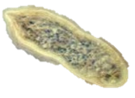
Meta-relationships

Slide 14
Double first cousins
Evidence of a very small population and a lot of inbreeding

Slide 15
Half-siblings
clone
clone
Evidence of a high degree of clonality

Slide 16
Aunt/uncle-niece/nephew (piblings)
Evidence of a direct human-snail-human transmission
Notes:
Evidence of human reservoir

Slide 17
Moving Forward
Sample from non-human mammals
Identify any additional examples of meta-relatedness
Develop a means of differentiating between the types of relatedness (double first cousins vs half-siblings vs piblings)

Slide 18
Towards Differentiation
Extend haplotypes -> capable of rapidly pulling clusters of sites in linkage disequilibrium (microhaplotypes)
Simulate recombination -> generate pedigrees including all relationships of interest
Identify expected patterns of allele sharing for different relationships
Providing unprecedented insight into disease transmission at the individual parasite level

Slide 19
Questions?

Slide 20
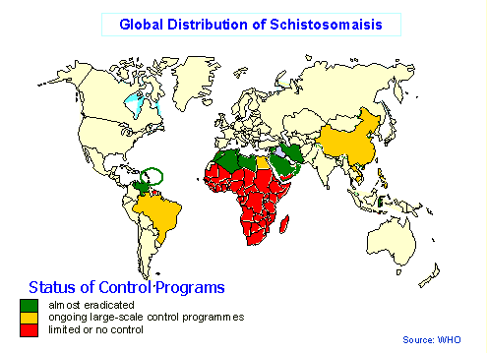
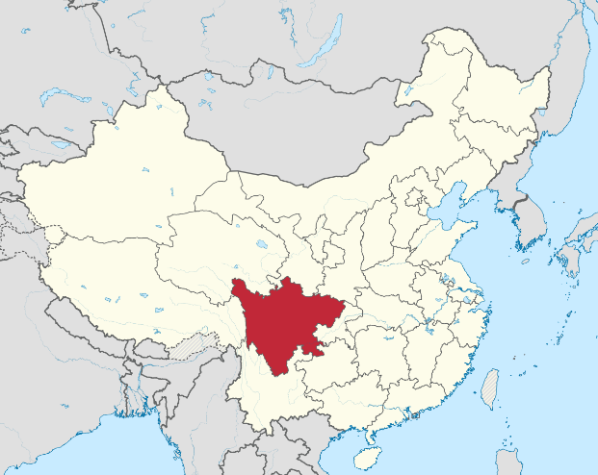
Schistosoma & Schistosomiasis
Notes:
Listed as a neglected tropical disease; infects more than 200mil people worldwide; estimated to kill thousands/year; in tropical areas (Africa, Asia, South America) economic impact is second only to malaria; treated with praziquantel (can be administered annually, and also when disease is found)

Slide 21
Genetic and Geographic Structure
0.2
Rare Allele Sharing Proportion
0.1
1-10km
10-20km
20-30km
Inter-Village Distance
Notes:
Closer villages exhibit significantly higher rare allele sharing between miracids.
A sign of local reservoirs.

