Slide 1
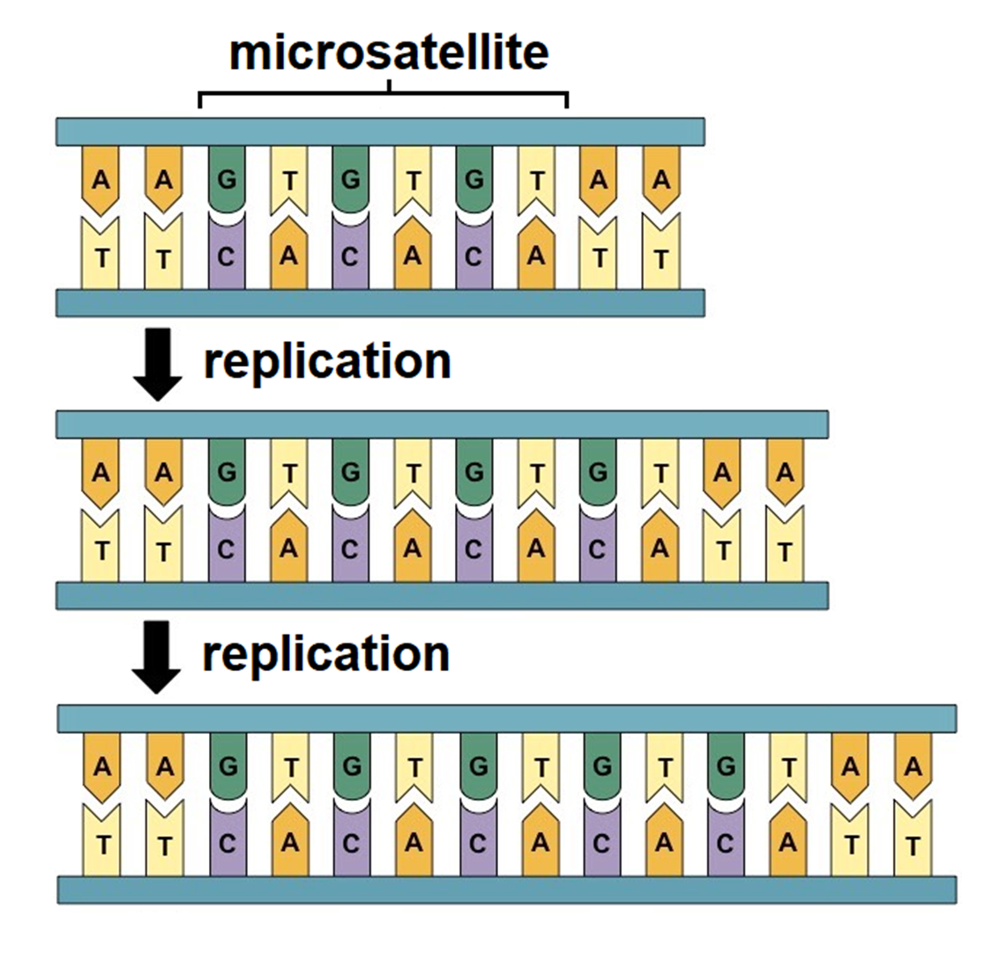
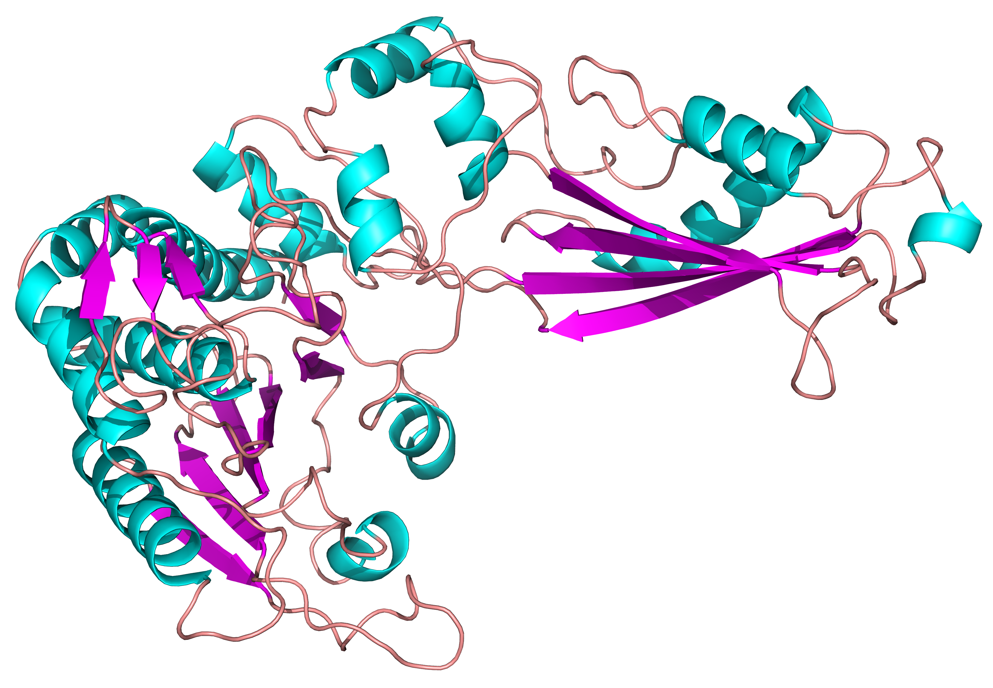
HIGH RESOLUTION PROTEOMICS AND GENOMICS OF CNDP1 REPEAT VARIANTS LINKED TO DIABETIC NEPHROPATHY
Parviz Shabane
Ramu Anandakrishnan
Arichanah Pulenthiran
Harold Garner

Slide 2
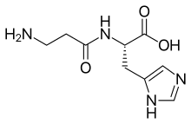
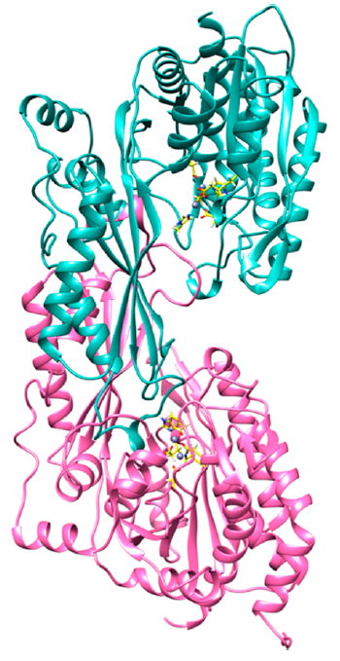
Background and Motivation
CNDP1 is an excreted dipeptidase that exists as a monomer or homodimer. Its two substrates are H-carnosine (preferred) and L-carnosine
At least 4 alleles can be identified by the number of Leucine residues in the NH₂ terminal signal peptide sequence: 4 to 8 leucine residues are known.
Alleles with 4 or 5 leucine residues protect against diabetic nephropathy and are less readily exported from the cell.
Enzyme activity varies by age, gender, and various neuromuscular disorders (multiple sclerosis, dystrophy, and dementia)

Slide 3
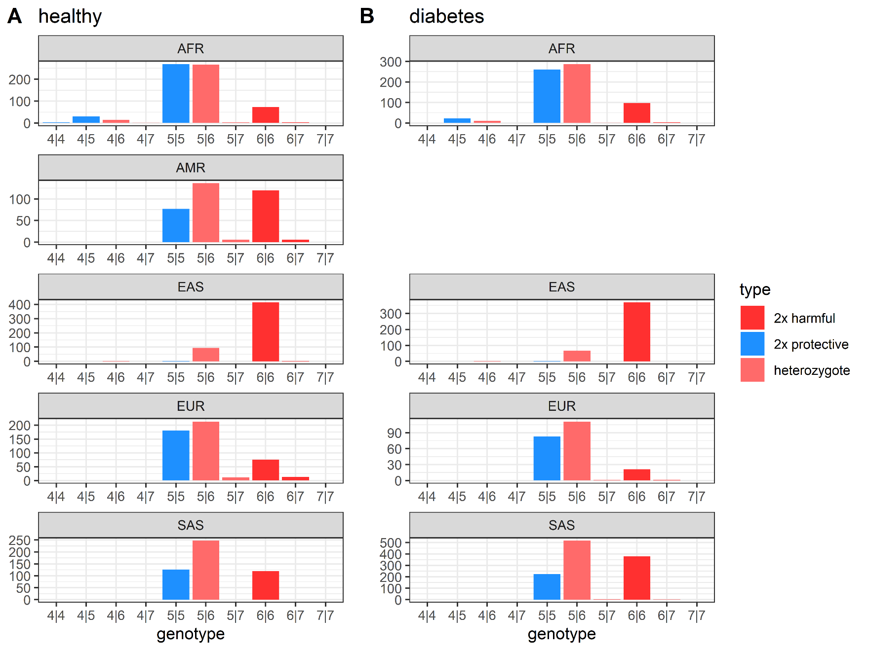
Results: Genomics
We investigated the CNDP1 genotypes for approximately 5000 individuals:
½ healthy, ½ diabetes
Distributions differ by ethnicity (rows) but not by disease state (column)
Enzyme activity varies by age, gender, and ethnicity

Slide 4
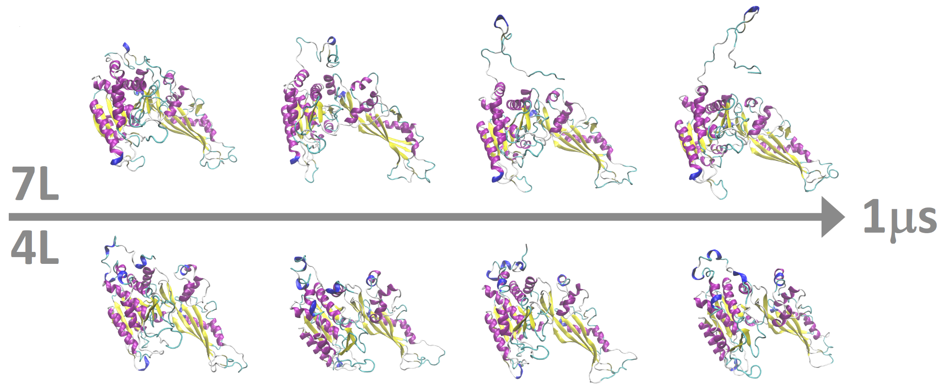
Results: Proteomics

Slide 5
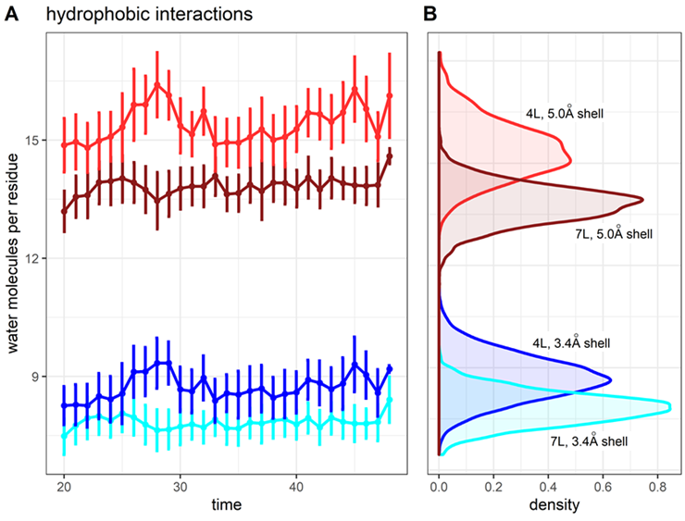
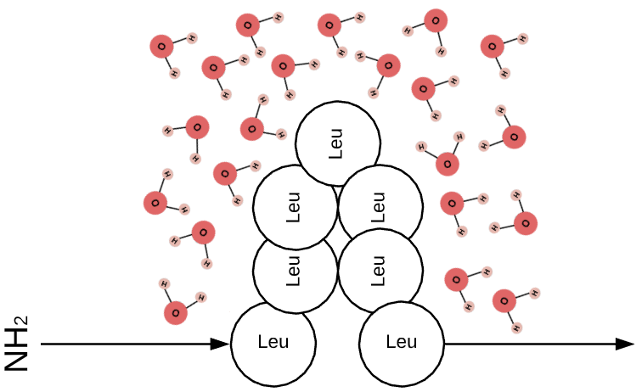
Results: Proteomics
Why do residues 1-28 form a hairpin in the 7L allele but not the 4L allele?
To what extent does the secondary structure of the tail residues influence secretion?

Slide 6
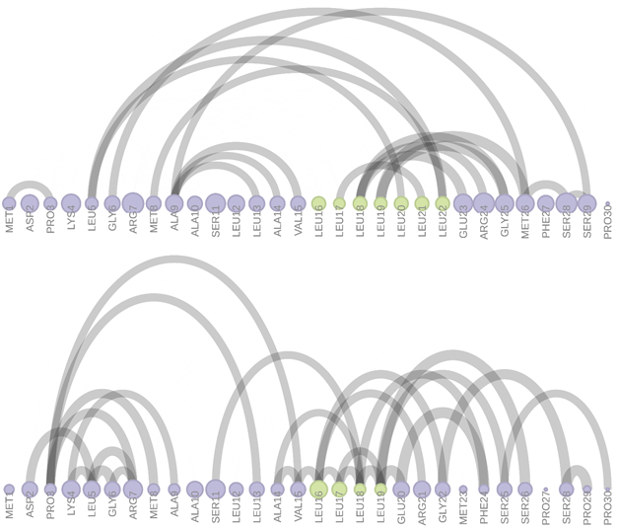
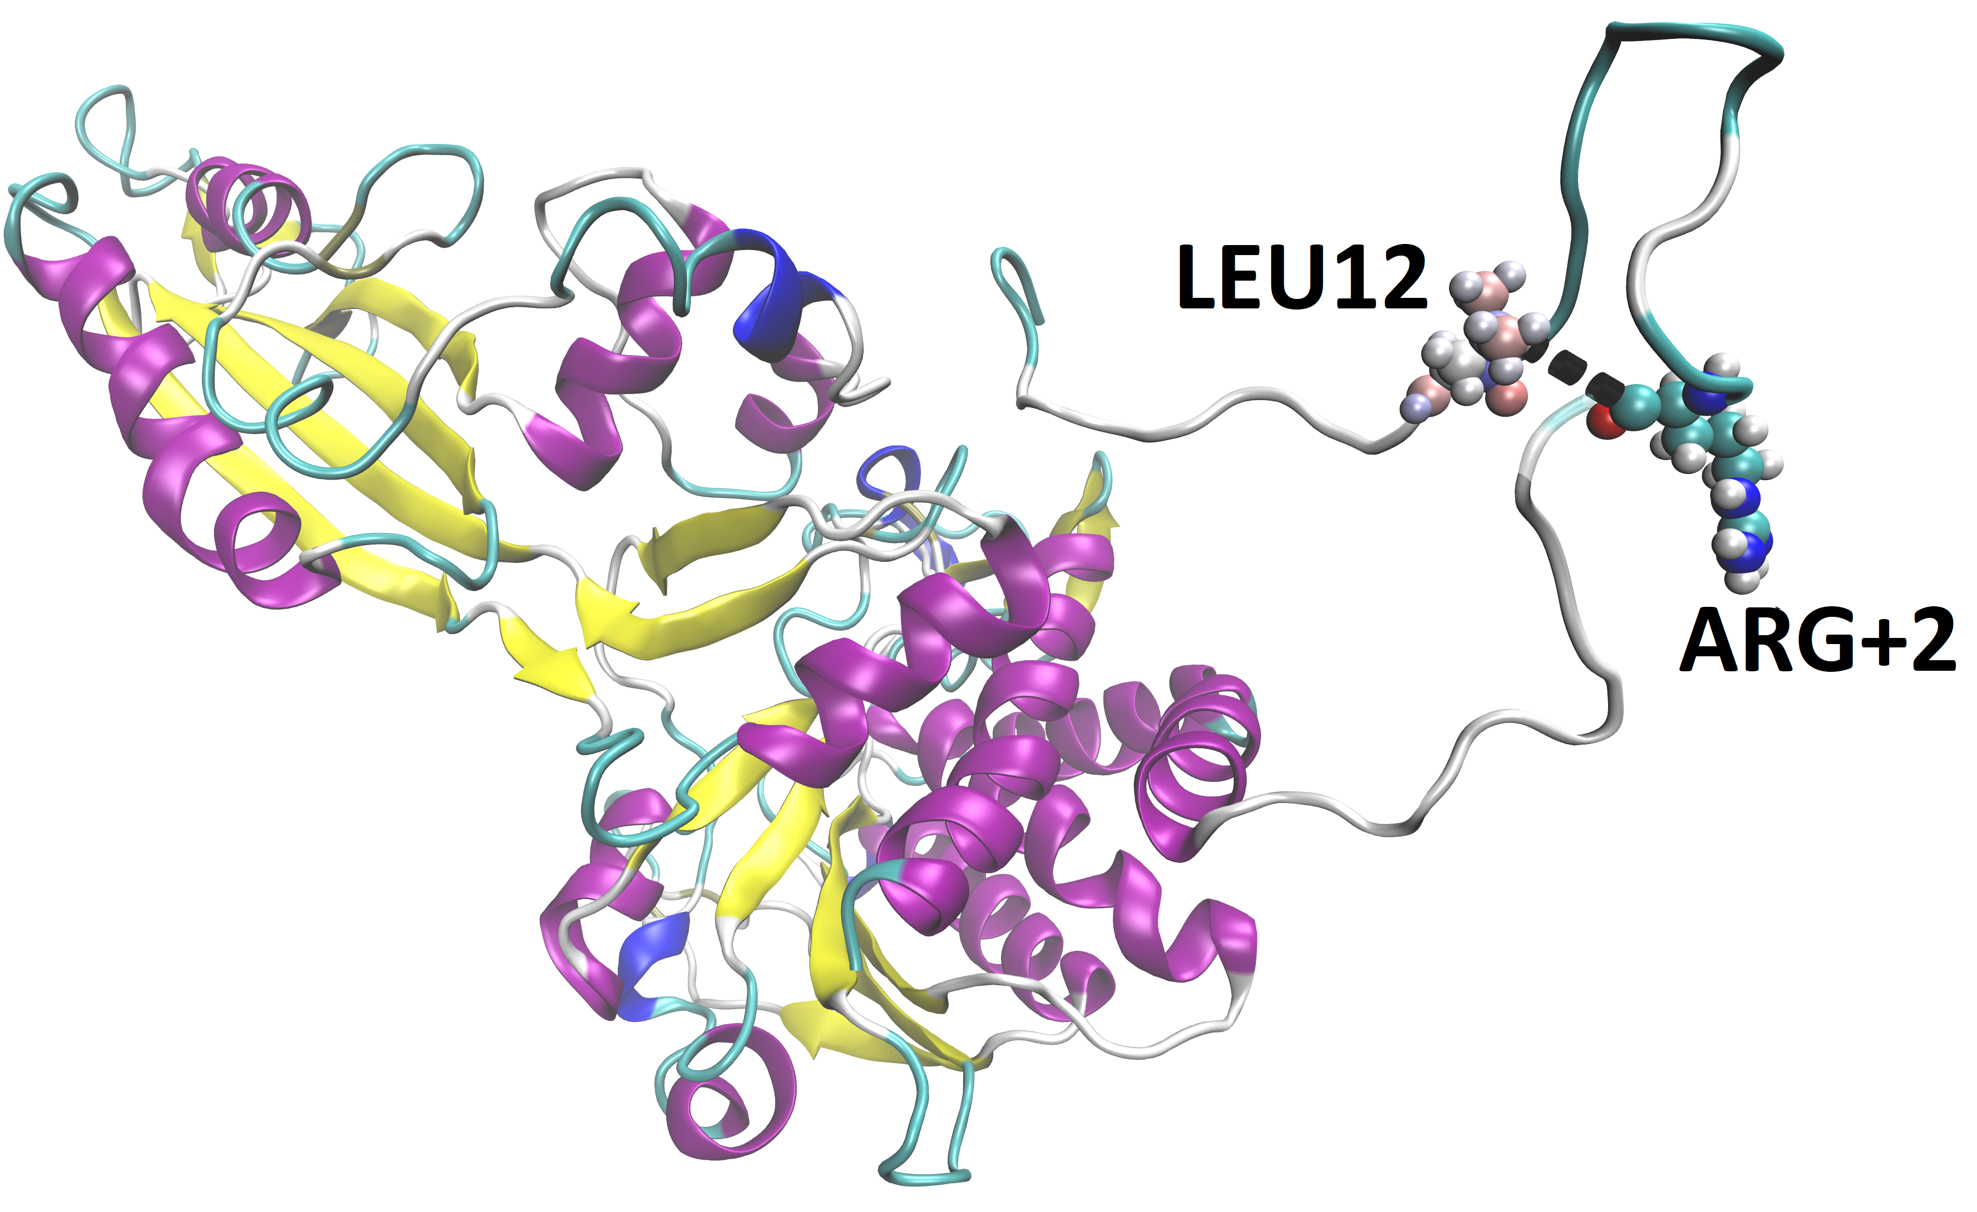
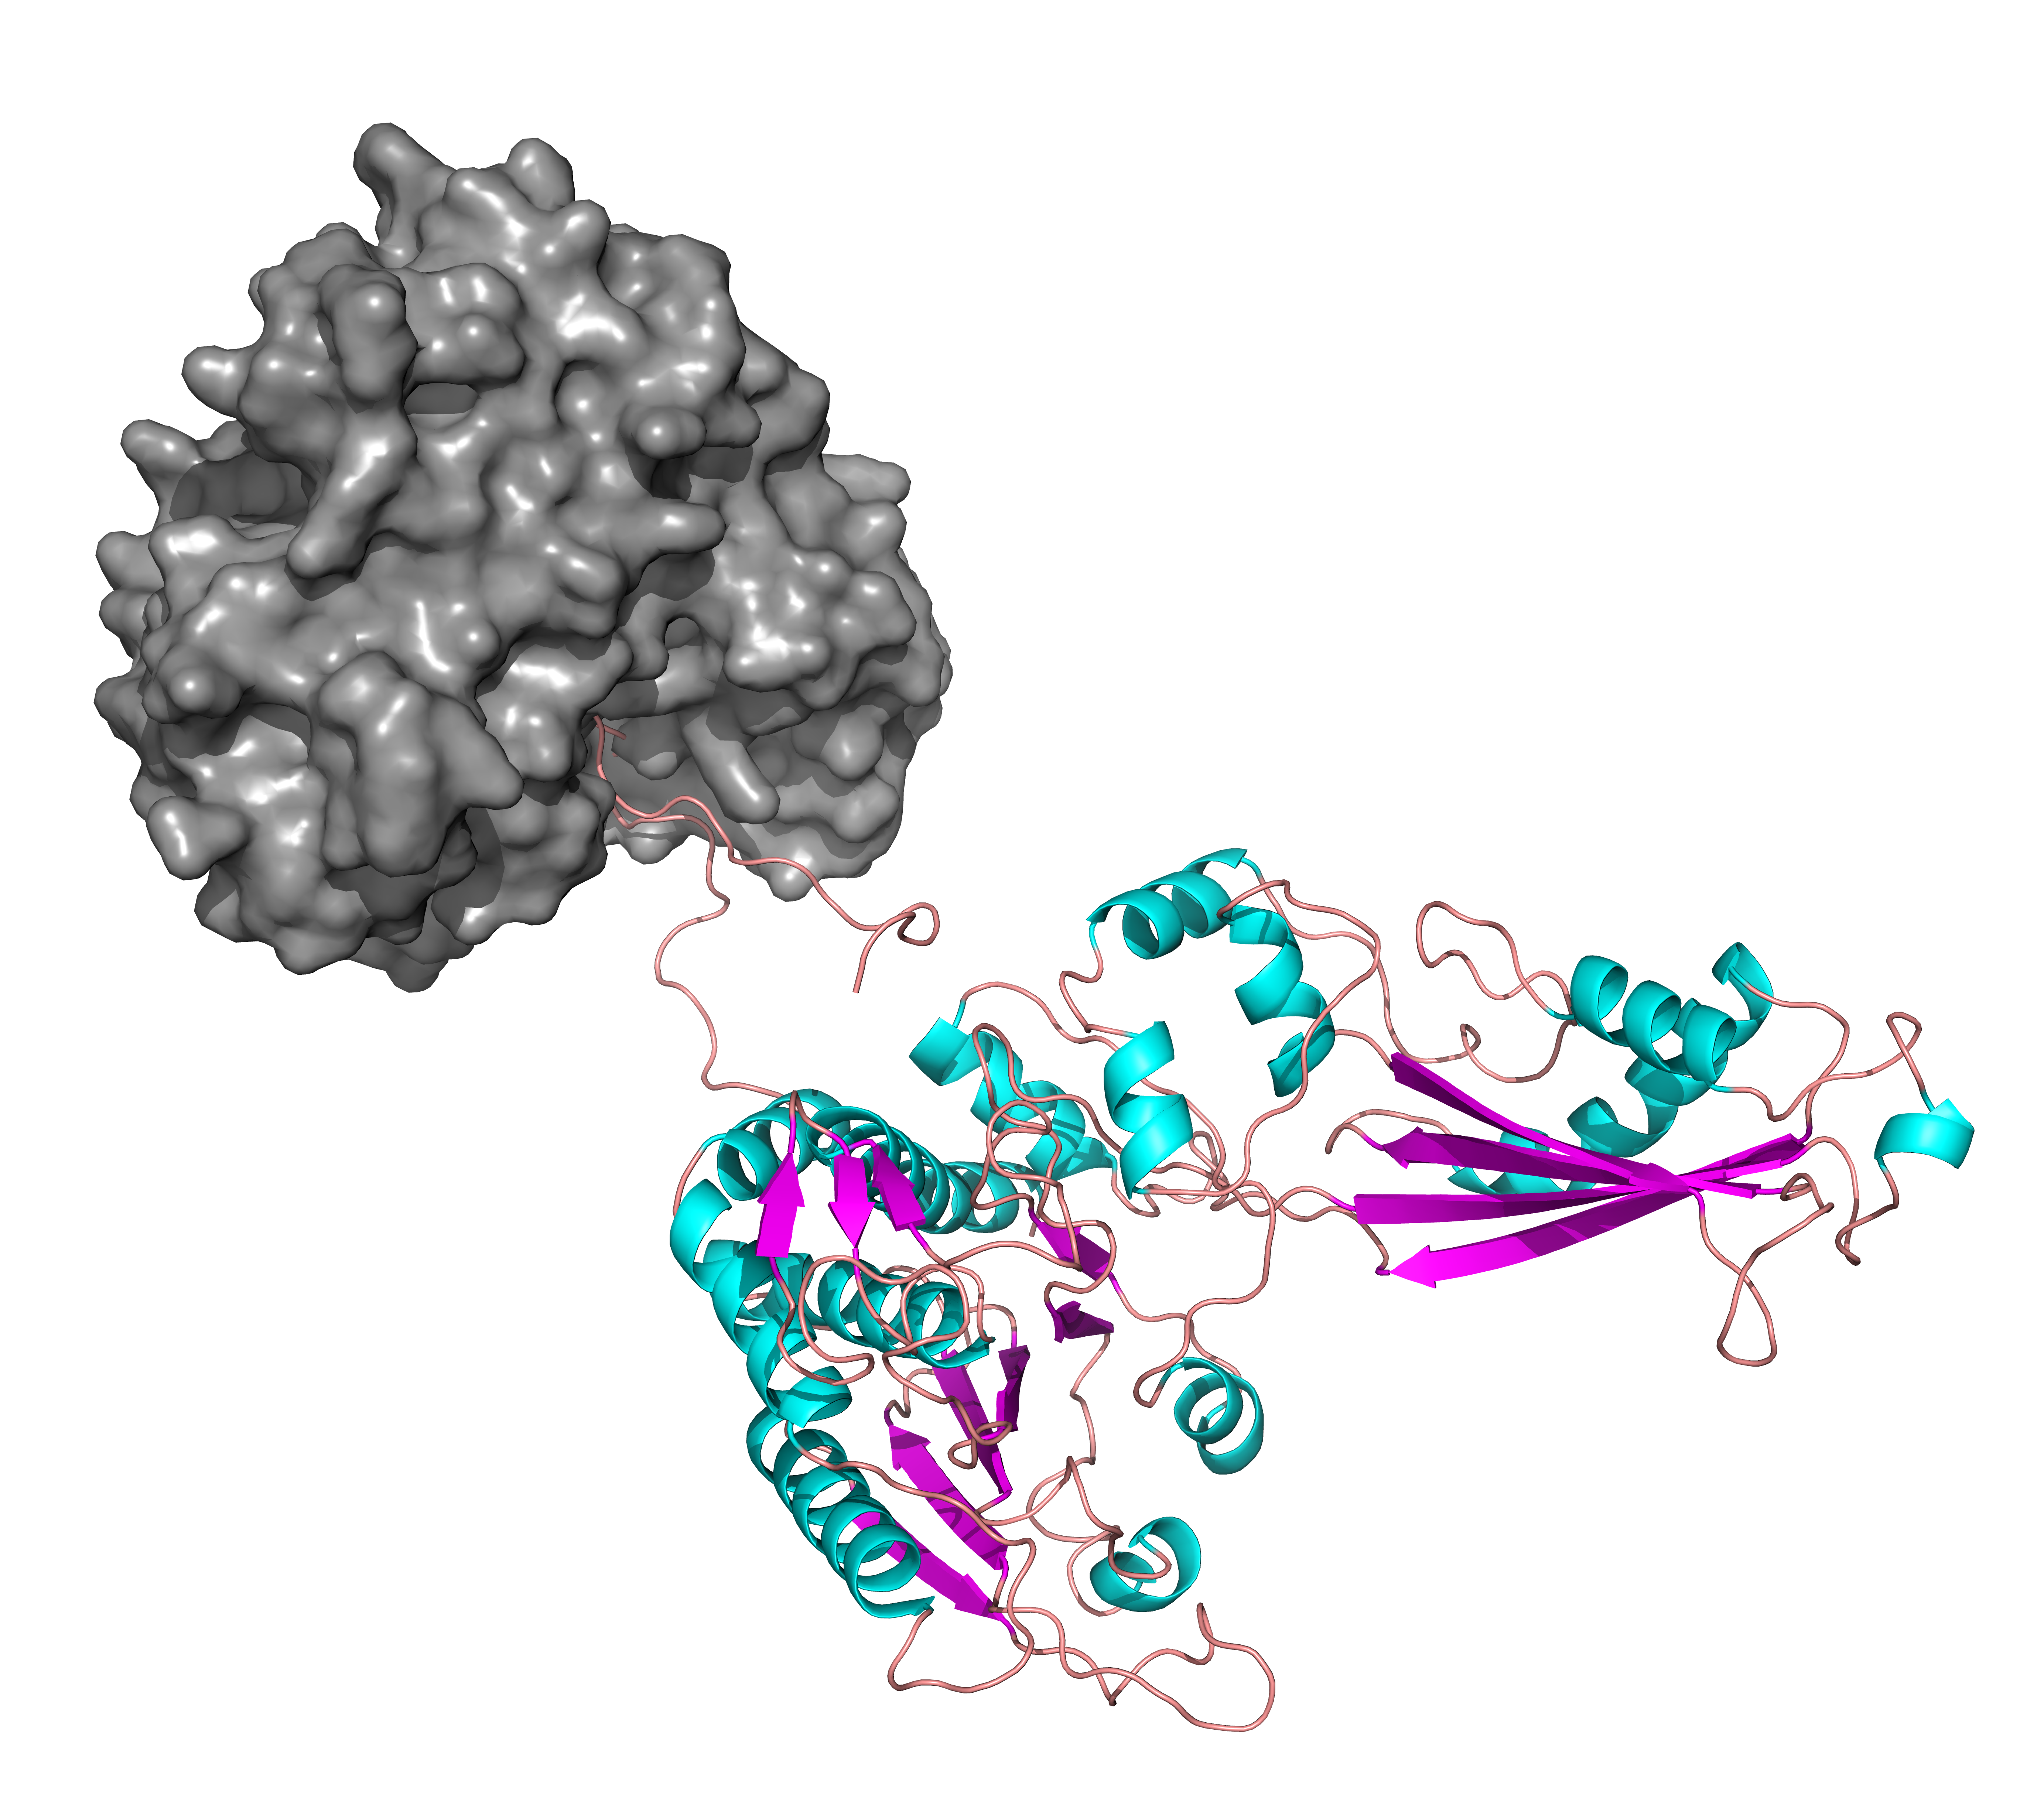
Results: Proteomics
Directions
7L H-bonds
Residues 1-30
4L H-bonds
Residues 1-30

