Slide 1
A Story of Proteomic Statistical Process Control at SomaLogic
Joseph Allison, PhD
Bioinformatics Scientist II
SomaLogic
Boulder, CO

Slide 2
What is Statistical Process Control (SPC)?
Identification, attribution, & control of batch effects
Environment
Experiment
Experiment
Experiment
Material Prep
Running the Experiment(s)
Standardization
Sanity Check
Person(s)
Equipment

Slide 3
Controlling the SomaScan® Assay
Identification, attribution, & control of batch effects
Environment
Experiment
Experiment
Experiment
Manufacturing
SomaScan® Assay
Standardization
Production Bioinformatics
Person(s)
Equipment
RA/QA

Slide 4
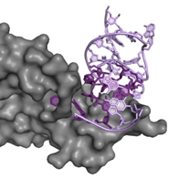
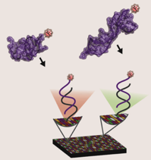
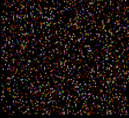
SomaLogic SomaScan® technology provides comprehensive assessments of thousands of proteins at scale
Slow Off-rate Modified Aptamers (SOMAmers) – a “next generation” of specific protein binding reagents
Combines thousands of different SOMAmer® reagents to measure thousands of proteins in a single blood sample
Measures relative protein concentrations via DNA measurement of the binding SOMAmer partners
Measurement of 5,000 / 20,000 canonical protein structures
5X more than anyone else in the world in a commercial context - at commercial scale and fidelity
At this level, we have an “informative signal” not previously available
Notes:
Delivers unmatched specificity, sensitivity, dynamic range, reproducibility, scalability, and speed

Slide 5

Our product development process - from proteins to health information
~300k
samples processed to date using the SomaScan assay
SomaSignal™ tests
1
6
11
16
21
2
7
12
17
3
8
13
18
4
9
14
19
5
10
15
20
Notes:
We have performed the SomaScan Assay on annotated specimens (with associated clinical information) 400,000 times, evaluating protein expression in humans with and without a number of health, wellness and disease conditions and characteristics. By doing this, and by virtue of the strong biological signal that thousands of proteins provide, we have developed a number of current state and future predictive state tests for health, wellness and disease.
These tests rely on sophisticated protein expression “models” developed using machine learning we have created for each condition or characteristic in question. We have obtained these specimens from around the world – from both pharma customers who pay SomaLogic to run the assay on clinical trial participants (for drug target validation, new drug target identification, etc.) and from annotated biobanks – many of which had never provided access to corporate enterprises before, but did so for us in exchange for more protein data on each individual in these banks than anyone else in the world could provide by a factor of up to 5X.

Slide 6
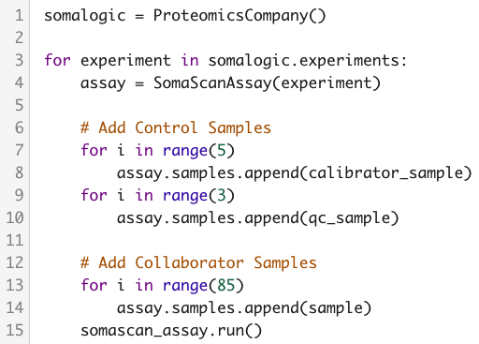
Detecting & Correcting Batch Effects
Control Samples
  Calibrator
    5 matrix-matched replicates
    Corrects for batch effects
    Assesses pre-standardization accuracy
  QC
    3 matrix-matched replicates
    Final check
    Assesses post-standardization accuracy
Sanity Checks

Slide 7
Production BI: The Process (2015 Edition)
Approx. 70 manual steps for sanity checking
Problems
  Repetitive
  Batch-related metadata was inaccessible
  The human brain is… not the best choice
    Imperfect storage & data loss
    High latency networking (days)
    Difficult to see the bigger stability picture
~days
~days
~days

Slide 8

Creating the Statistical Process Control Pipeline: Umbrella
Born from a desire to automate that work away entirely.
Python-based Django Webserver
  Highly customizable & extendable
  Can import Python data science libraries
  Free & well supported
xkcd.com/1319/

Slide 9


Umbrella
Architecture/Implementation
DevOps
Docker Containers
Kubernetes
AWS
Task Execution
Long running
High load
Client
Vue.js & JQuery
Bootstrap
Plotly, D3.js
Webserver
Serves pages & responses
Manages Databases
Sends tasks to Celery Workers
Message queue
Lossless
High volume

Slide 10
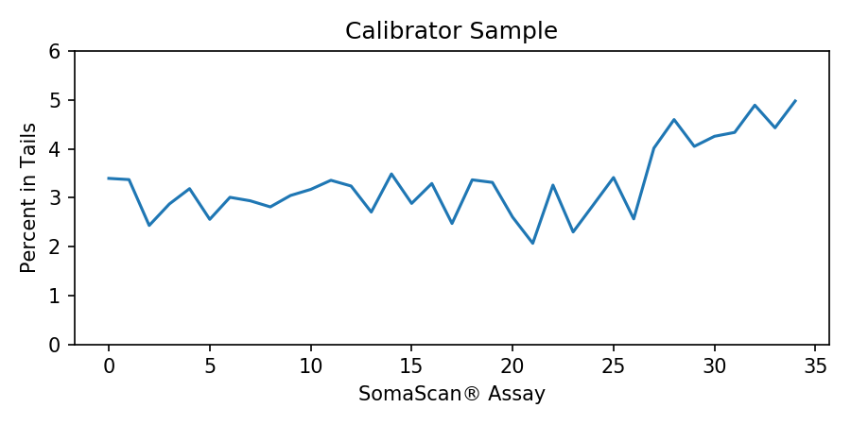
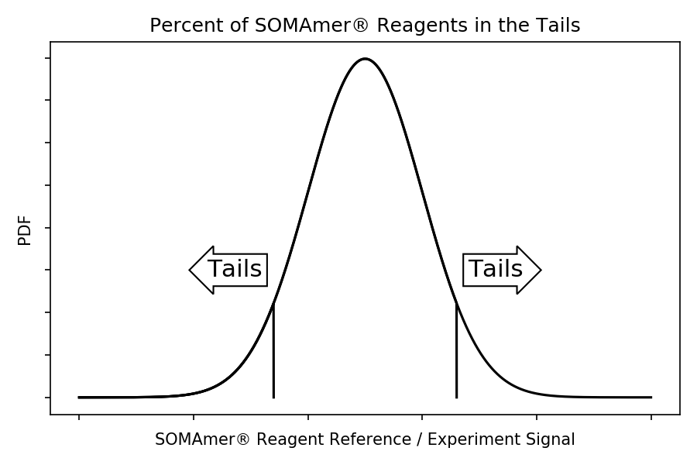
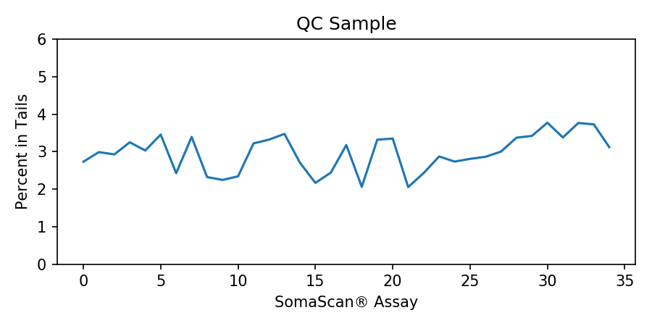

Umbrella Tour
Simulated Assay Issue
Primary Question: Is there a batch effect?
$$SOMAmer® Reagent Ratio: \frac{Reference Value}{Exp Signal}$$

Slide 11
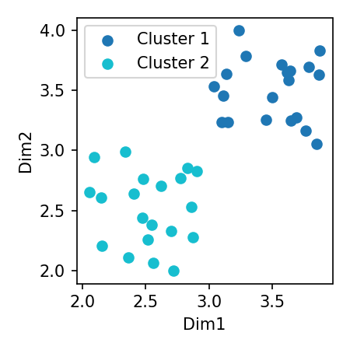
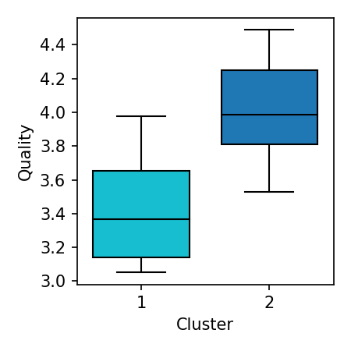
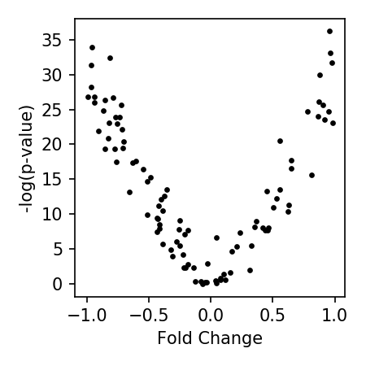
Umbrella’s SPC Pipeline
Identify
Attribute
= Baseline
= Batch Effect

Slide 12
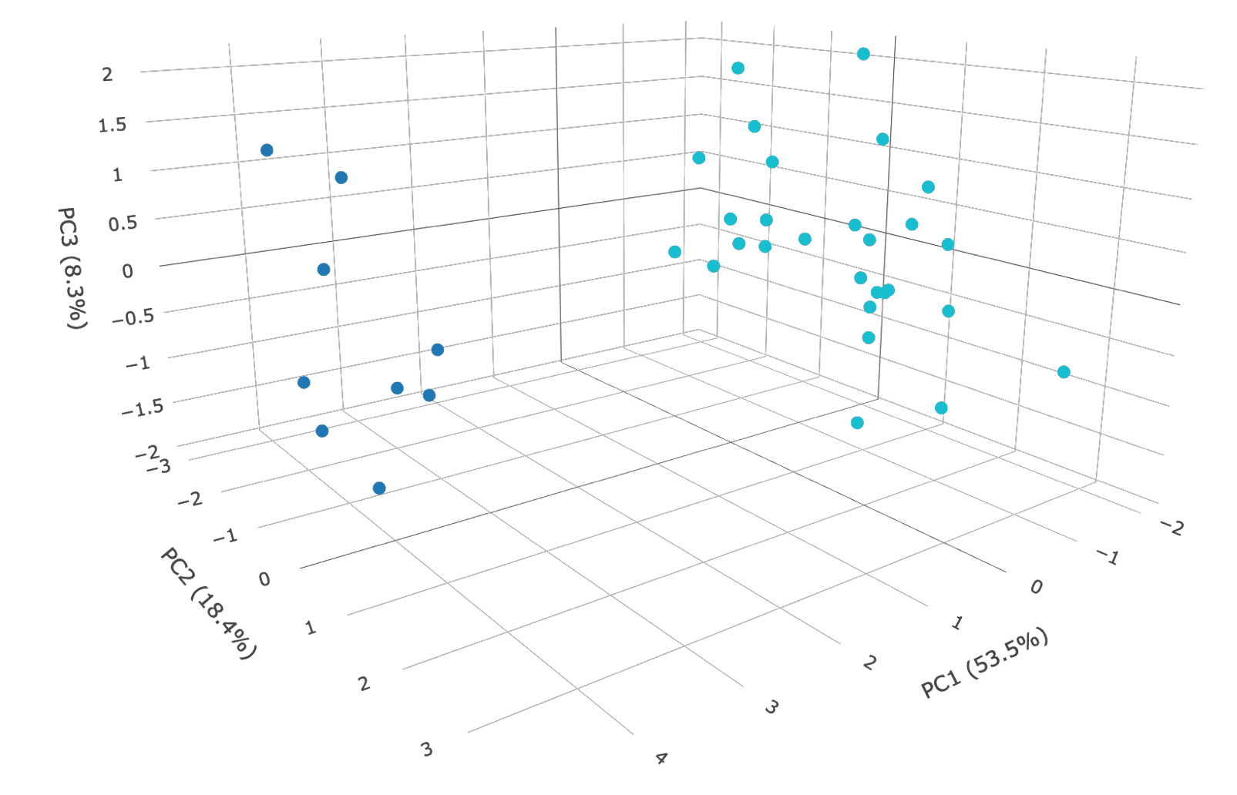
Identify Clusters of Assay Runs
Clustering with HDBScan
Calibrator Sample-Based Clusters
Clustering on all 5000 ratios for each assay
Detect clusters of non-similar density
Minimum cluster size = 3
Built to be more robust to the effects of noise
  Allows points to remain un-clustered

Slide 13
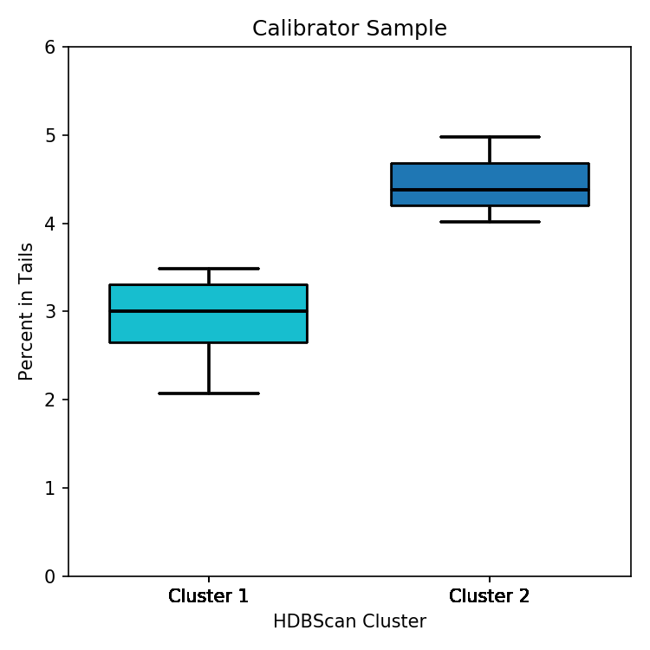
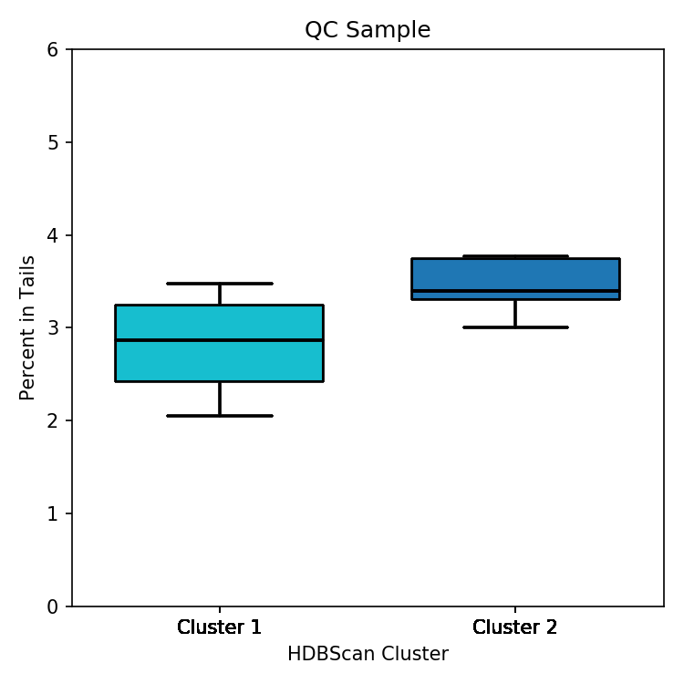
Characterize Performance of Clusters

Slide 14
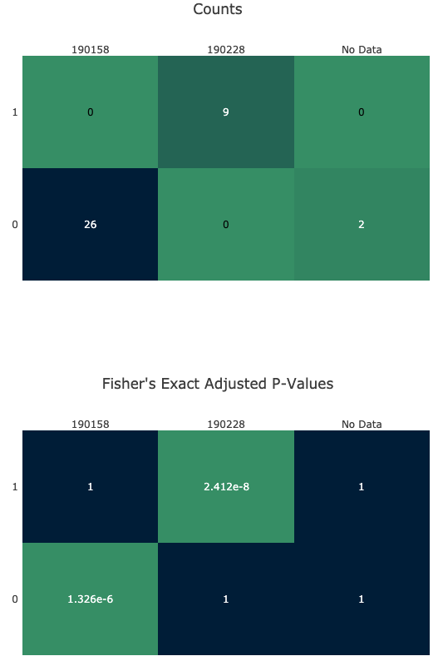
Attribute to Root Cause
Metadata
Counts
Mat 2 Lot 1
Mat 2 Lot 2
2
0
9
Series of Fisher’s exact test across metadata
  Equipment
  Material Data
For each cluster & material batch/instrument id:
Correct the p–value for the number of tests
Cluster
 | p-value
Instrument Type A | 0.18
Instrument Type B | 1
Instrument Type C | 0.75
Material Type 1 | 1
Material Type 2 | <Significant-looking p-value>
Material Type 3 | 1
1
26
0
Fisher’s Exact Adjusted P-Value
 | Within Cluster X | Outside Cluster X
Using Batch Y | 5 | 0
Not Using Batch Y | 0 | 20
Mat 2 Lot 1
Mat 2 Lot 2
2
1
Significant Looking
Cluster
Significant Looking
1
1

Slide 15
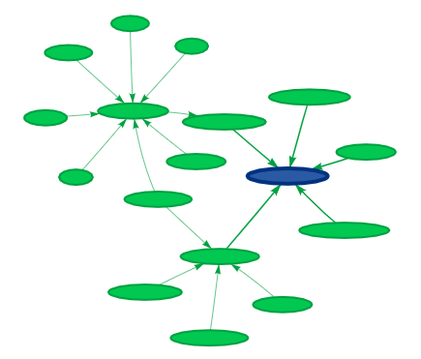
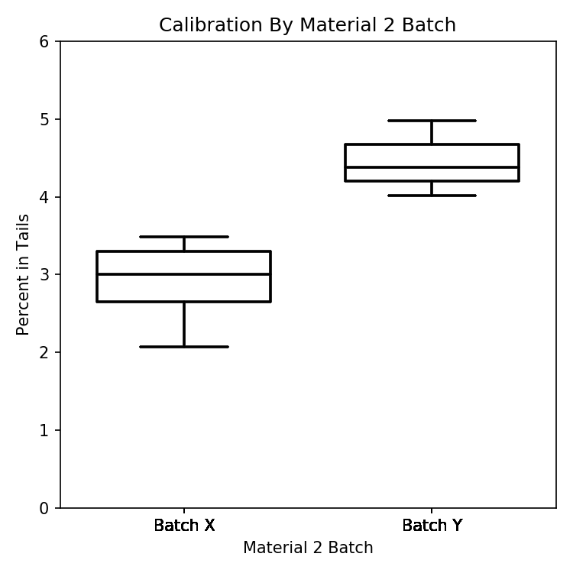
Attribute to Root Cause
Material Inspection
O
N
P
Mat A
M
Mat K
Mat J
Mat B
Mat I
L
Mat 2
Mat H
Mat C
Mat D
Mat G
Mat E
Mat F

Slide 16
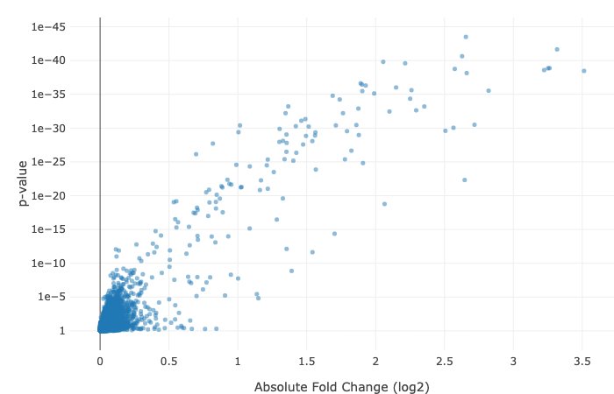
Attribute to Root Cause – SOMAmer® Reagents Summary
SOMAmer® Reagent Calibration Ratios Across Cluster Groups (GLM).

Slide 17
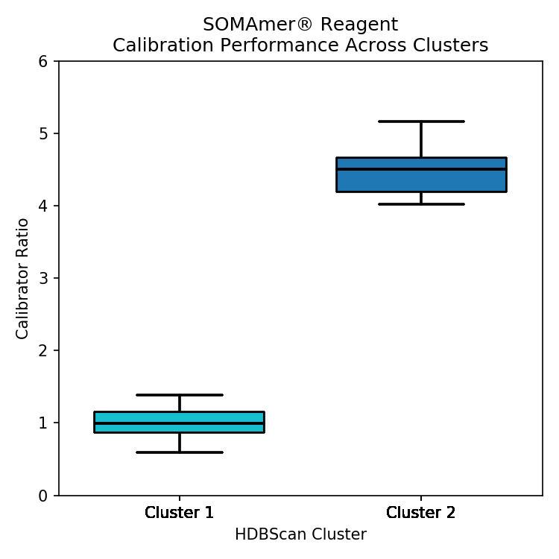
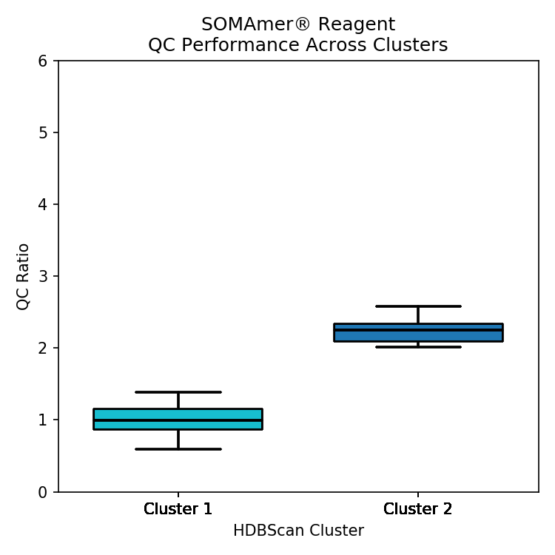
Attribute to Root Cause – SOMAmer® Reagent Performance

Slide 18
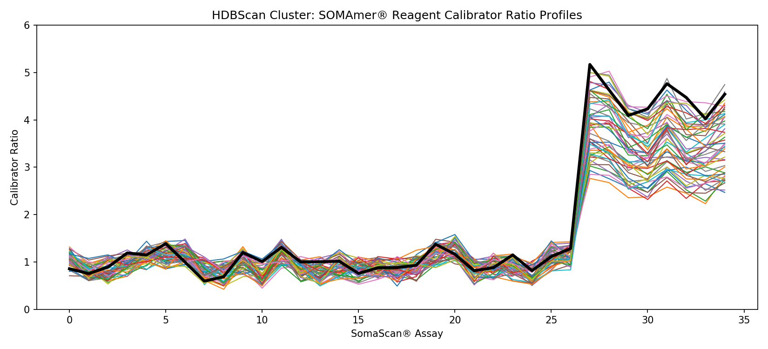
Attribute to Root Cause – SOMAmer® Reagent Clustering

Slide 19
Umbrella Impacts
Provided a real-time & in-depth view into the stability of SomaScan® Assay
Coalesced multiple sources of assay metadata for quick analysis
Reduced assay investigation time by an order of magnitude
Garnered fervor for more information

Slide 20
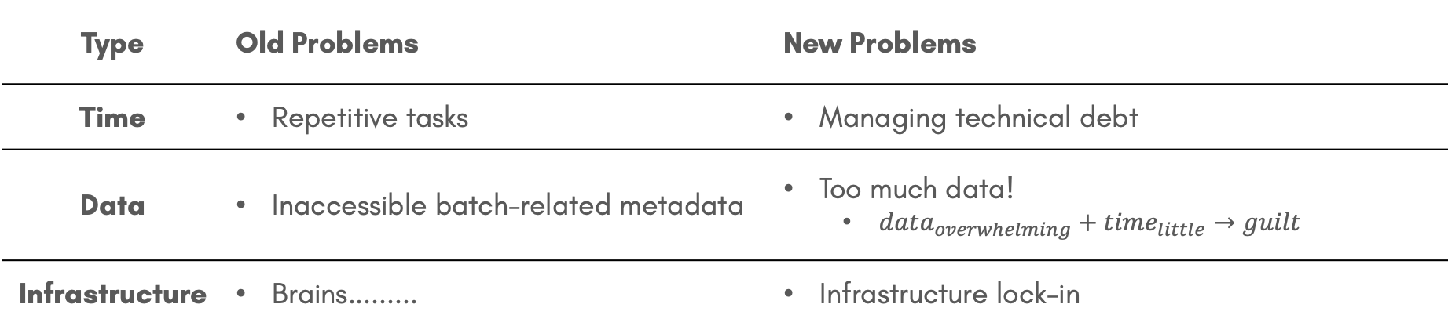
The Subtle Art of Inheriting a Better Class of Problems
Type | Old Problems | New Problems
Time | Repetitive tasks | Managing technical debt
Data | Inaccessible batch-related metadata | Too much data! $data_{overwhelming}+time_{little}→guilt$
Infrastructure | Brains......... | Infrastructure lock-in

Slide 21
The “Lynchpin” Problem
Almost every place has a lynchpin
  Been there seemingly forever
  Maintains the SUPER OLD legacy system(s) that is keeping everything running
Is absolutely vital
  Until they’re gone

Slide 22


My Current Attempt at Attacking the ”Lynchpin” Problem
Build software with a lifecycle in mind
Implementing lifecycles helps with:
  Technical debt
  Training scientists
  Technology adoption
  Reimagination of what the project is
https://www.djangoproject.com/download/#supported-versions
https://nodejs.org/en/about/releases/

Slide 23
The Subtle Art v.2
Type | Old Problems | New Problems | New New Problems
Time | Repetitive tasks | Technical debt | Major version changes
Data | Largely inaccessible | Too much data! | Management of data pipelines
Infrastructure | Imperfect storage | Lock-in | Learning new technologies

Slide 24

The Thank You Slide
@josephtallison
jallison@somalogic.com
josephtallison.com
SomaLogic
  Chain of Command
    Alan Williams
    Alex Poole
    Darryl Perry
  Production Bioinformatics Group
    Ted Johnson
    Lena Cuddeback
  Bioinformatics Group
  DevOps Group
https://xkcd.com/365/

Slide 25
BACKUP SLIDES

Slide 26
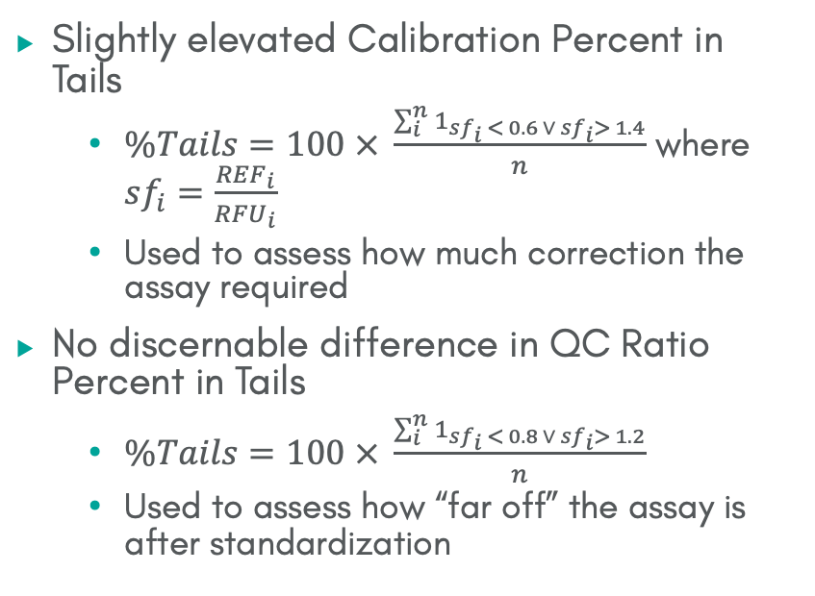
Slightly elevated Calibration Percent in Tails
  $\%Tails=100 × \frac{\sum_{i}^{n}{1_{{sf}_{i} < 0.6 ∨{ sf}_{i}> 1.4}}}{n}$ where ${sf}_{i}=$ $\frac{{REF}_{i}}{{RFU}_{i}}$
  Used to assess how much correction the assay required
No discernable difference in QC Ratio Percent in Tails
  $\%Tails=100 × \frac{\sum_{i}^{n}{1_{{sf}_{i} < 0.8 ∨{ sf}_{i}> 1.2}}}{n}$
  Used to assess how “far off” the assay is after standardization

Slide 27
SOMAscan® Assay: The 12,510 Foot View
B
SOMAmer®
Reagent
SOMAmer Immobilization
Binding/Wash
NHS-Biotin Tagging
Photo-cleavage
Kinetic Challenge
Streptavidin Magnet Resin Beads
SM Bead
Protein
B
B

Slide 28
SOMAscan® Assay: The 12,510 Foot View
SOMAmer®
Reagent
SOMAmer Immobilization
Binding/Wash
NHS-Biotin Tagging
Photo-cleavage
Kinetic Challenge
Capture & Washes
B
SM Bead
B
Protein
B

Slide 29
SOMAscan® Assay: The 12,510 Foot View
SOMAmer®
Reagent
SOMAmer® Reagent Immobilization
Binding/Wash
NHS-Biotin Tagging
Photo-cleavage
Kinetic Challenge
Capture & Washes
Elution
Hybridization
Scan
Agilent Slide
RFU_{a}
RFU_{b}
B
SM Bead
Protein
B
B

Slide 30
DAPPER
Impacts/Future Directions
Impacts
The Future
Reduced assay investigation time by >10x
Garnered fervor for more information
Find New Data
Incorporate Data
Build new tools

Slide 31
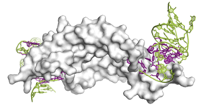
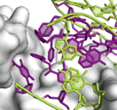
How we measure proteins - SOMAmer® reagents and the SomaScan® Assay
Turning a protein measurement challenge into a DNA measurement solution
Synthetic single-stranded DNA structures, with ”protein-like” modifications
Protein of interest
Platelet-derived growth factor and specific SOMAmer reagent
#

Slide 32
Title: A Story of Statistical Process Control at SomaLogic: A Brief History of Umbrella Abridged
Chapter 1: A failed attempt at automating myself out of a job (7 minutes)
5 bajillion ft view of SomaLogic
Vignette of what Production BI looked like when I joined
Automating that work & the beginnings of Umbrella/Longitudinal Tracking/SPC
Chapter 2: Inheriting a better class of problems (3 minutes)
Quick look into one of the principles that I lead my life by: Upgrading my class of problems
Specific examples: Old Production Job (Problems) vs. New PBI Full Stack/Data Engineering Job (Problems)
Chapter 3: Umbrella Walkthrough (15 minutes)
Description of Umbrella’s current technical stack
Walkthrough of Umbrella’s feature set with a faux “Quality Issue” showing the full path from plate quality/material data to individual SOMAmer performance
BIG POINT: Enables us to be able to detect & tease out artificial artifact vs. biological signal
People taking notice of Umbrella & the implications therein
Technical debt piling up (a lot of and this, and this, and this becoming apparent after-the-fact)
Chapter 4: Lessons learned & the future (5 minutes)
What is “Legacy” code? When does something become “Legacy”?
“Maintenance hell” & its impact on your job skills.
Building applications with a life duration/expiration in mind.

Slide 33
Abstract
The processes that have been implemented to support and run the SomaScan® Assay at SomaLogic are incredibly robust but, before the introduction of Umbrella, post-hoc tracking of these processes and their longitudinal stability was spread across the collective consciousness. Umbrella is a bespoke full-stack data science platform designed to coalesce that collective knowledge and report back to the company at large. These reports range from simple control charting to unsupervised ML pipelines to detect nuanced assay artifact, identify potential causes, and document the impact on our SOMAmer® reagents’ signals. It is this system that enables us to be able to robustly distinguish between biological signal and assay artifact.

